Slide 1
Processing & Calibrating
Spectra
RAG Sept 2024
Andrew Thornett
andrew@thornett.net
Tel 07770841767

Slide 2
Advert
Process spectra yourself
Impress your friends and family with the scientific data you’ve produced!
Print out at home and frame and put up on wall for all to see and admire!

Slide 3
What audience needs to bring to session
Their laptops and chargers
They need to download VSPEC and spectra onto their laptops in advance

Slide 4
Learning plan for session
Need to download VSPEC on my laptop and try all this out on that first.
I need spectra including CFL spectra on my laptop.
Ask people to download VSPEC and spectra I send which should include CFL spectra taken with same camera and telescope and spectrometer as other spectra. Both I and participants need to bring their laptops and chargers to session. I also need CFL and lamp.
Start by describing what session is about - we are going to GP through process of processing data together and then I've got some spectra for them to try themselves.
Show them VSPEC.
Say as part of process we will need to calibrate the spectrum which means we compare it to known spectrum where we know the frequencies and we can then put this into the software. We are going to use CFL where frequencies on Wikipedia.
Start by loading up CFL spectrum to VSPEC and go through calibration routine to get VSPEC to display wavelengths.
Then load up whatever spectrum I am going to use as example. Correct orientation and other processes on VSPEC to get spectrum displayed. Then look at main lines and compare these to list lines.
Describe what Balmer series is and show diagrams of electron transitions.
Get audience to do it themselves on several examples

Slide 5
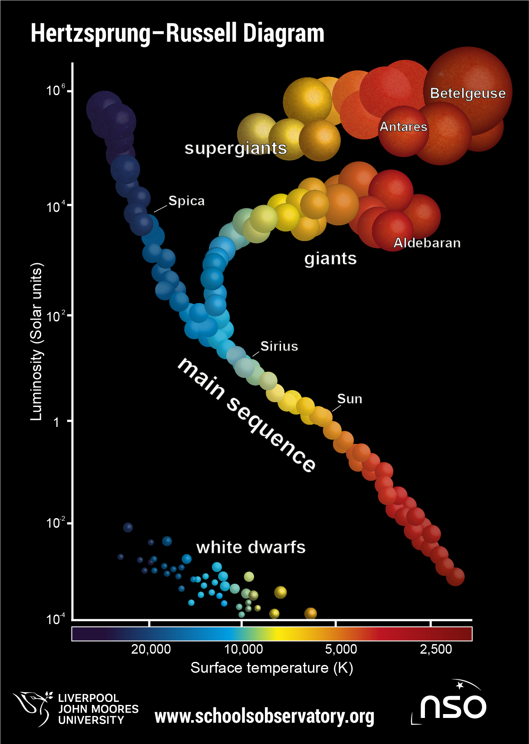
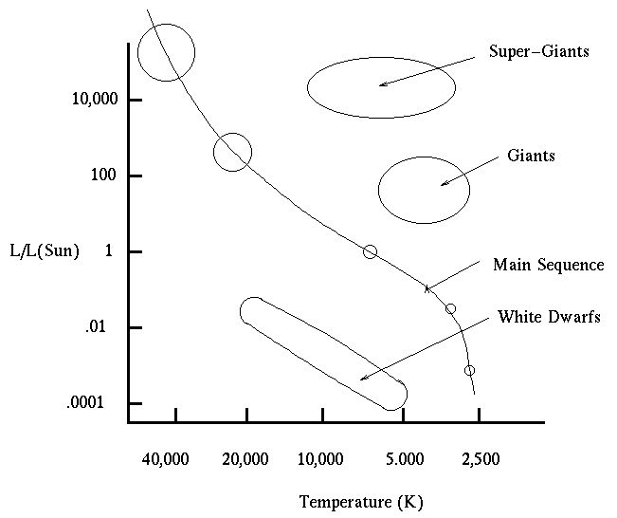
Hertzsprung Russell Diagram
And Stellar Evolution

Slide 6
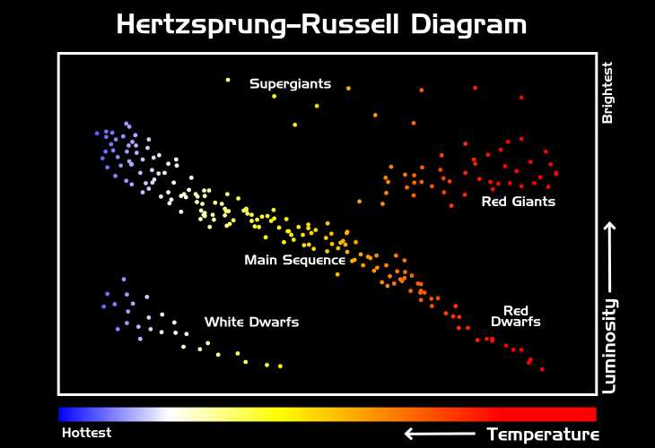

Slide 7
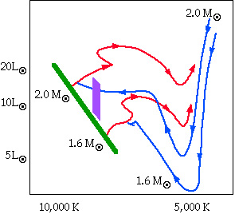
Examples of stellar evolution curves for stars of 1.6 and 2.0 solar masses.
Blue curves = track followed by the collapsing protostar = called Hayashi Tracks.
Green line = main sequence, where the star spends most of its lifetime sitting around fusing hydrogen into helium.
Once star stops burning hydrogen in core ➔ expands ➔ moves off main sequence ➔ towards upper right (the giant region).
More massive stars sit hotter portion of main sequence, live shorter lives than the less massive stars, and become larger giants.
Less massive stars sit cooler portion of main sequence, live much longer lives, and may never become giant stars at all.
Our sun should remain similar to now on main sequence, for about 8,000,000,000 years.
Supermassive hot star, =/> 20,000 C ➔ main sequence for =/< 1,000,000 years.
Cool red star, =/< 3000 C ➔ main sequence for up to 100,000,000,000,000 years.

Slide 8
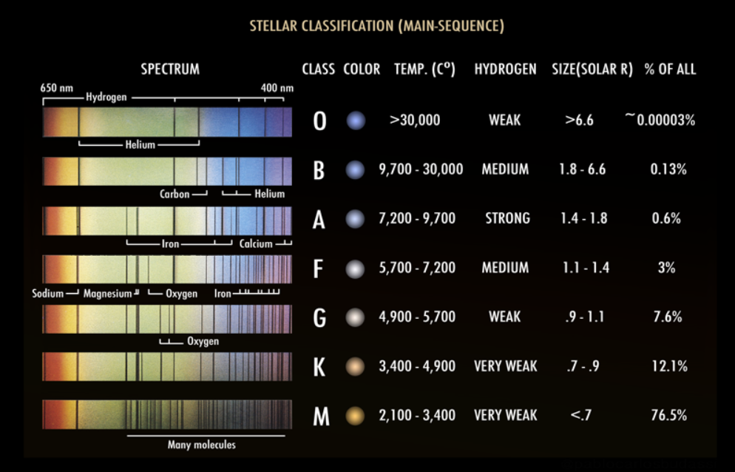
Harvard Stellar Classification

Slide 9
Order of stellar types from hot stars to cool is O, B, A, F, G, K, M.
Mnemonic:
“Oh, Be A Fine Girl [or Guy], Kiss Me”.
Classification initially based on appearance & strength of certain spectral lines, but later understood to reflect stellar temperatures³.

Slide 10
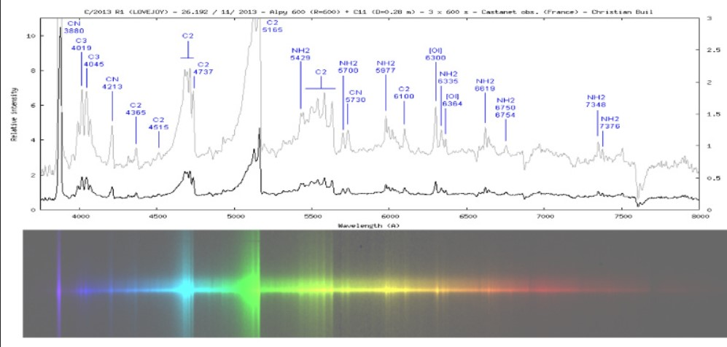
Spectroscopy Processing = Turning spectrum below into plot above so that it can be interpreted

Slide 11
Peaks on the spectrum = main spectral lines of this spectrum
Each element/molecule has unique spectral signature which we can identify in spectra

Slide 12
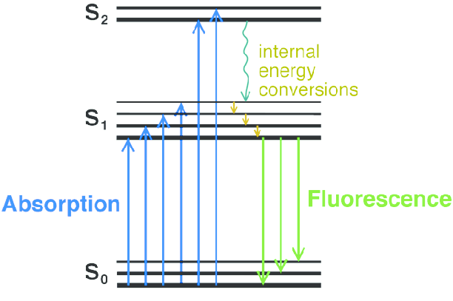
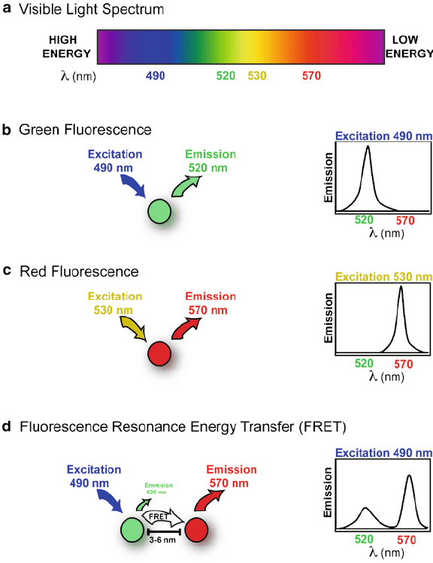
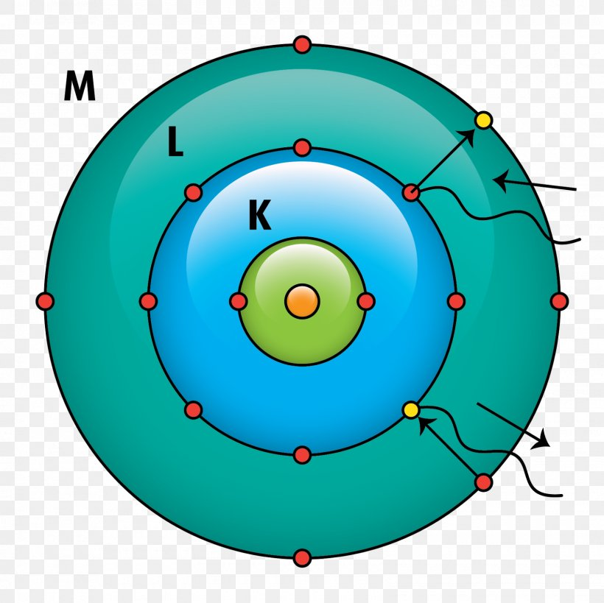
Electron Transitions in Atom Causing Emission Light
Emission Light
on light

Slide 13
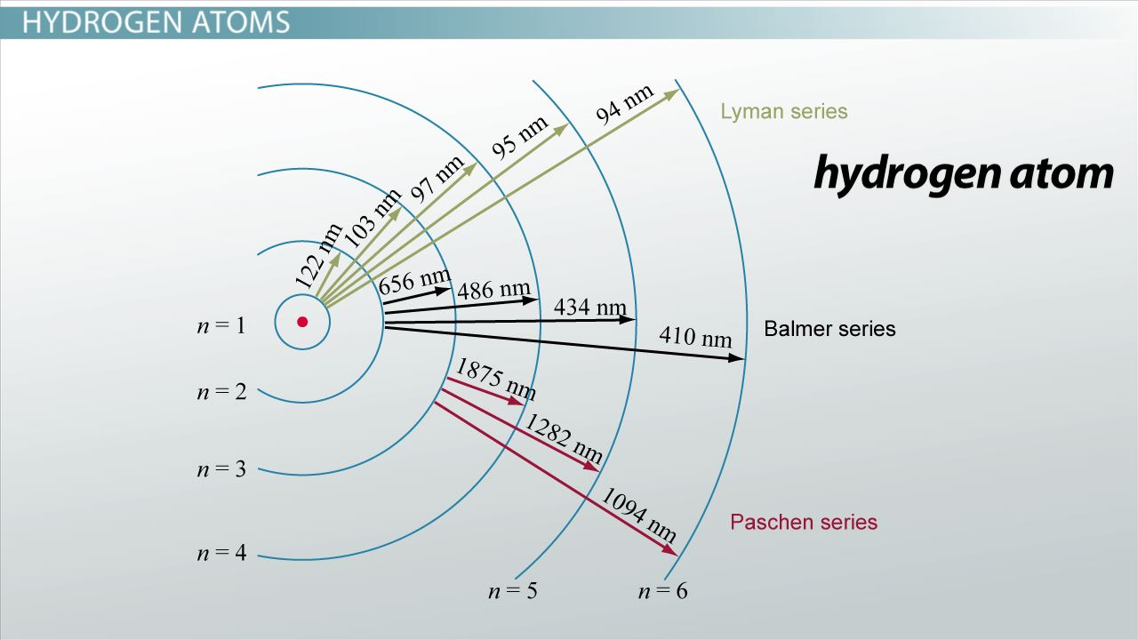

Slide 14
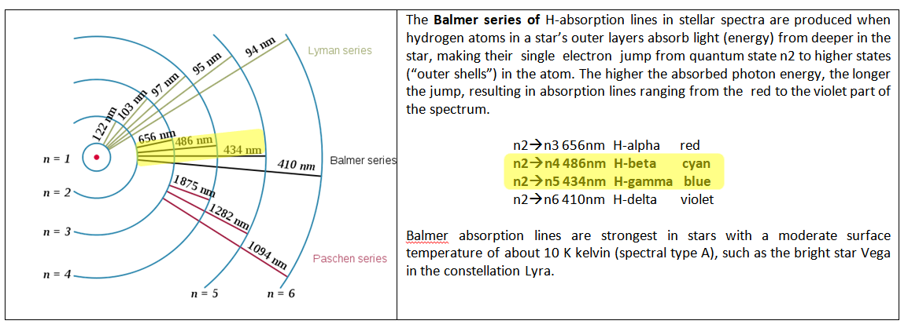

Slide 15
Demonstration VPSEC & taking spectra
Software we are going to use is VPSEC (Visual Spec)
http://www.astrosurf.com/vdesnoux/download.html
Designed for Windows, sadly no Mac or Linux version.
Visual Spec has been designed with Visual Basic 6.0 - It has been tested by writers on W95, W98, Vista, Wi7, W10, including 64bits.
One warning with VPSEC – I have noticed has tendency to crash at least in Windows 11 if illogical action taken by user

Slide 16
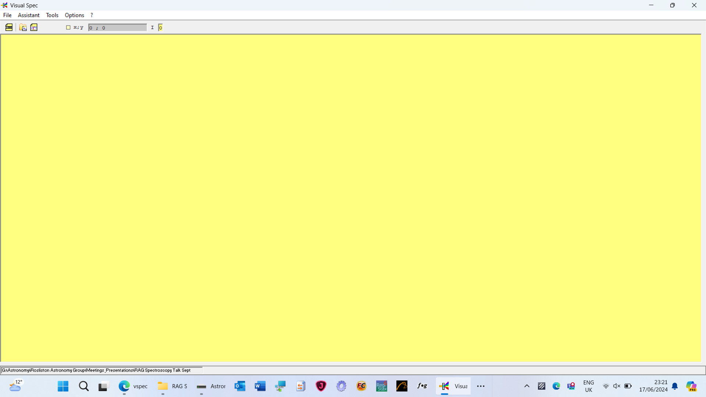
To get a spectrum in VPSEC couldn’t be easier
Start by opening the programme…..

Slide 17
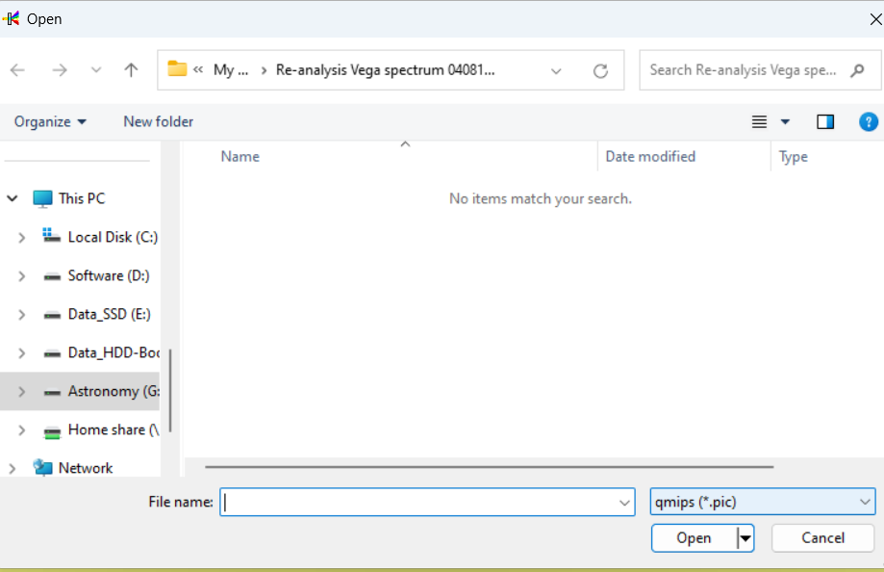
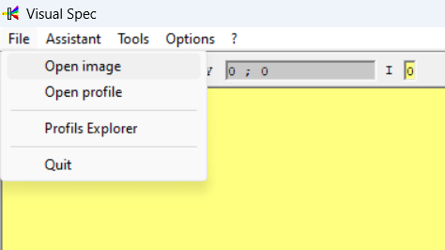
Open an image – File→Open Image
Change image type to FITS or BMP

Slide 18
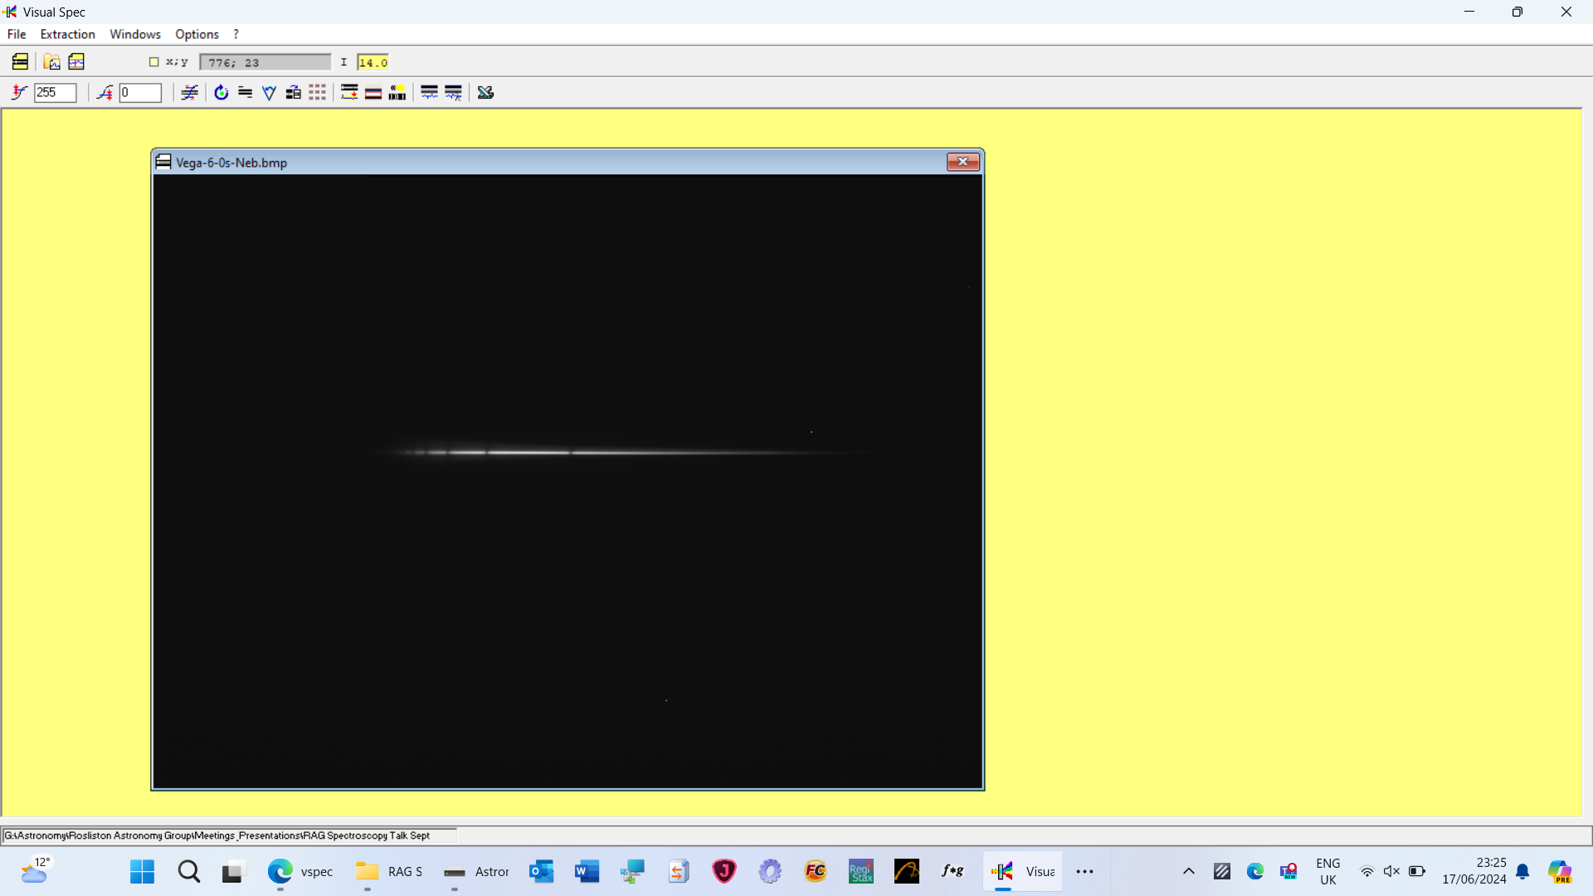
Select image

Slide 19
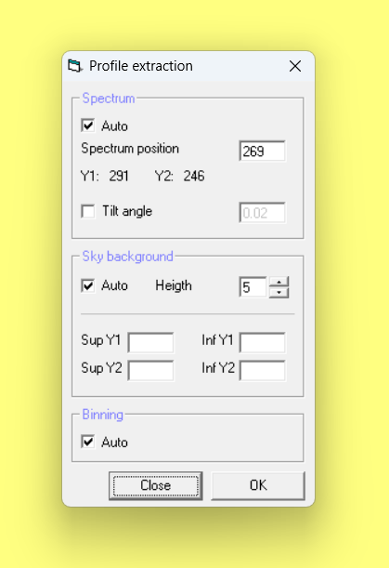
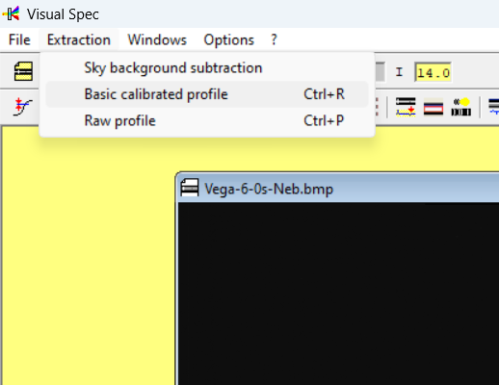
Click Extraction→Basic Image Profile – and ensure automatic ticked

Slide 20
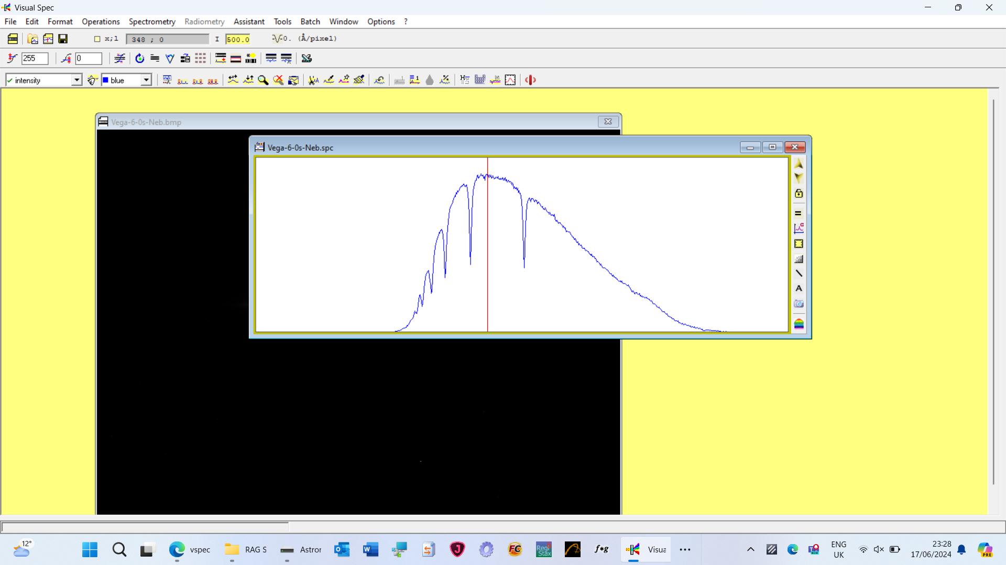
Software automatically creates spectrum!!

Slide 21
Calibration
This is NOT like flat frames or dark frames
Instead, it is method to determine what the wavelengths (frequencies) are in the spectra you record with your telescope and spectrometer.
You take a spectrum of a light source, where you are able to identify main spectral lines and know their wavelengths, using the same telescope/spectrometer/camera setup that you use for your other spectra/your data.
In the spectroscopy software, you label the known wavelengths (usually two are required) on the calibration data.
The software will now calculate the wavelengths on other plots foryou, allowing you to identify spectral lines on those plots.

Slide 22
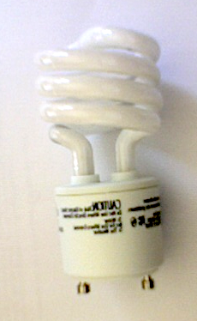
Calibration – Compact Fluorescent Light Bulb (CFL)
Similar to other fluorescent lighting: electrons that are bound to mercury atoms that are excited to states where they will radiate ultraviolet light as they return to a lower energy level; this emitted ultraviolet light is converted into visible light as it strikes the fluorescent coating, and into heat when absorbed by other materials such as glass.

Slide 23
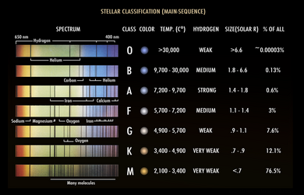
Stellar Type vs Spectrum

Slide 24
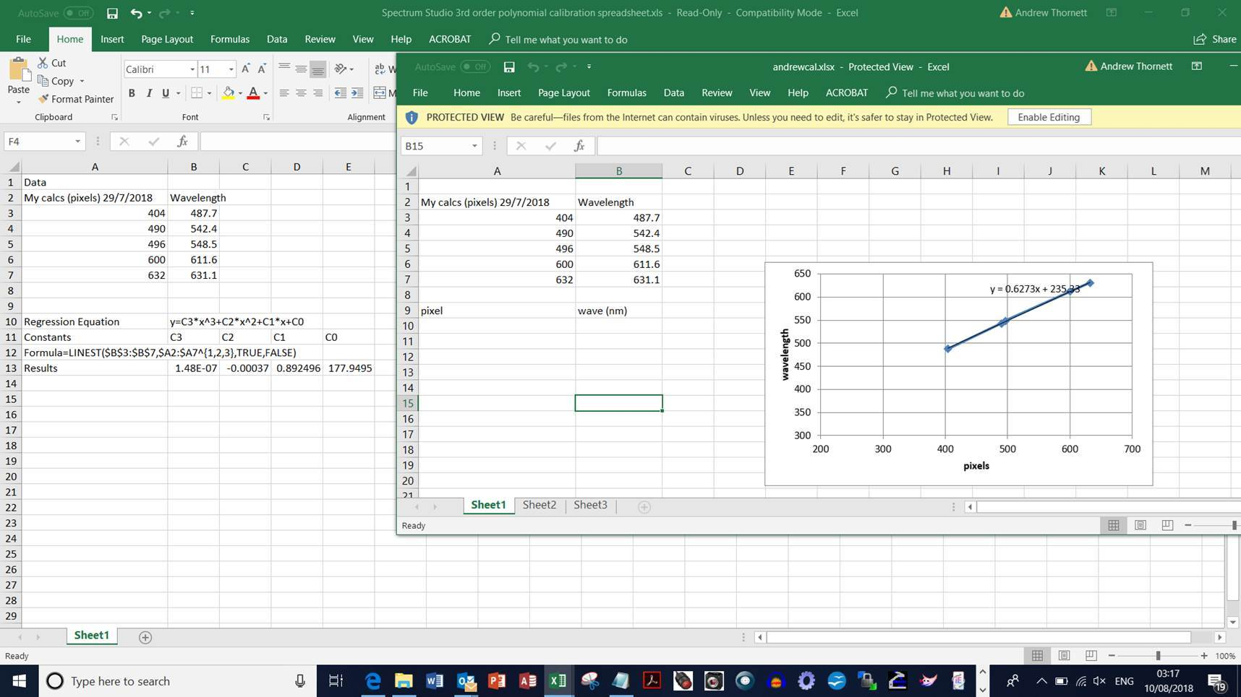
Better calibrating - polynomials

Slide 25
Demonstration of calibration
Using VSPEC (Visual Spec)

Slide 26
Now it’s your turn to have a go!

