Slide 1
Guide to the Night Sky in Derbyshire & Staffordshire Summer 2025

Slide 2
Birmingham 25 May 2025 @ 22:00

Slide 3
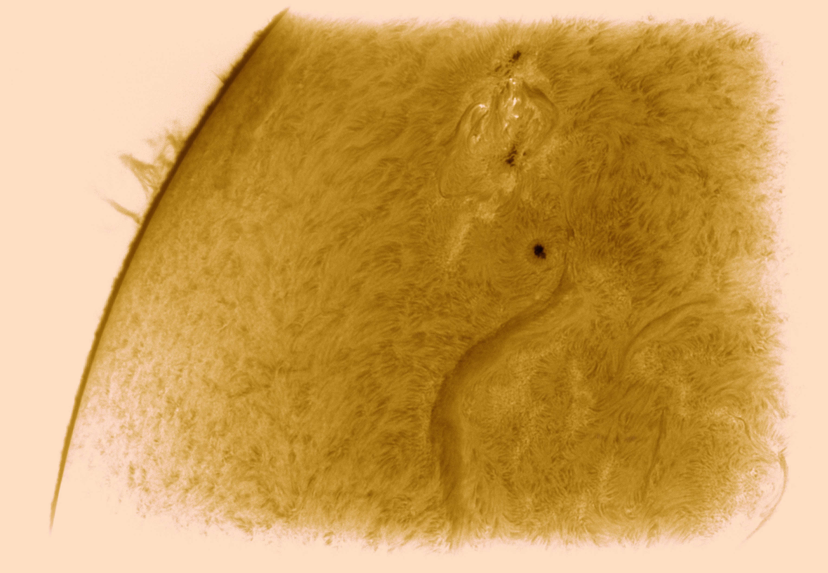
Sun
Current solar cycle peaks mid-2025.
Take precautions viewing Sun: Properly fitting filters, cover other optics such as finders, ask for help.
SUNSPOTS: Dark blemishes that arise when strong magnetic fields near the Sun’s surface, or photosphere, restrict heat flowing from interior. The surface cools by few thousand degrees ➔ area doesn’t radiate as much light as surroundings. Sunspot near solar equator takes 27 days to return to same location = combination of Sun’s 25-day rotation rate + Earth’s orbital motion.
GRANULATION: Rice-grain pattern of convection cells in photosphere.

Slide 4
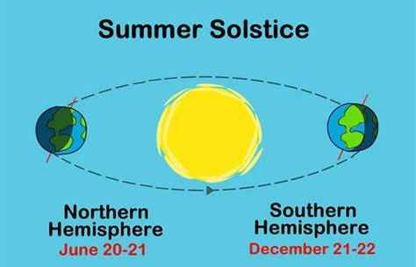

Slide 6
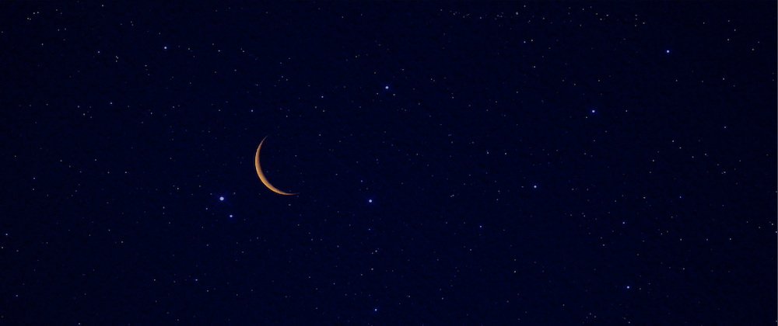
June 25
July 24
August 23
September 21
October 21
November 20
December 19
New Moons for rest of year

Slide 7
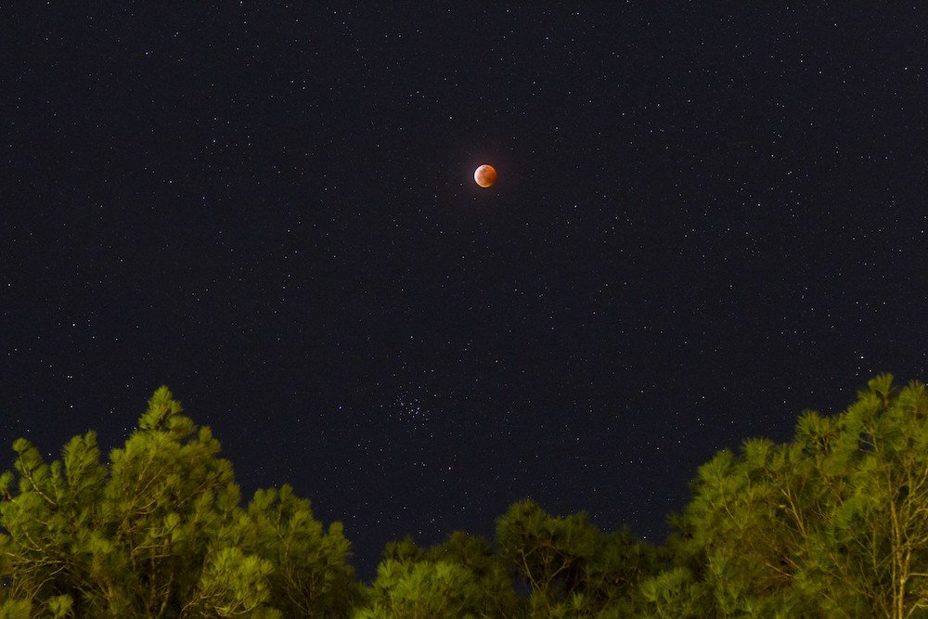
September 7 – Total Lunar Eclipse over Everywhere
BUT the Americas

Slide 8
The Plants during Summer 2025

Slide 9
Main planetary events

Slide 10
Mercury is
difficult to spot
because it never strays far
from the Sun in our sky ➔ appears in twilight before sunrise or after sunset.
Your first view could come
June 9. Mercury then lies 13°
east of the Sun and stands 5°
high in the west-northwest
30 minutes after sundown.
Glowing at magnitude –1.1,
it should be visible through
binoculars if you have a haze-free
and unobstructed horizon.
What makes this
evening special is the presence
of a guide “star”: magnitude
–1.9 Jupiter lies 3° below Mercury.

Slide 11
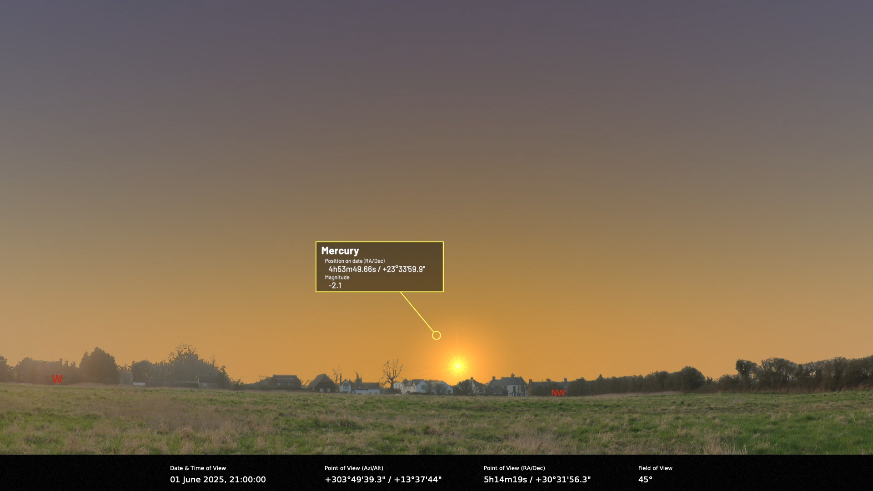

Slide 12
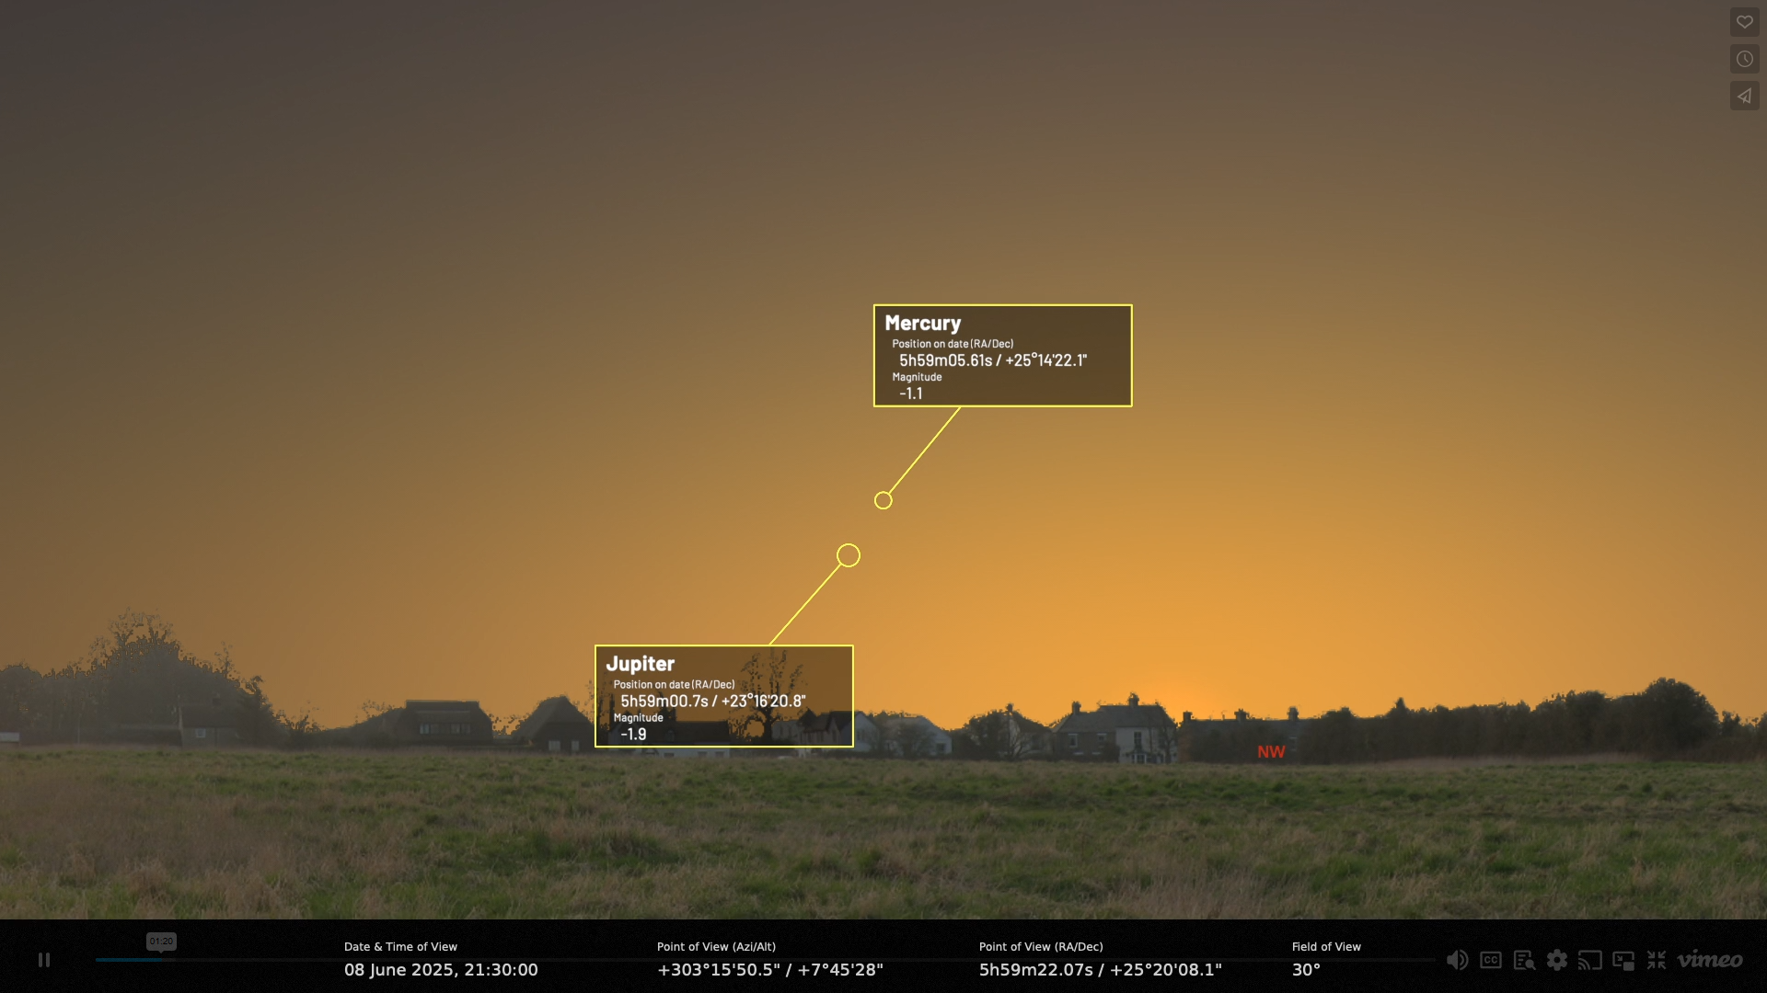

Slide 13
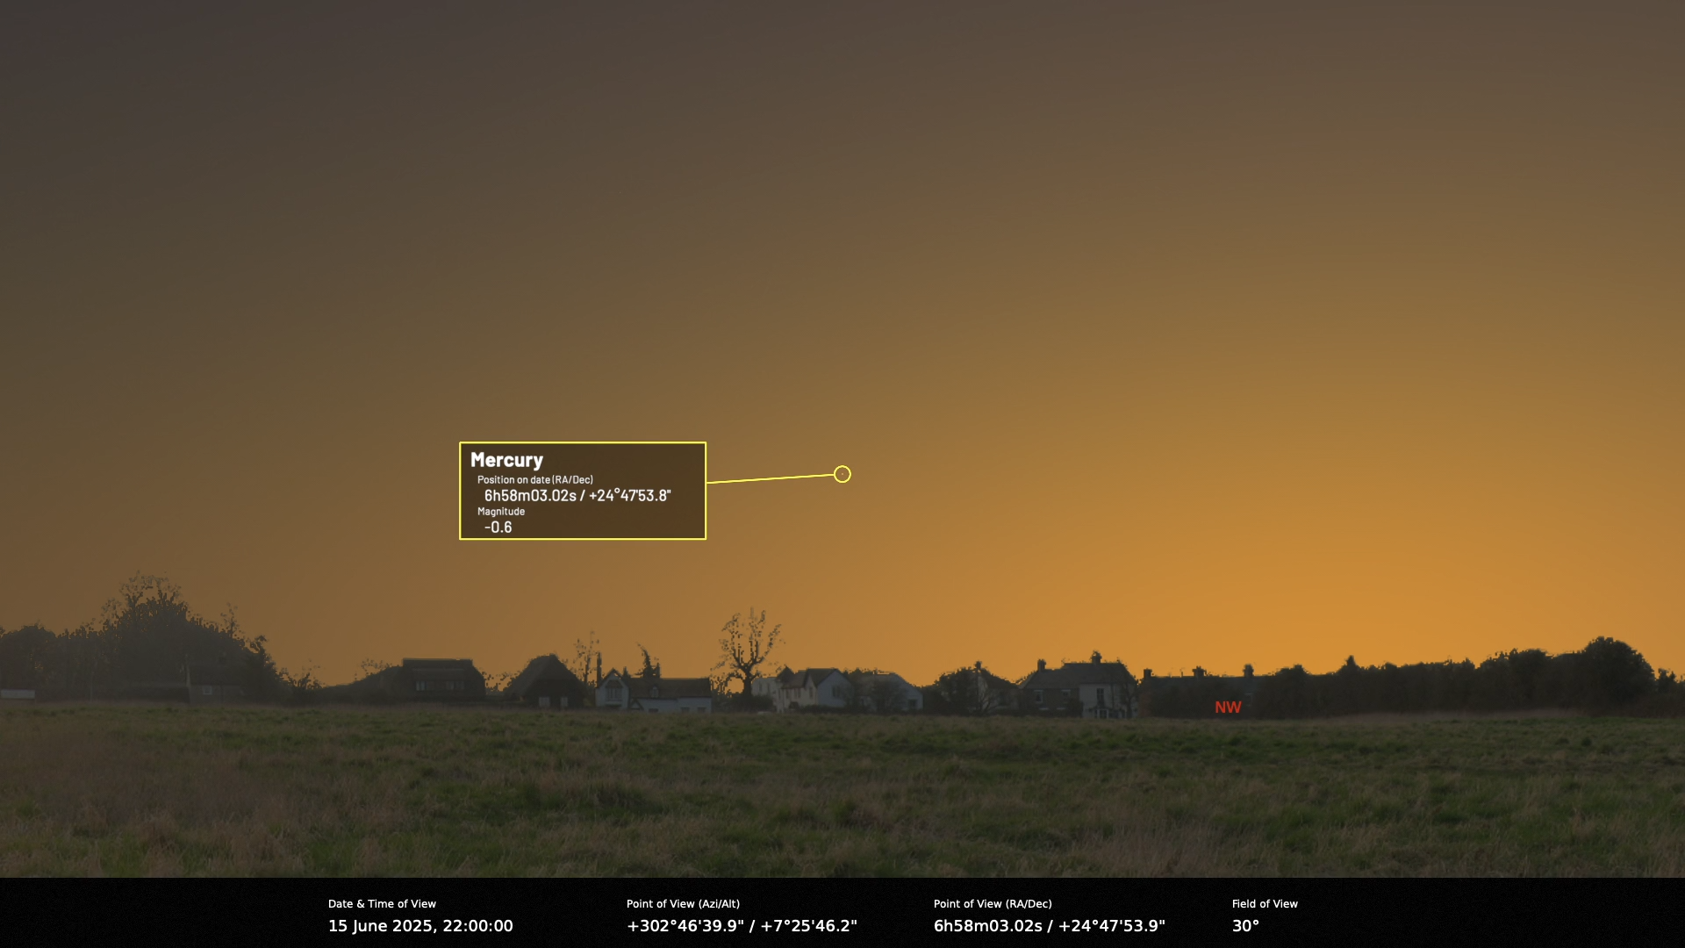

Slide 15
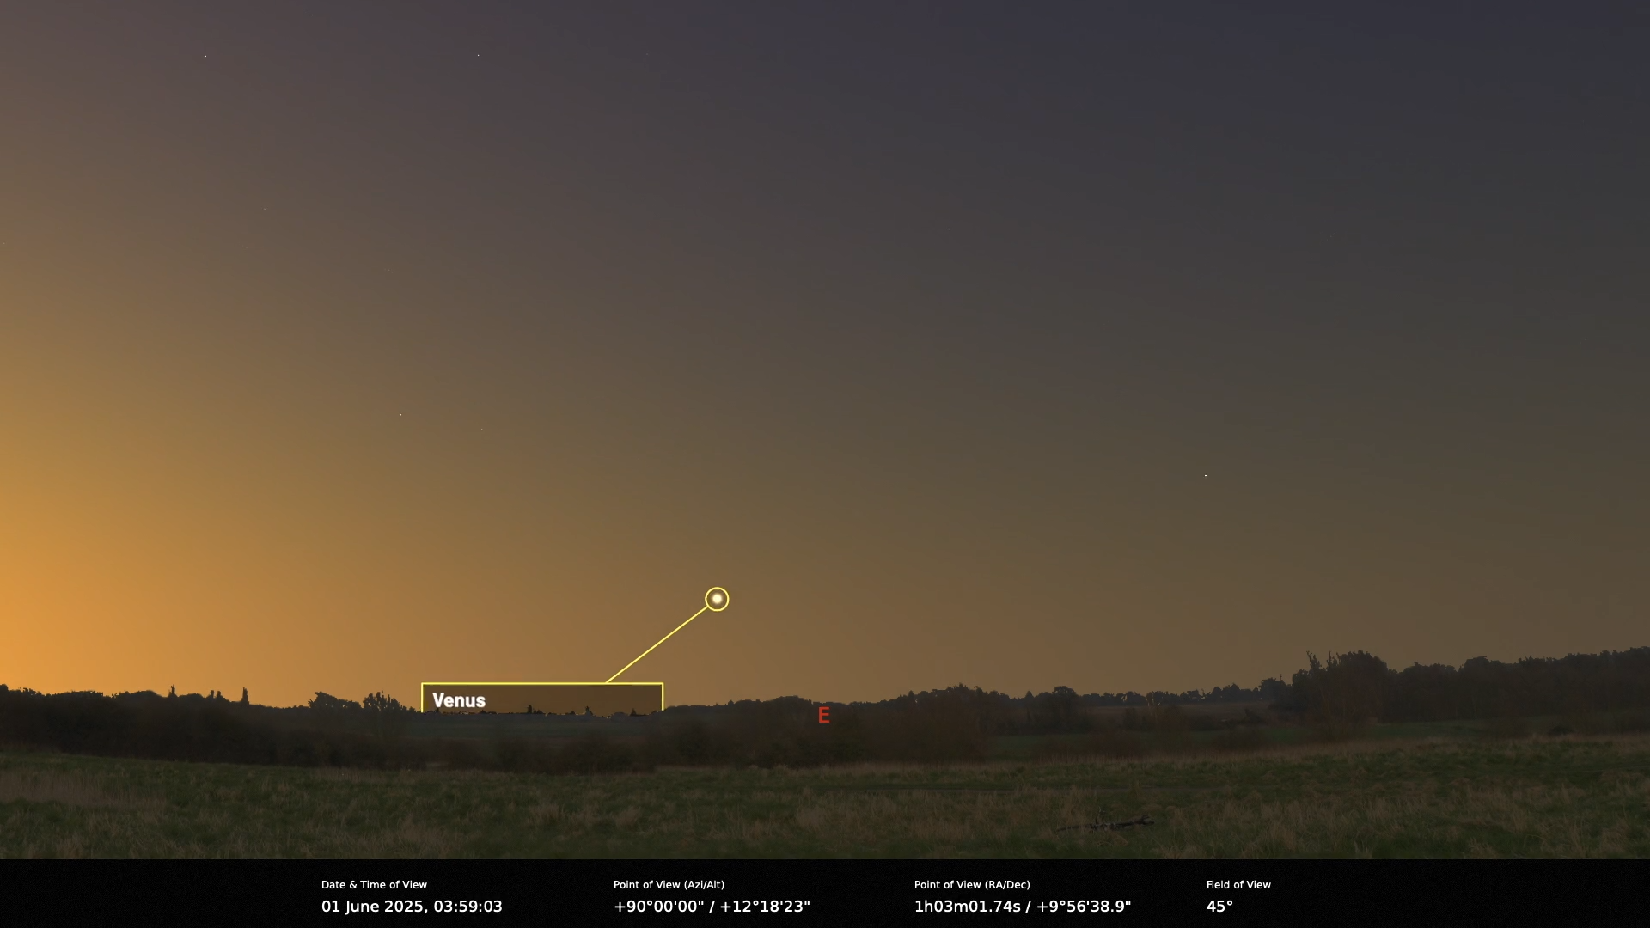

Slide 16
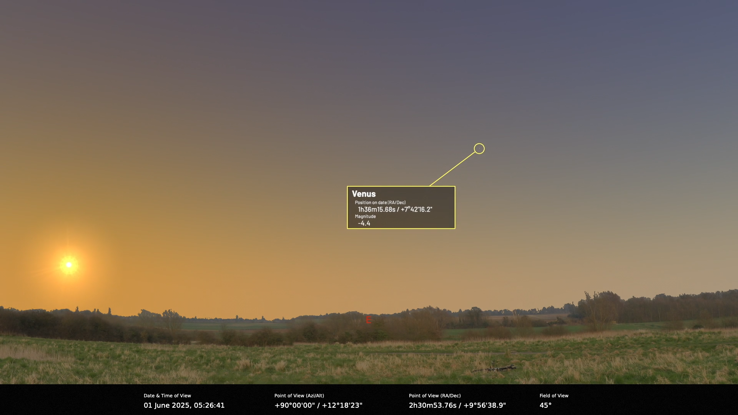

Slide 17
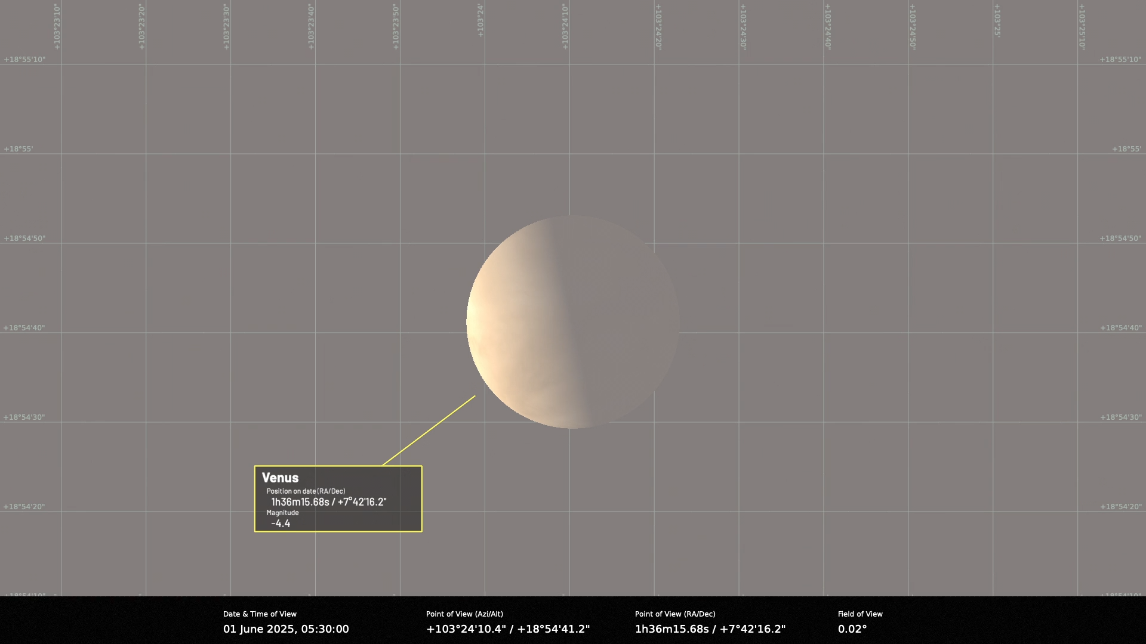

Slide 18
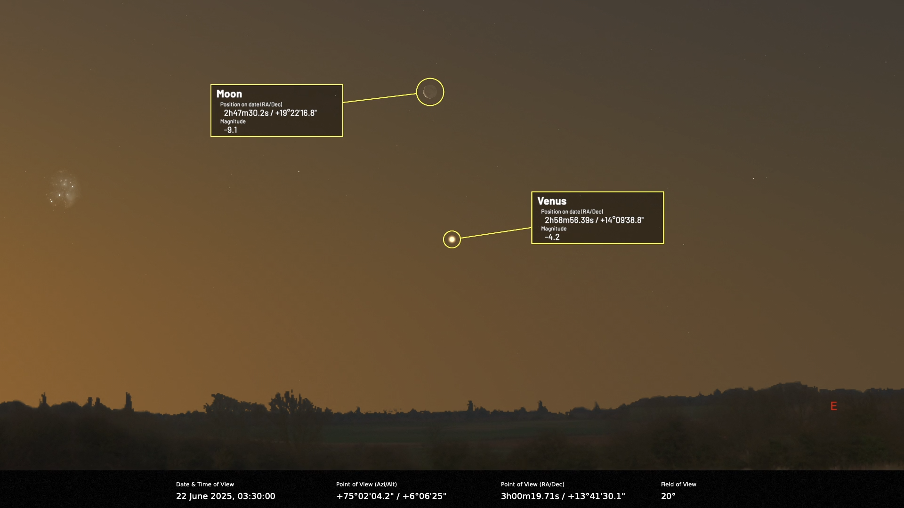

Slide 19
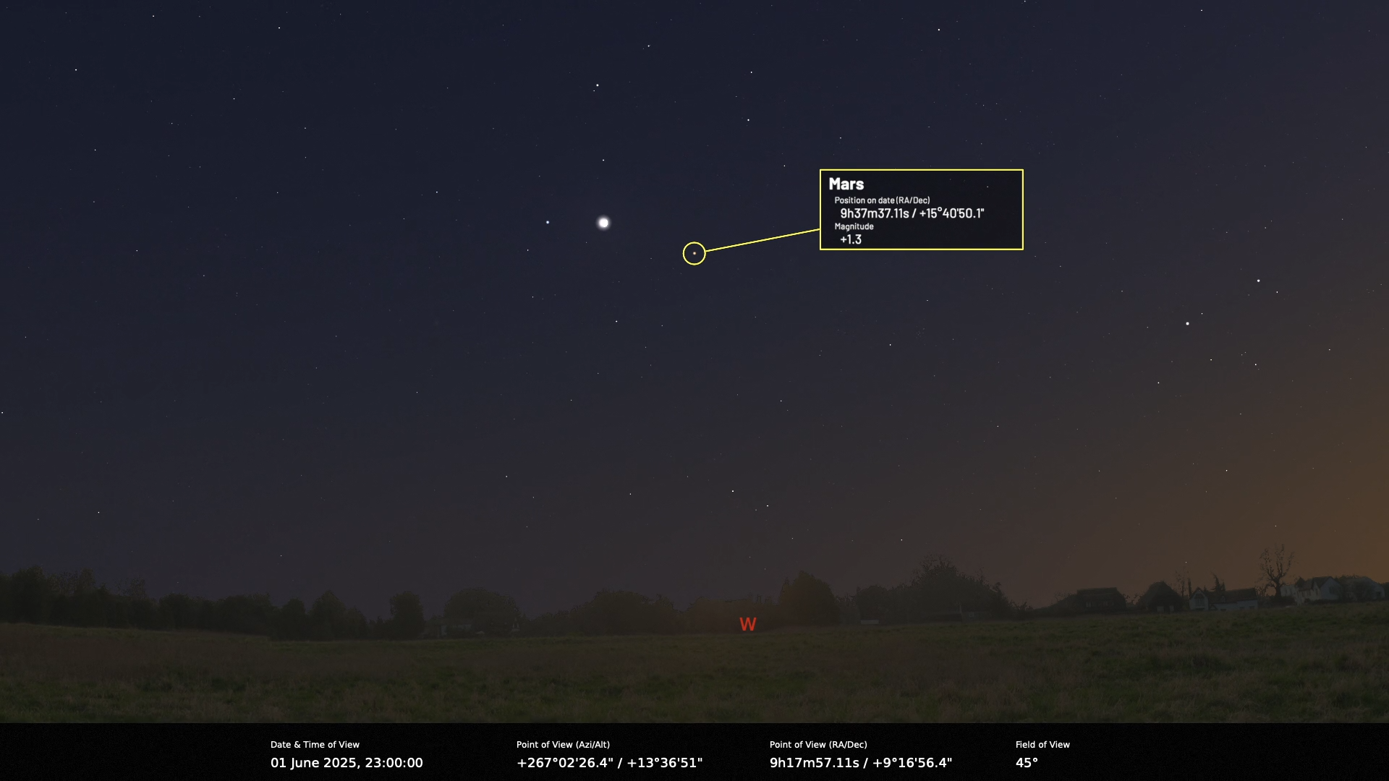
Moon

Slide 21
Jupiter meets Venus

Slide 22
Saturn
Saturn reaches opposition night 20/21 Sept. 2025 ➔ shines brightest/largest size/visible all night.
Good views last for several months.
Rings appear this year as only thin line because they turned edge-on to Earth: Circles the Sun once every 29.4 years, and its axis tilts 27° to its orbital plane. During half of its orbit, the northern side of the planet and rings tip toward us. The other half finds the southern side inclined toward us. And twice each saturnian year, the rings tilt edge-on to Earth.

Slide 23
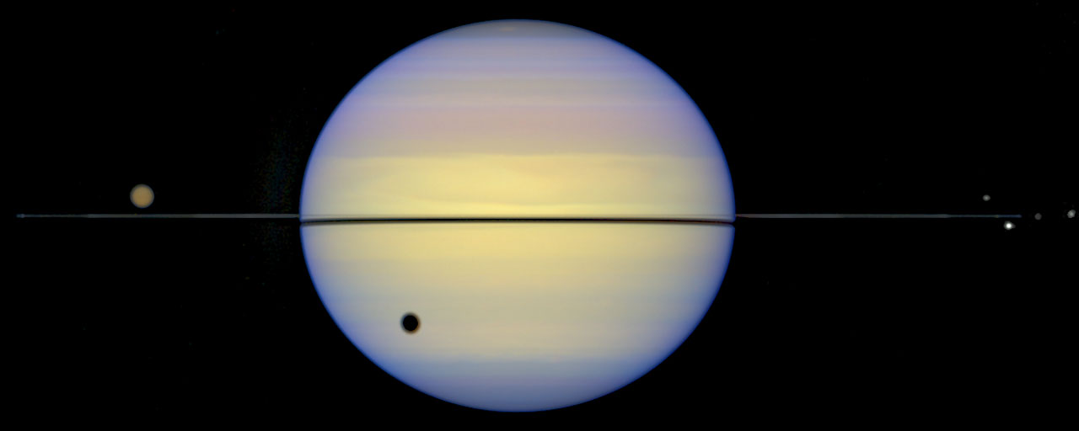
September 21 – Saturn at Opposition

Slide 25
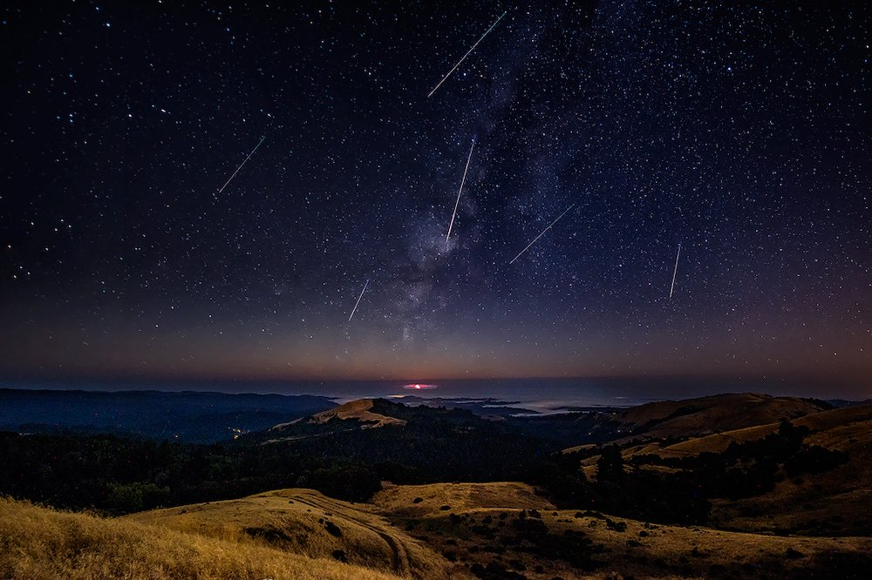
August 12 – Peak of the Perseid Meteor Shower

Slide 26
Current three brightest comets

