Slide 1
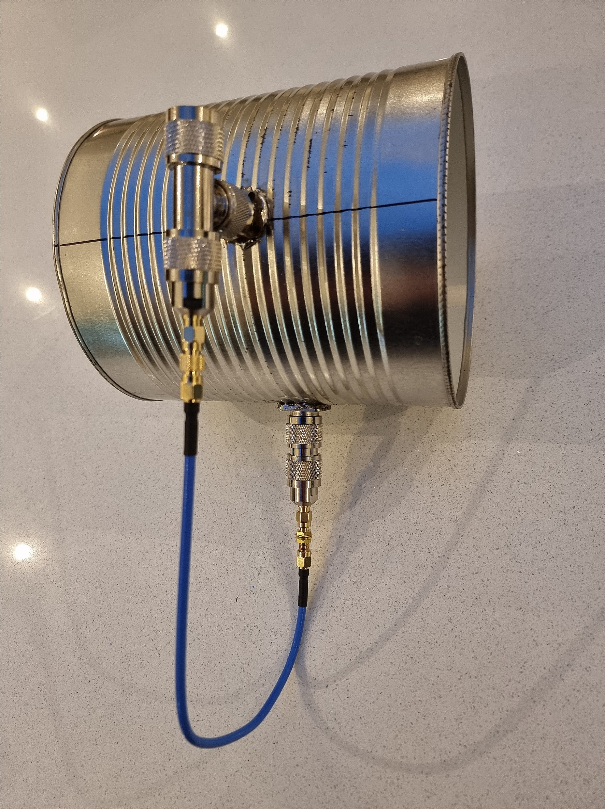
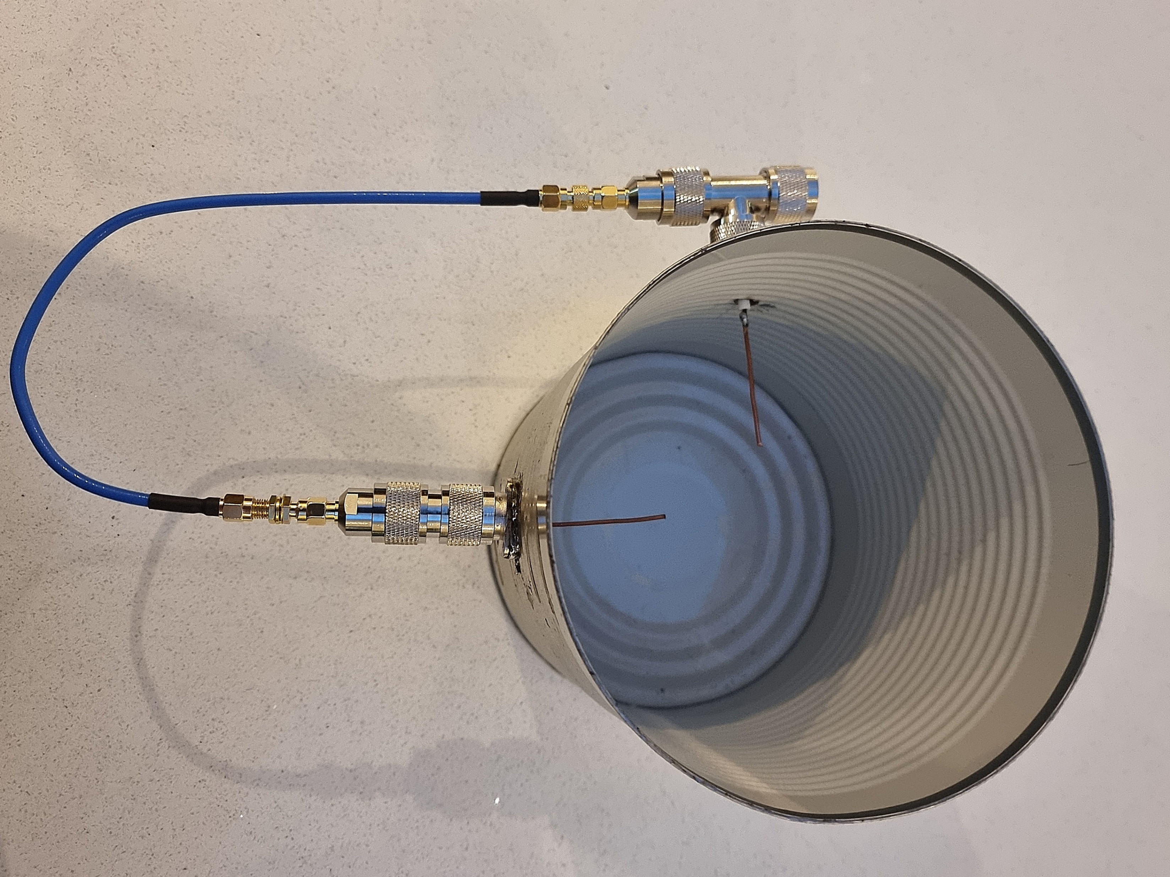

Slide 2
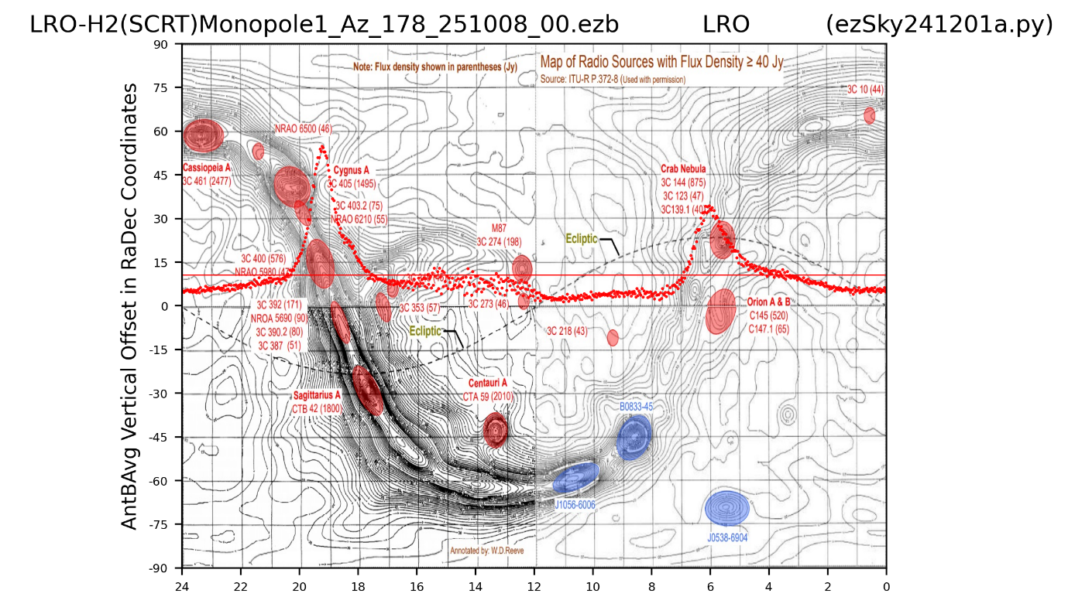
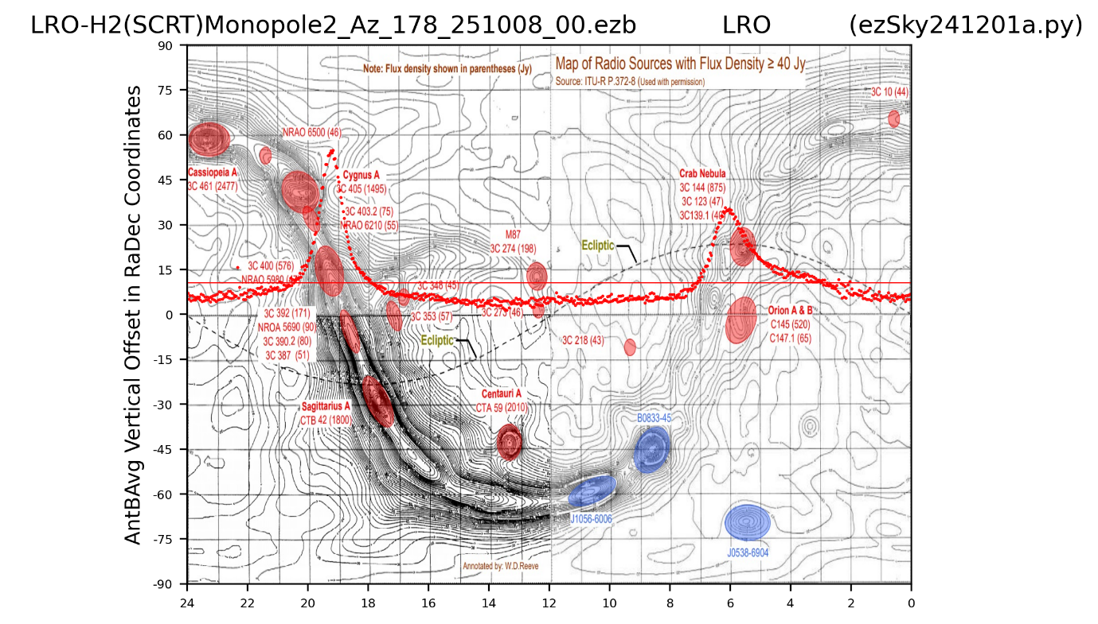
Results of one drift scan using LRO-H2, with two orthogonal monopole probes in the cantenna waveguide
Monopole 0 degrees
Monopole 90 degrees

