Slide 1
Calculating Cantenna Dimensions for H-Line

Slide 2
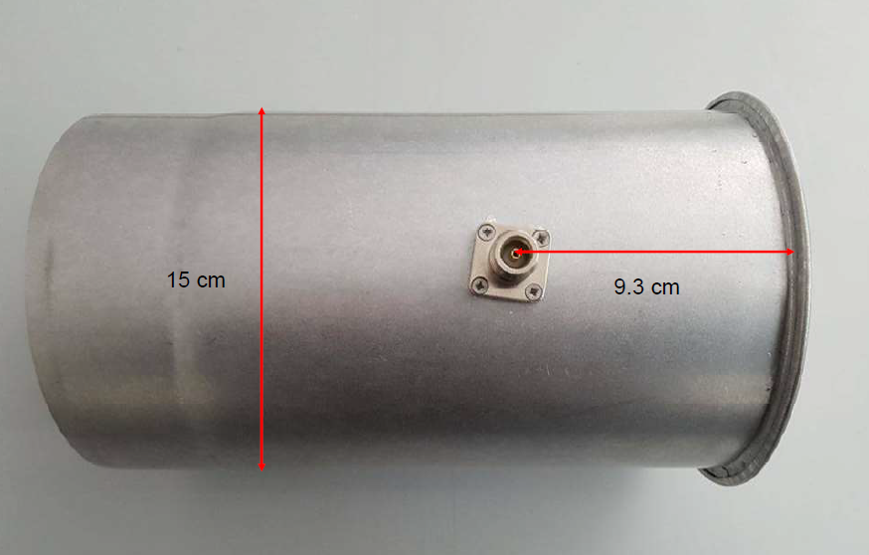
Astropeiler Stove-Pipe Cantenna Design

Slide 3
Waveguide wavelength (λg) & probe placement — practical starting points
Waveguide wavelength λg = λ₀ / sqrt(1−(fc/f)²). Using the TE11 fc above:
145 mm dia → λg ≈ 404 mm → place probe ≈ 0.25–0.40·λg ≈ 100–162 mm from back wall as a tuning range to try.
165 mm dia → λg ≈ 319 mm → place probe ≈ 0.25–0.40·λg ≈ 80–128 mm from back wall.
Many builders report good starting probe positions around 3–3.5 in (≈75–89 mm) for the ~154 mm cans; so use the ranges above and fine-tune while measuring return loss.

Slide 4
Can length, probe tip and other tips
Can length: many practical designs use ~0.75–1.0·λg (experimentally people report ~0.75·λg works well for 6" cans). A short choke / flange at the mouth helps control pattern and improve matching.
Probe (pin) length: start near a quarter-wave in free space (~52–53 mm) and trim for best return loss inside the can. Use an LNA at the probe and an analyzer/SWR meter or NWA to tune.
Mechanical: 165 mm cans (or buckets) are a bit heavier/larger — make sure mounts and supports are solid. Add a choke/flange or taper if you use the cantenna as a feed for a dish.

Slide 5
Mode behaviour for a 160 mm diameter cantenna
If D = 160 mm, c = 3e8 m/s, f = 1420.4058 MHz, λ0 ≈ 211 mm (free-space wavelength)
TE11 cutoff frequency
Formula (circular waveguide): fc_TE11 = (1.841 * c) / (pi * D)
Insert numbers (convert D = 0.160 m): fc_TE11 ≈ (1.841 * 3e8) / (3.1416 * 0.160)
fc_TE11 ≈ 1.10 GHz
TE21 cutoff frequency
fc_TE21 = (3.054 * c) / (pi * D)
Numerically:
fc_TE21 ≈ (3.054 * 3e8) / (3.1416 * 0.160)
fc_TE21 ≈ 1.82 GHz
Since: fc_TE11 < 1420 MHz < fc_TE21 the can operates single-mode at 1420 MHz (ideal).

Slide 6
Waveguide wavelength (λg)
Formula:
λg = λ0 / sqrt(1 - (fc_TE11 / f)^2)
Compute ratio:
(fc_TE11 / f) ≈ (1.10 / 1.420) ≈ 0.775
(fc_TE11 / f)^2 ≈ 0.6006
Then:
1 - 0.6006 = 0.3994
sqrt(0.3994) ≈ 0.632
➔ λg = 211 mm / 0.632 ≈ 336 mm

Slide 7
Probe distance from back of can
Use 0.25–0.40 of λg:
0.25 * λg ≈ 0.25 * 336 ≈ 84 mm
0.35 * λg ≈ 0.35 * 336 ≈ 118 mm
Recommended starting value:
Probe distance = 90–100 mm from the back plate

Slide 8
Probe (feed pin) length
Start with quarter-wave in free space:
L_probe ≈ λ0 / 4
L_probe ≈ 211 / 4
L_probe ≈ 52–53 mm
Trim by a few mm during tuning.

Slide 9
Summary Values
D = 150-160 mm
Height = 165 mm (good)
fc_TE11 ≈ 1.10 GHz
fc_TE21 ≈ 1.82 GHz
Operates single-mode at 1420 MHz
λg ≈ 336 mm
Probe distance = 90–100 mm, Astropeiler 93mm with D=150mm
Probe length = 52–53 mm

Slide 10
Choke rings for cantennas in hydrogen line radio astronomy
A waveguide choke ring is a special conductive groove or structure around a waveguide opening, used to improve performance by suppressing unwanted modes, reducing reflections (improving impedance matching), or shaping radiation patterns, often seen in high-performance feeds for satellite dishes or specialized antennas to improve efficiency, bandwidth, and reduce cross-polarization. Essentially, it acts as a parasitic element or a broadband matching network to control how microwave energy radiates or couples between components, preventing signal leakage and improving directivity, especially in compact designs.

Slide 11
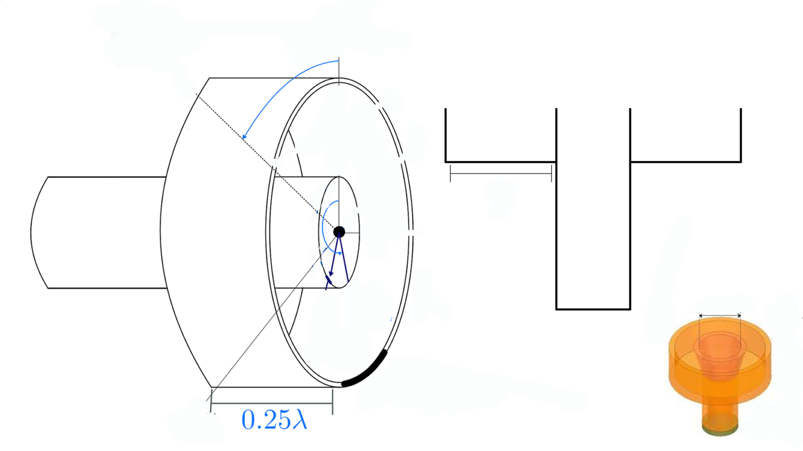

Slide 12
Choke Ring Design (Waveguide Choke)
Choke ring = physical structure around mouth of cantenna/feed horn/antenna.
Purpose: Improves beam efficiency & reduces side lobes (cutting down noise from unwanted directions).
Design Considerations:
  Dimensions frequency-dependent: Dimeter & depth of choke ring is critical and precisely calculated based on operating frequency (1420 MHz for h-line projects).
  Calculation Tools: Specialized Excel sheets & software from sources like the SETI League or specific amateur radio operators (e.g., JA6XKQ) are used to determine these exact dimensions.
  Construction: Prototypes can be built from sheet metal or even simple folded mesh to test effectiveness.
  Placement: The choke ring is typically placed a short distance from the mouth of the feed element.

Slide 13
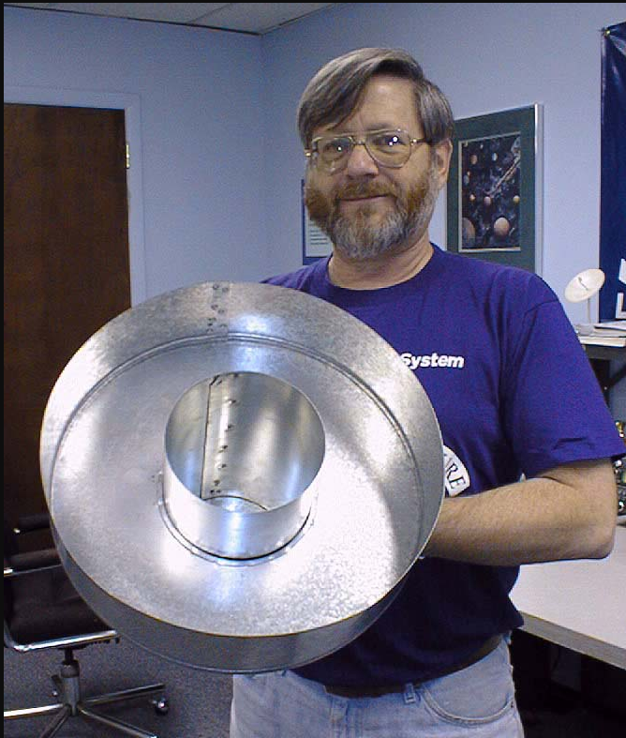
SETI League Choke Design http://setileague.org/hardware/feedchok.htm
SETI League Photo

Slide 14
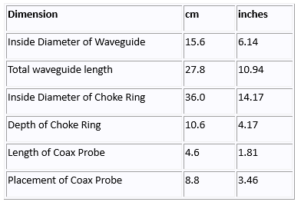
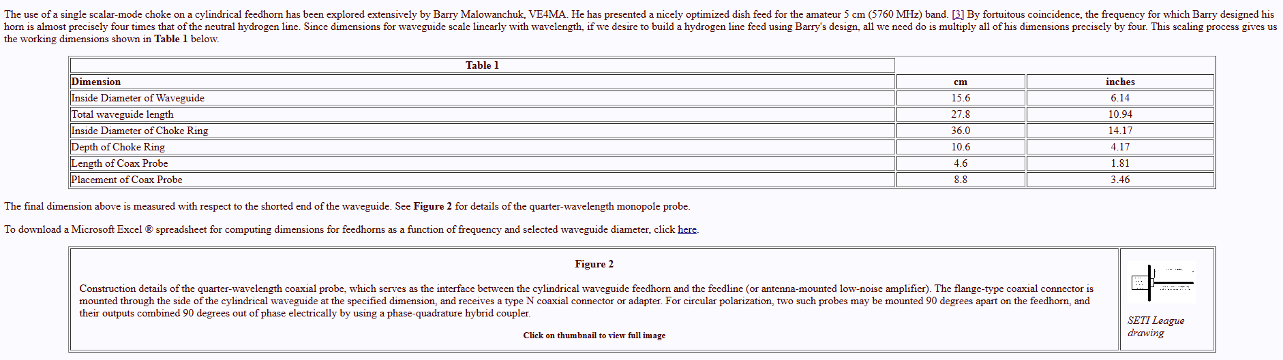
Design by Barry Malowanchuk
VE4MA

Slide 15
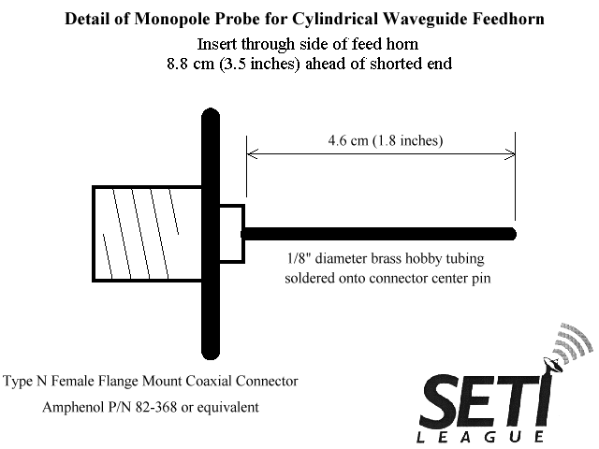
Design by Barry Malowanchuk
VE4MA

Slide 16
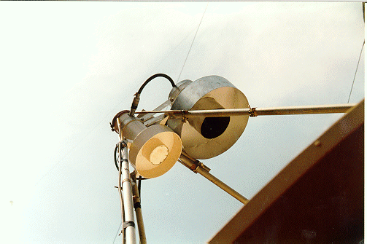
Dual feedhorns installed on EA3UM 5m SETI dish. These cylindrical waveguide feedhorns utilize choke rings of VE4MA design.
H-line feed offset from centre, allowing parasitic SETI whilst dish still used for another purpose.

Slide 17
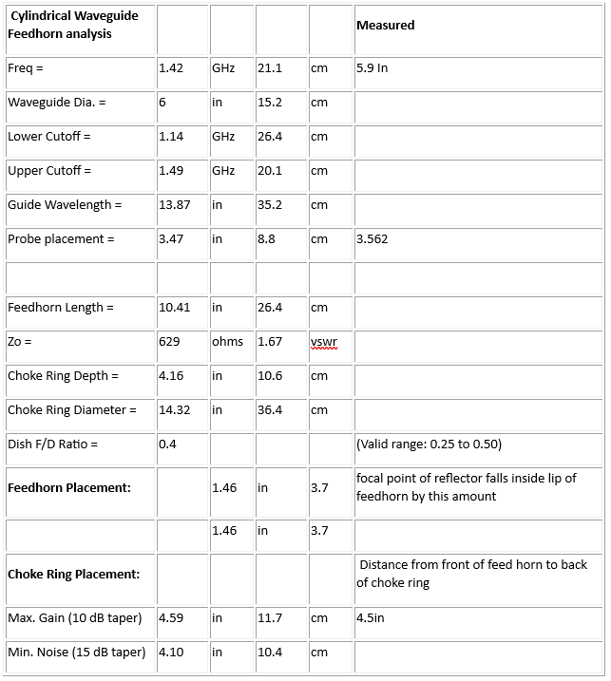
Argus Station Measurements https://www.seti.net/indepth/calculators/calculators.php

Slide 18
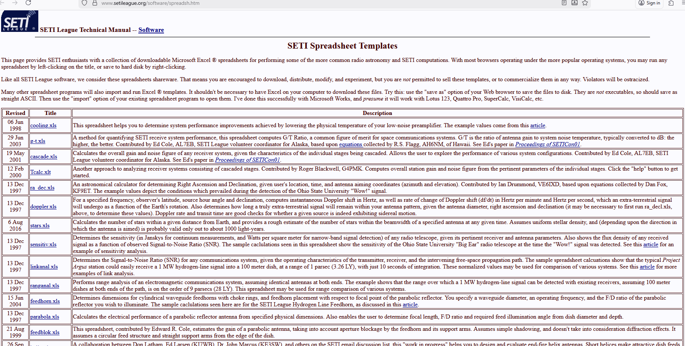
SETI Calculators https://www.setileague.org/software/spreadsh.htm

