Slide 1
Workshop on using NanoVNA to test aerials/antennae using a mini-far field setup in the workshop. EUCARA Harwell Campus UK September 2025
Andrew Thornett & Jason Burnfield
With grateful thanks to Bryan Harber G8DKK for use of his slides and Jason Burntfield for his help in preparation of workshop

Slide 2
Topics
Nano Vector Network Analyser
NanoVNA Features
Calibration
NanoVNA Measurements
NanoVNA PC Software
Using NanoVNA to check your amateur radio telescope – this will be covered in the demonstration

Slide 3
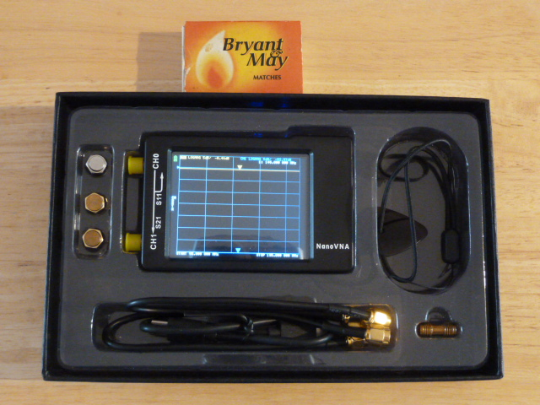
NanoVNA-H 2.8” Package

Slide 4
NanoVNA Features
Built-in touch screen, LCD Display
2.8”, 4” and 4.3” versions
Handheld, stand-alone 2-Port VNA
Frequency ranges 50kHz to 600MHz, 900MHz, 1.5GHz, 3GHz, 4GHz, (6GHz)
Not just an antenna analyser
Measure VSWR/Return Loss, Gain/Loss & cable length
Must be calibrated with a Cal Kit
Linear or Polar (Smith Chart) displays
Measurement Points originally fixed at 101 points, upgrade now 51, 201, 301 and more in some models
Internal rechargeable Lithium battery

Slide 5
VSWR
VSWR, or Voltage Standing Wave Ratio, is a measure of how efficiently radio frequency (RF) power is transmitted from a source to a load, like an antenna.

Slide 6
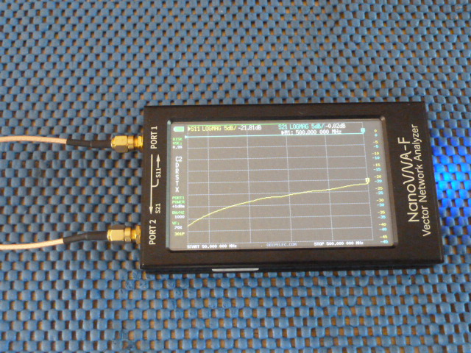
NanoVNA Frequency Ranges
Frequency Range | 50kHz–300MHz | 300MHz–600MHz | 600MHz-900MHz
S₁₁ Dynamic Range | >60dB | >50dB | >40dB
S₂₁ Dynamic Range | >70dB | >70dB | >60dB
Harmonic | Fundamental | 3rd Harmonic | 3rd Harmonic

Slide 7
S11 dynamic range
S11 Parameter indicates amount of power reflected back from input port of network when output port terminated with matched load.
S11 dynamic range refers to decibel (dB) difference between maximum signal level that Vector Network Analyzer (VNA) can accurately measure & minimum detectable signal level, for S11 parameter (reflection coefficient). In simpler terms, it indicates how well the VNA can measure both strong and weak reflected signals from a device under test (DUT).

Slide 8
S21 dynamic range
S21 Parameter, also known as forward transmission coefficient, represents ratio power leaving port 2 to power entering port 1 (power transfer). In simpler terms, it indicates how well a signal passes through a device or system from input to output.
S21 dynamic range is the range of signal levels that can be accurately measured for signal transmission (S21) through a Device Under Test (DUT) = Difference between maximum measurable signal level & VNA noise floor when measuring S21. Higher dynamic range allows for more accurate measurements of devices with a wide range of transmission characteristics.

Slide 9
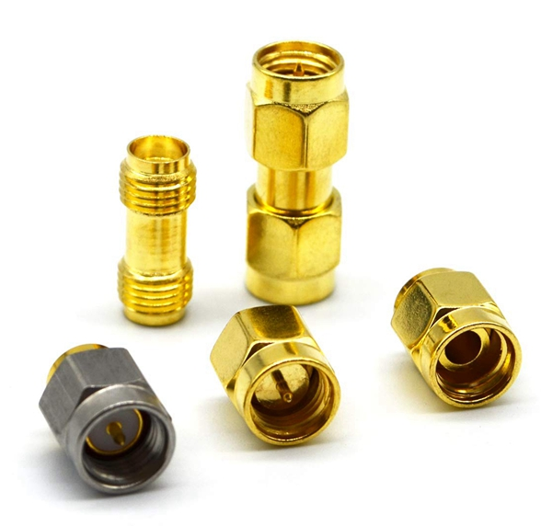
NanoVNA Calibration Kits
NanoVNA provided with SMA male S.O.L.T. (Short-Open-Load-Through) calibration kit:
Short – male SMA with pin protruding from flat 4mm diameter disc. No PTFE insulator.
Open – male SMA with outer ring but no inner pin. No PTFE insulator.
Load – male SMA 50Ω load
Through - 2 lengths coax provided for through-cal when SOLT calibration required.

Slide 10
NanoVNA Calibration
A single port calibration is suitable for one port devices like antennas (aerials) or dummy loads
Only the short, open and load (SOL) are necessary
Options are to calibrate directly at test port 1 (Ch 0 in H version) or at the end of a cable connected to test port 1
Two port devices require calibration at the end of a single cable, even when 2 cables are used
From the architecture we can infer that port 2 for the through measurement only compensates for the source match
There is no “through match” calibration possible

Slide 11
Port 2 Test
Set a wide span for example 50MHz to 500MHz
Connect one of the cables to port 1 + SMA female adapter
Press “Reset” and perform a Short, Open, Load Calibration
Press done immediately after the Load calibration
Store the calibration in one of the stores
Connect the cable to Port 2 and run the marker to max frequency. Note the marker value
Now press “Reset” & perform a new SOLT calibration at the end of cable. Store in same store (or different)
Connect cable to Port 2 and note the marker value and trace shape. It will be the same as first measurement

Slide 12
Calibration at End of Cable
An important aspect of a VNA is the ability to calibrate at the end of a coaxial cable
A “cable” could also be connector adapters (e.g. test just the aerial on your H-Line setup by calibrating at end of cable you use to connect to the aerial for the test.)
The calibration pieces from the cal kit are applied to the end of the cable attached to the Tx port, port 1
This type of calibration reduces cable ripple
Using 2 cables, the cable on the Rx port, port 2 is more difficult to reduce cable ripple as it relies on the source port calibration plus the match of the Rx port

Slide 13
Calibration at End of Cable
This means
antennas
can be tested using
cables that will be used in live observations but
separate results from cables measured
An important aspect of a VNA is the ability to calibrate at the end of a coaxial cable
A “cable” could also be connector adapters (e.g. test just the aerial on your H-Line setup by calibrating at end of cable you use to connect to the aerial for the test.)
The calibration pieces from the cal kit are applied to the end of the cable attached to the Tx port, port 1
This type of calibration reduces cable ripple
Using 2 cables, the cable on the Rx port, port 2 is more difficult to reduce cable ripple as it relies on the source port calibration plus the match of the Rx port

Slide 14
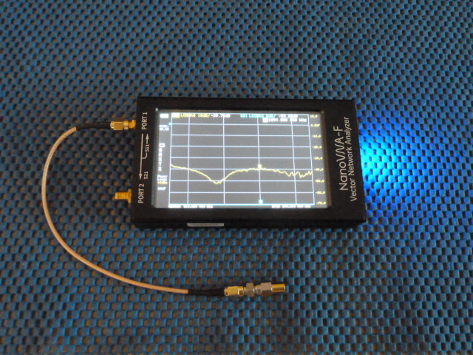
Calibration at End of Cable

Slide 15
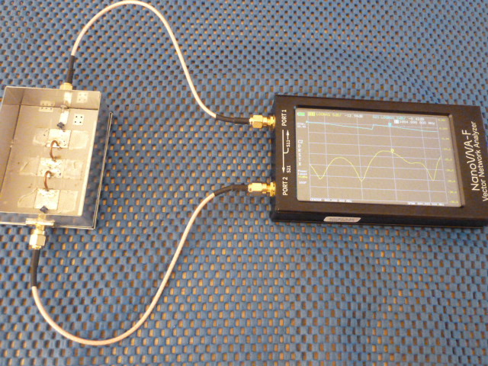
NanoVNA Measurements
1500MHz LP Filter swept from 500MHz to 1300MHz
Two cables

Slide 16
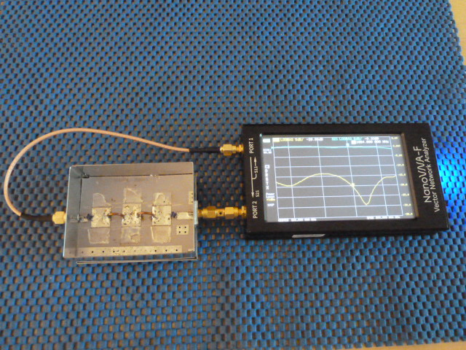
Single Cable with D.U.T
1500MHz LP Filter swept from 500MHz to 1300MHz

Slide 17
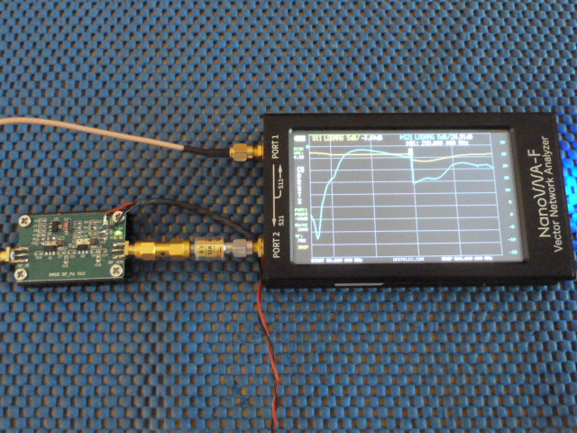
Amplifier Measurement

Slide 18
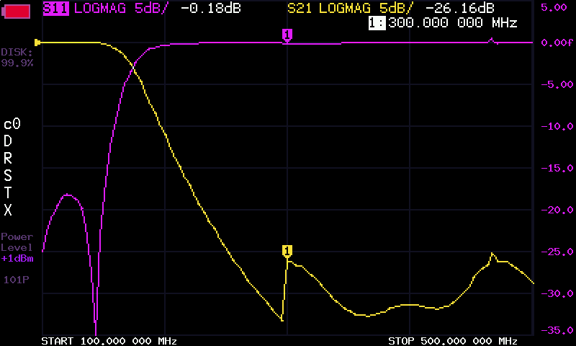
NanoVNA-F Screen Capture

Slide 19
Smith Chart
Named after Phillip Hagar Smith, introduced in Electronics magazine Jan 1939.
Designed to simplify mathematical calculations & allow problems to be solved graphically using compass, ruler + pencil.
Still useful for visualizing complex impedances, especially as function of frequency.
Mainly used when for one-port measurements, particularly to visualize reflection coefficients. It represents the load impedance, ZL, relative to source impedance, Z0. Complex impedance values can be plotted as individual points or as lines that depict impedance over range of frequencies.

Slide 20
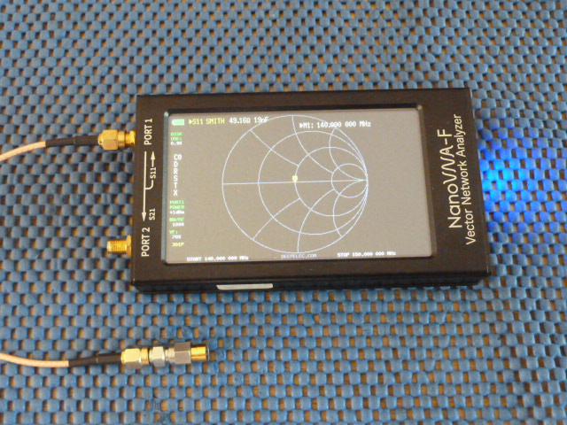
Smith Chart Display - Load

Slide 21
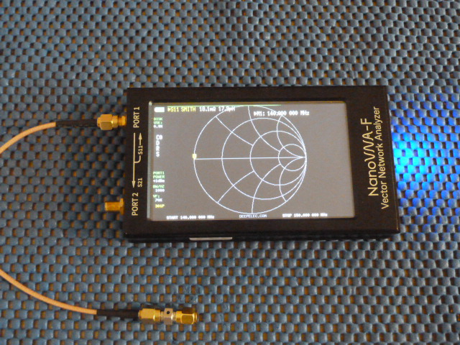
Smith Chart - Short

Slide 22
Nano VNA Software
NanoVNA#, NanoVNA server

Slide 23
NanoVNA PC Software
The NanoVNA-F manual points to two PC software packages for use with these units:
Nanovna.exe
Nanovna-saver by Rune B. Broberg
A modified version of nanovna is nanovna#
NanoVNA & NanoVNA# are capture & display programs. They can run calibration routines but 101 points only plus save & load files in Touchstone format
NanoVNA-saver is a large program with many features including chaining sweeps to gain more than 101 display points

Slide 24
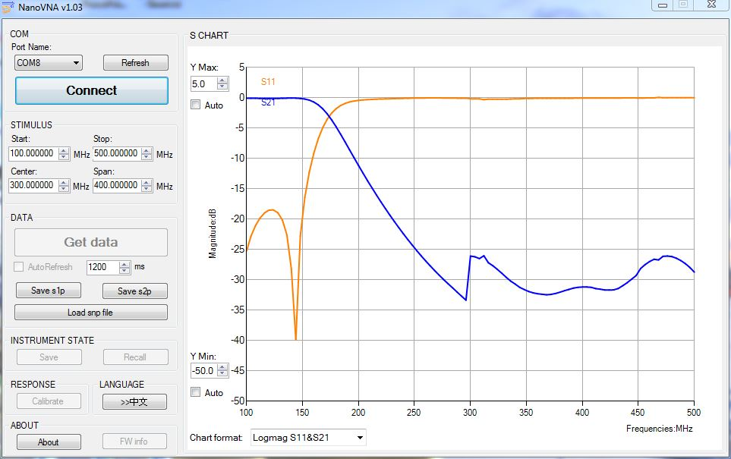
NanoVNA V1.03 170MHz LPF

Slide 25
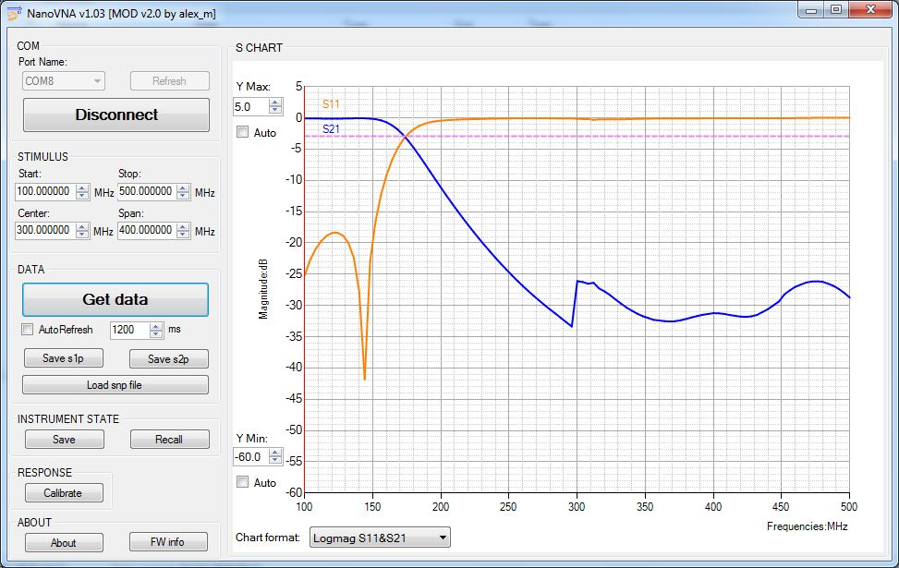
NanoVNA Sharp Capture

Slide 26
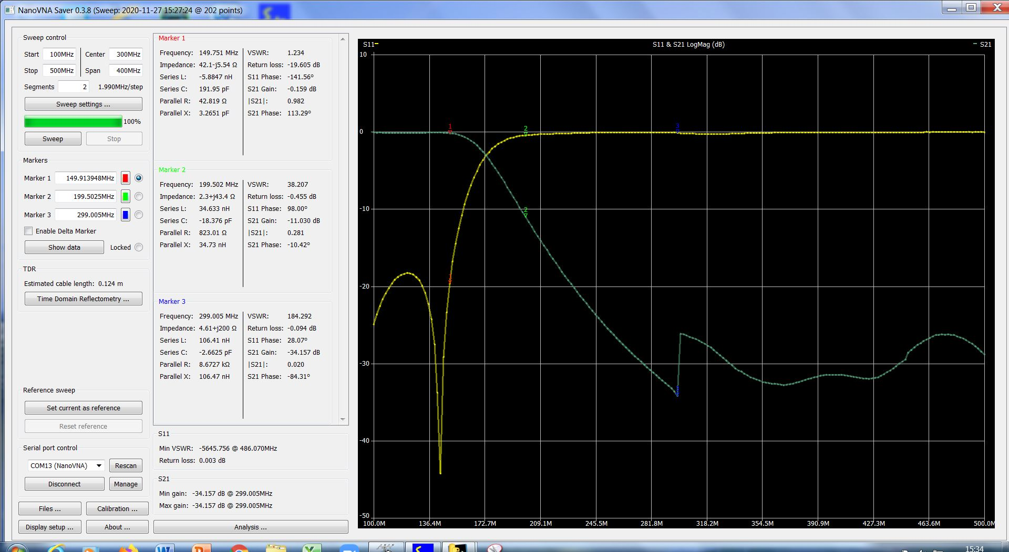
NanoVNA Saver

Slide 27
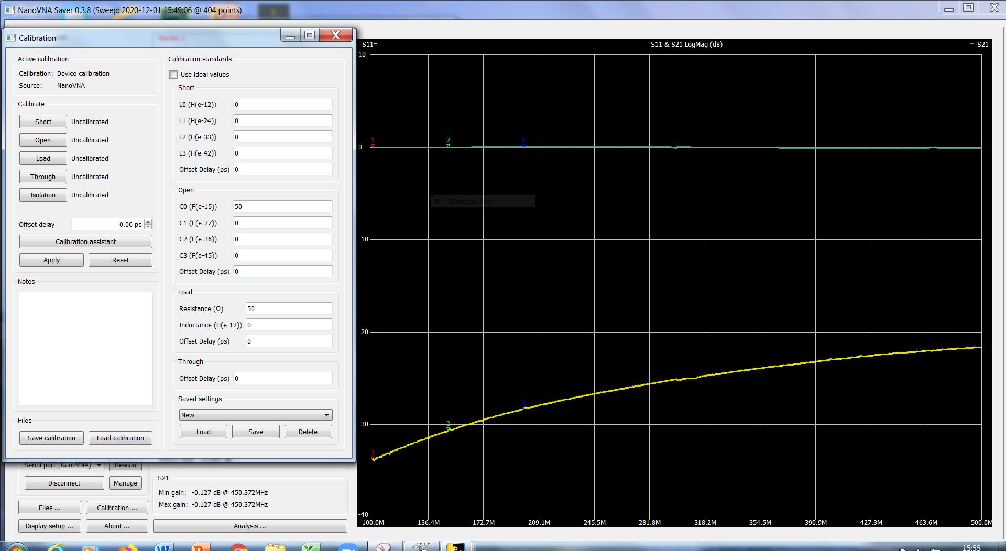
NanoVNA Saver – Cal Kits

Slide 28
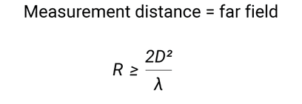
Indoor antenna testing range
Ideally in anechoic chamber, but we don’t have one today, so hopefully all of you will absorb any reflections!
Equation explanation on next slide
Signal Source Aerial under test, able to move
Also known as Device Under Test (DUT)

Slide 29
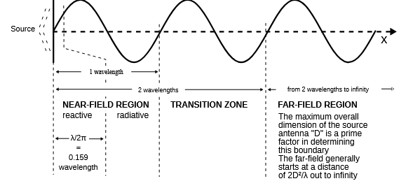
General Far Field Condition
“Rule of thumb" for determining if a point is in the far field is to check if the distance (r) from the source is much greater than λ/2π (where λ is the wavelength).
Far field starts at distance from source of 2 x square of diameter of source antenna (“D”) / wavelength being used for test.

Slide 30
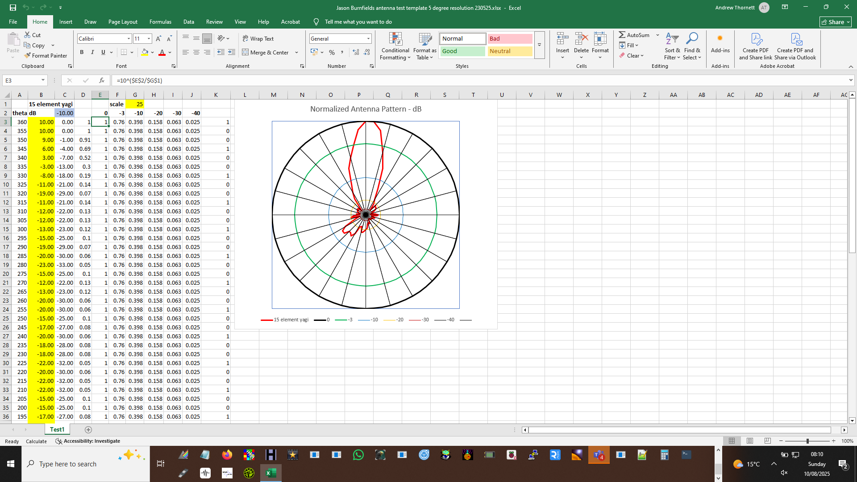
Jason Burnfield’s Excel Template to plot mini-antenna range measurements

Slide 31





