Slide 1
SARA Drake’s Lounge
LRO Update
19/4/2026

Slide 2
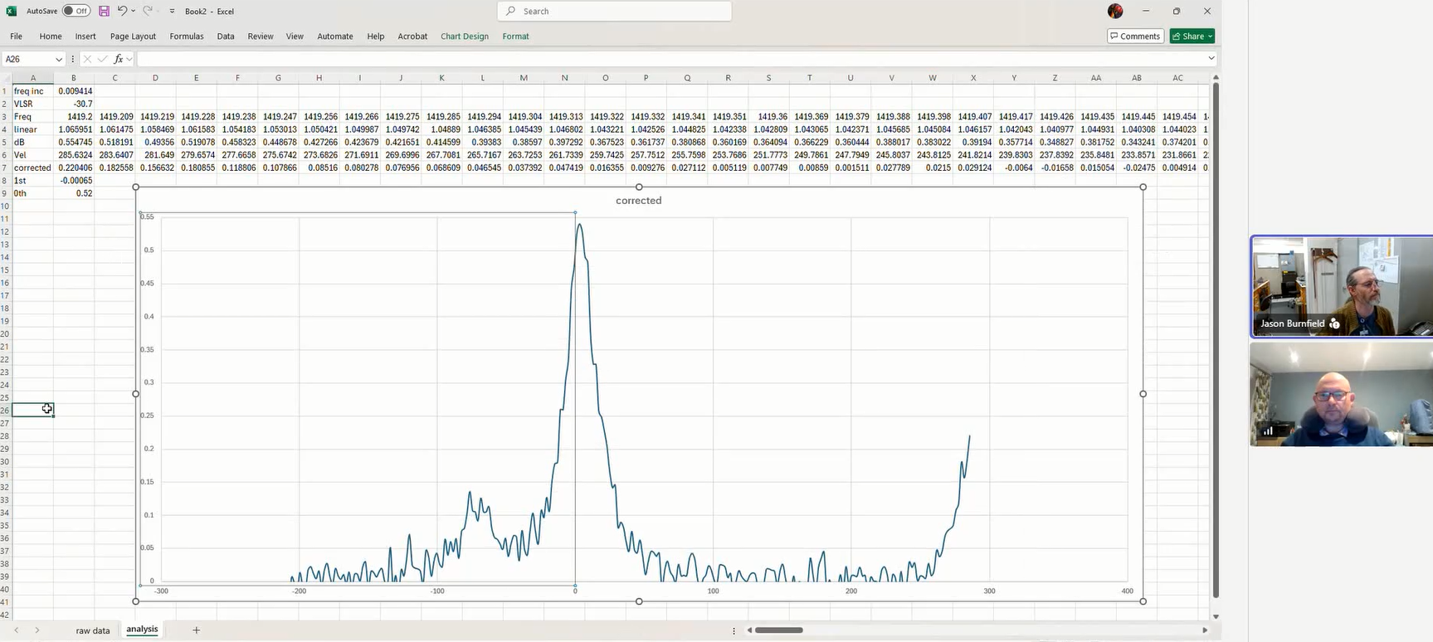
Assessing performance of LRO-H2 - Cygnus
dB
(y-axis)
Frequency Doppler Shift MHz (X-axis)

Slide 3
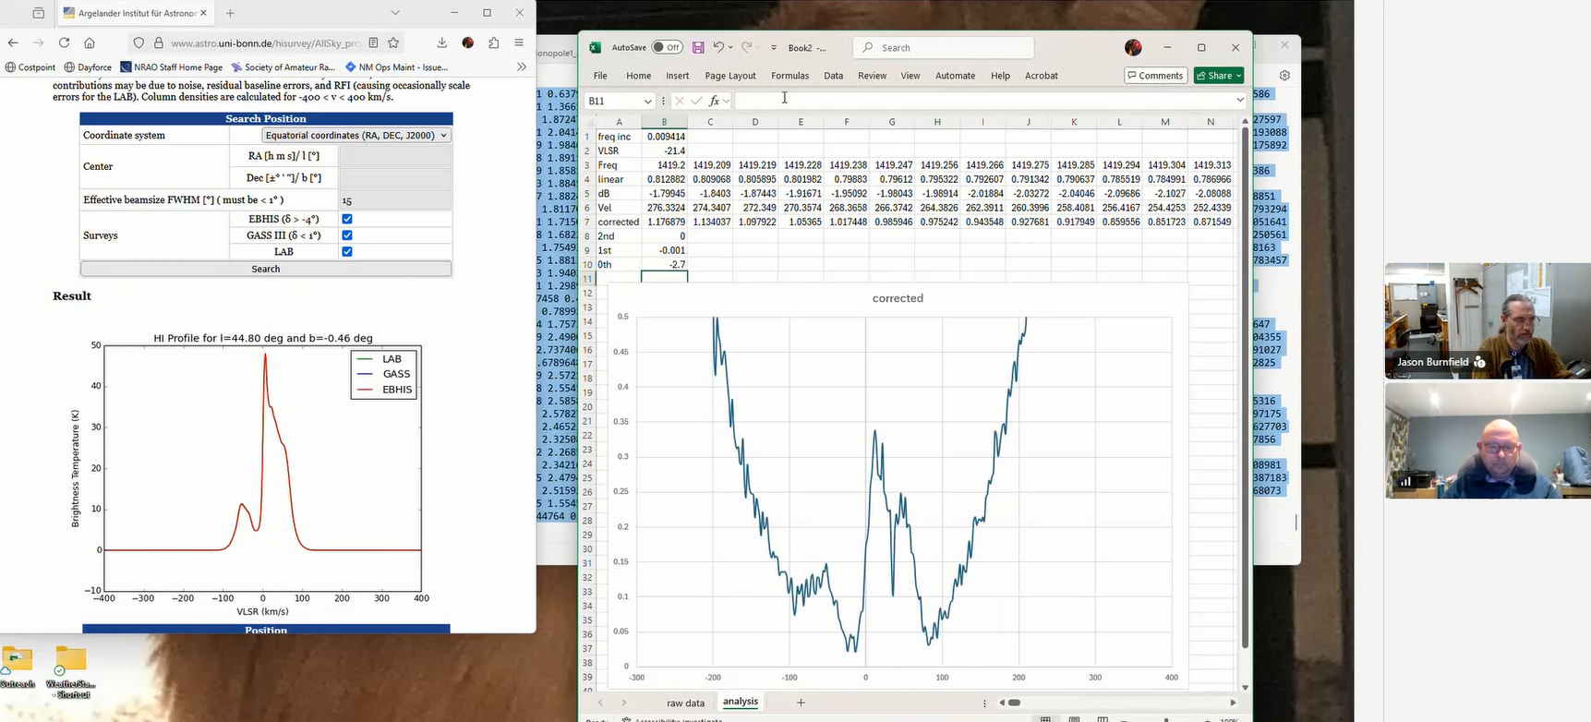
Comparing H-Line Plot at LRO-H2 (right) to LAB Survey (left) – Plot 1 of 2

Slide 4
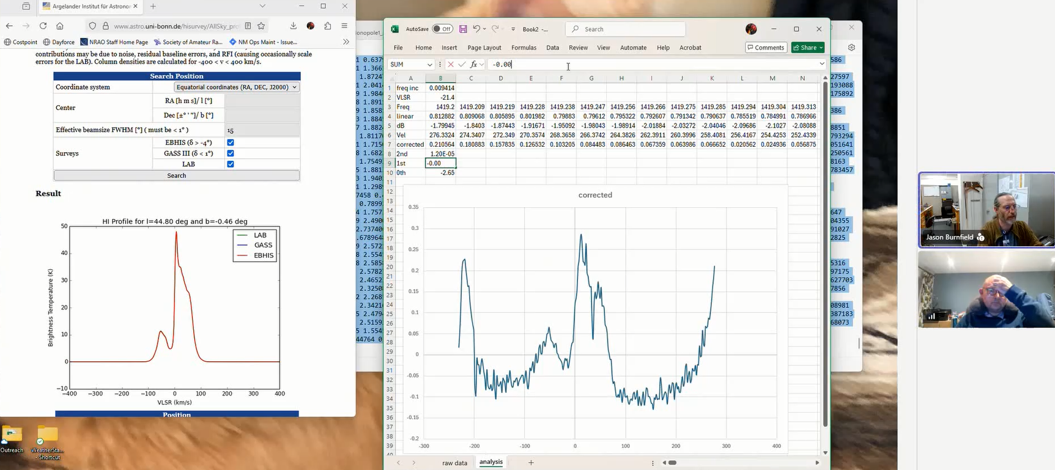
Comparing H-Line Plot at LRO-H2 (right) to LAB Survey (left) – Plot 2 of 2

Slide 5
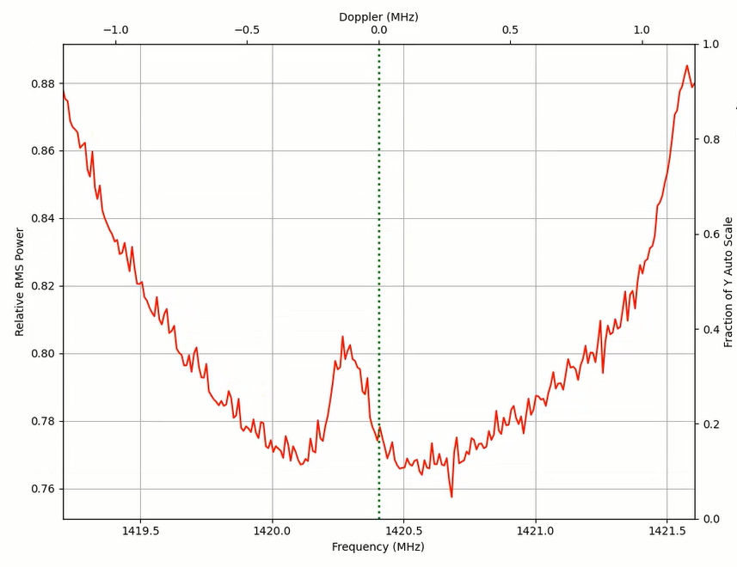
Slot 1 on supporting arms for Brian Coleman hydrogen line feed on LRO-H2
Screenshot from ezCol.py (Ted Cline’s ezRA suite) showing maximum hydrogen line detection in 24-hour period

Slide 6
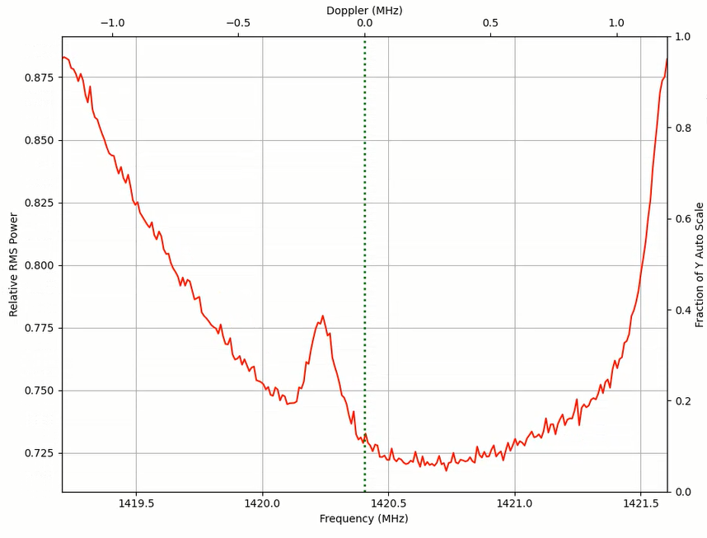
Slot 2 on supporting arms for Brian Coleman hydrogen line feed on LRO-H2
Screenshot from ezCol.py (Ted Cline’s ezRA suite) showing maximum hydrogen line detection in 24-hour period

Slide 7
Building a Cakepan Loop Feed

Slide 8
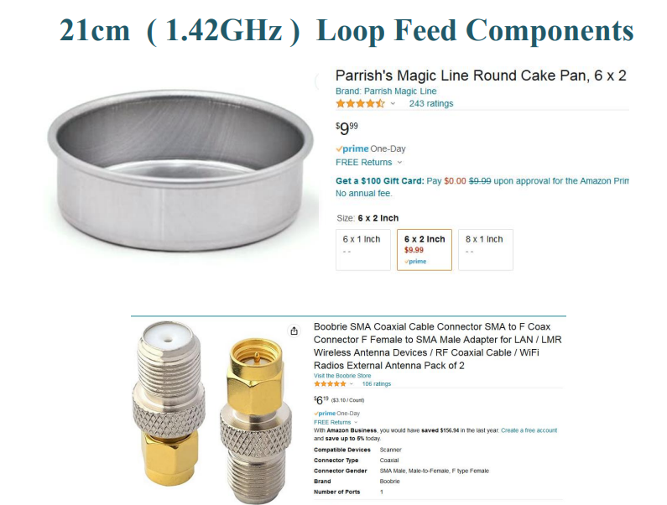

Slide 9
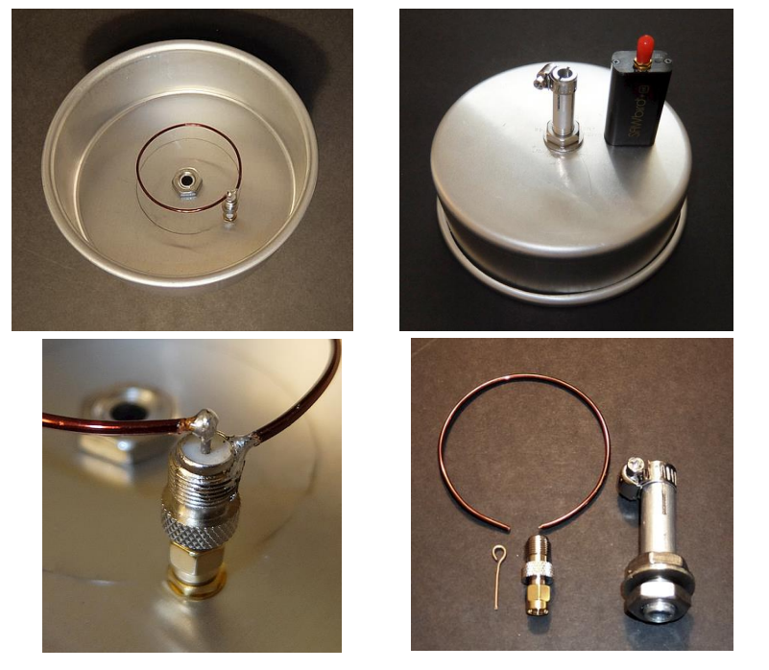

Slide 10
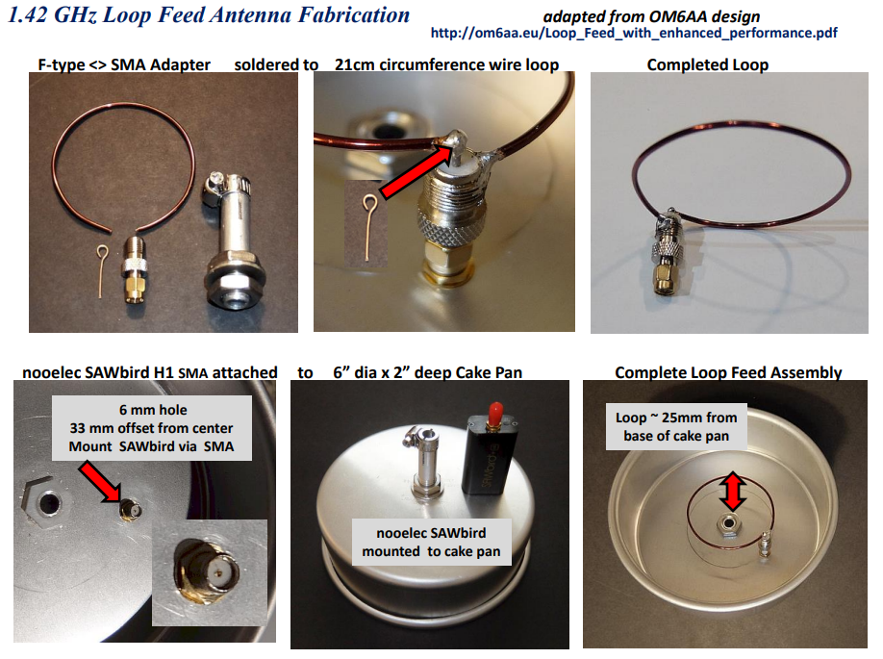

Slide 11
