Slide 1
SARA Online
Drake’s Lounge Meeting
17 May 2026
Andrew Thornett, Lichfield Radio Observatory, www.astronomy.me.uk
E-mail via the “Contact Me” page on the above website.

Slide 2
LRO Experiment to test effect of placing various amounts of lead between two x UKRAA CosmicWatch Muon Detectors in coincidence mode
16-17 May 2026

Slide 3
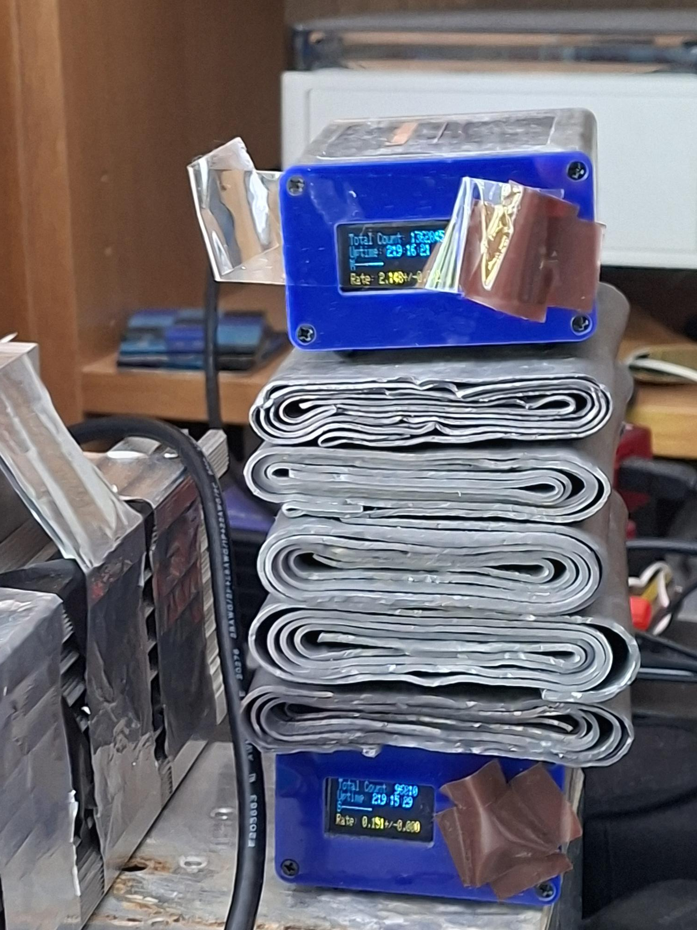
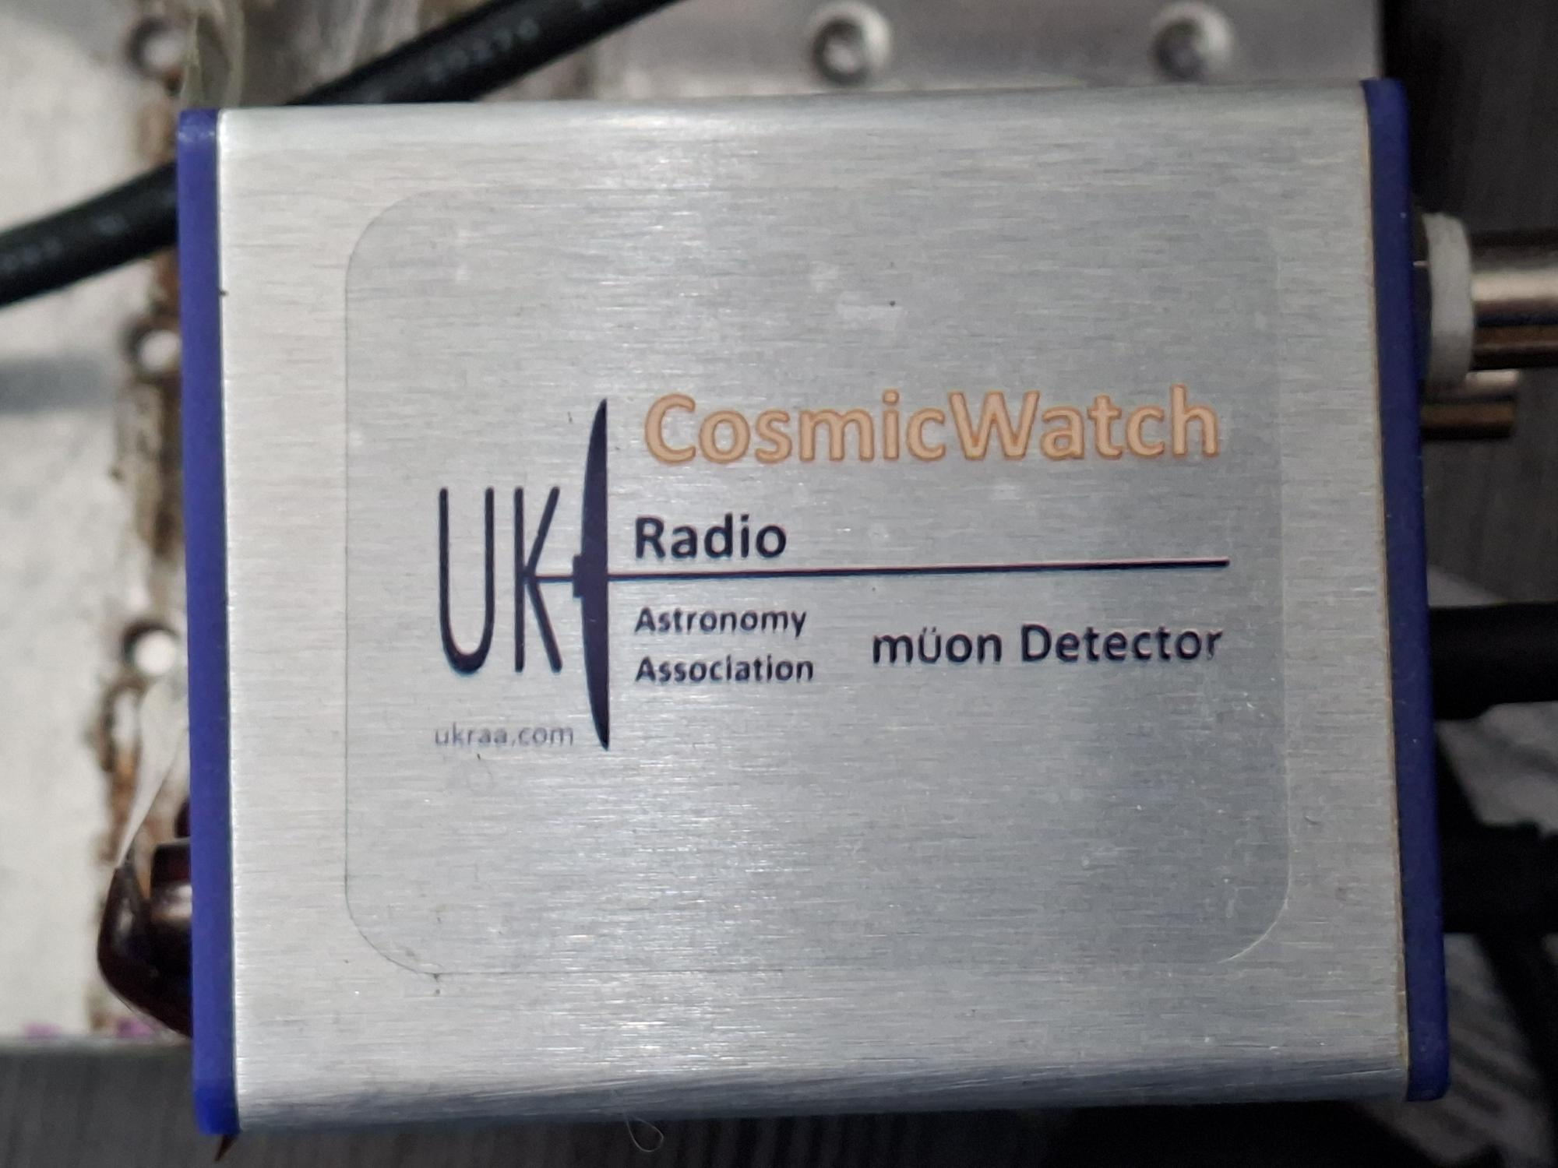
Experiment recommended at last SARA online meeting.
Here are results with 0→5 sheets lead.

Slide 4
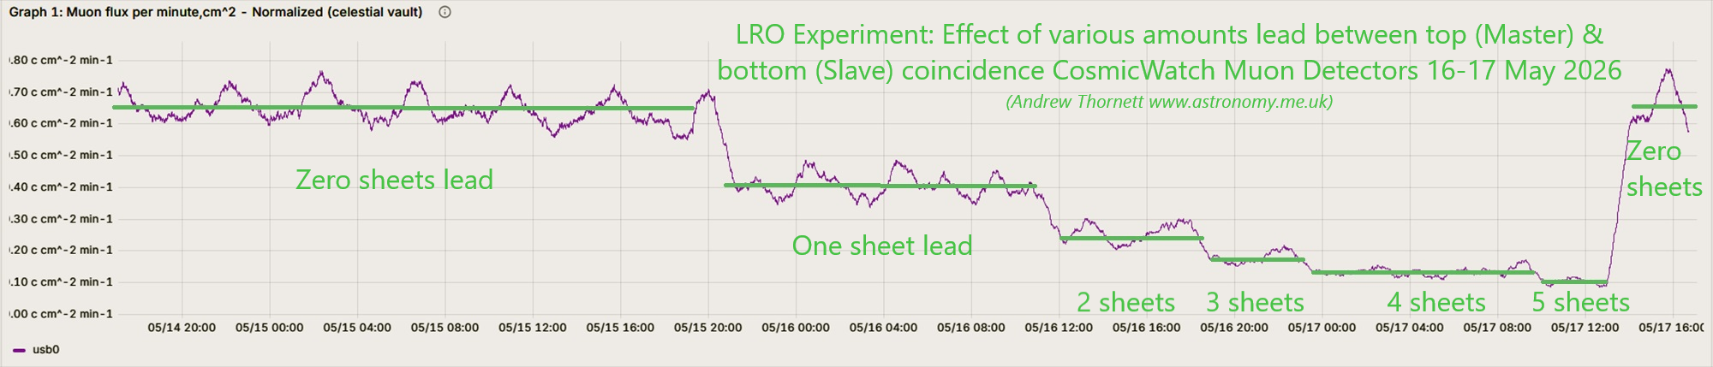
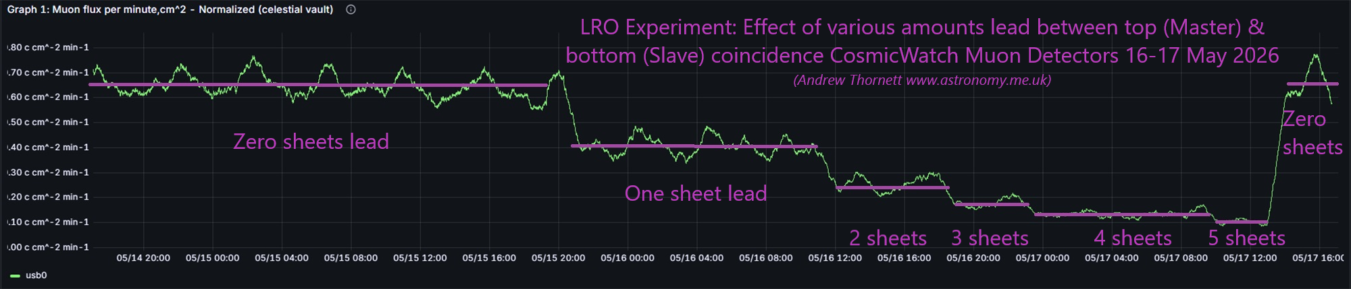

Slide 5
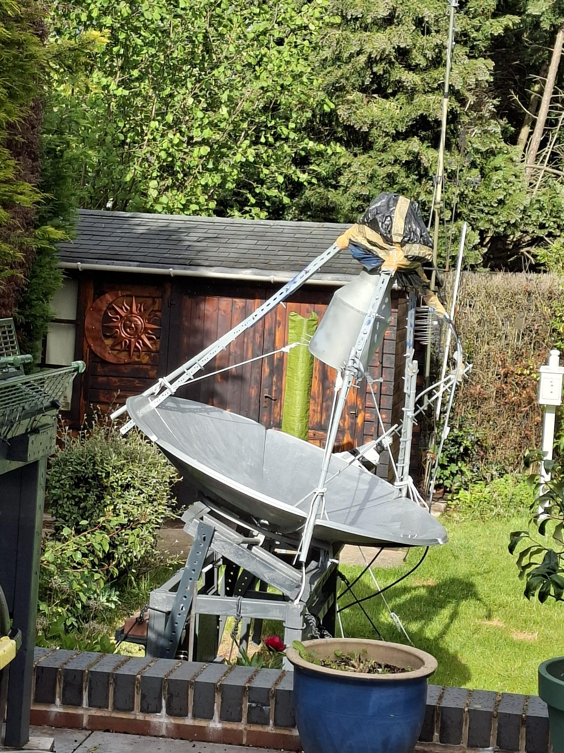
Plot data Brian Coleman H-Line feed placed @ (I think..) correct focal point on LRO-H2

Slide 6
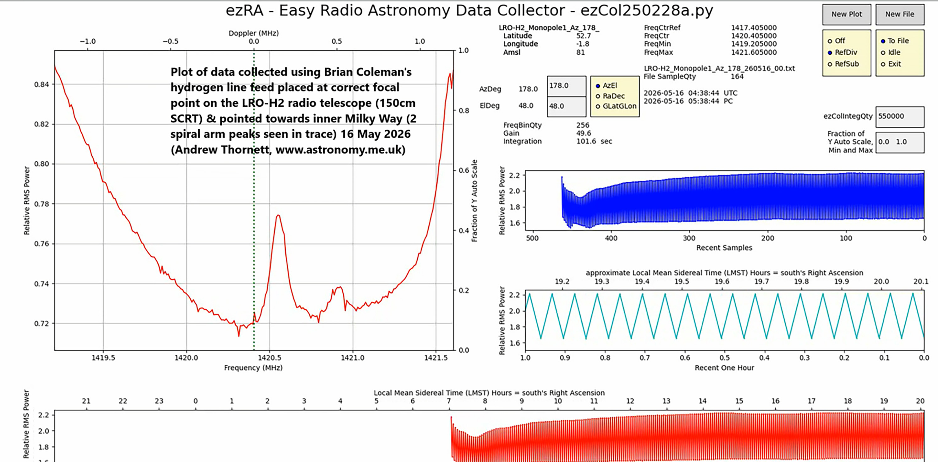

Slide 7
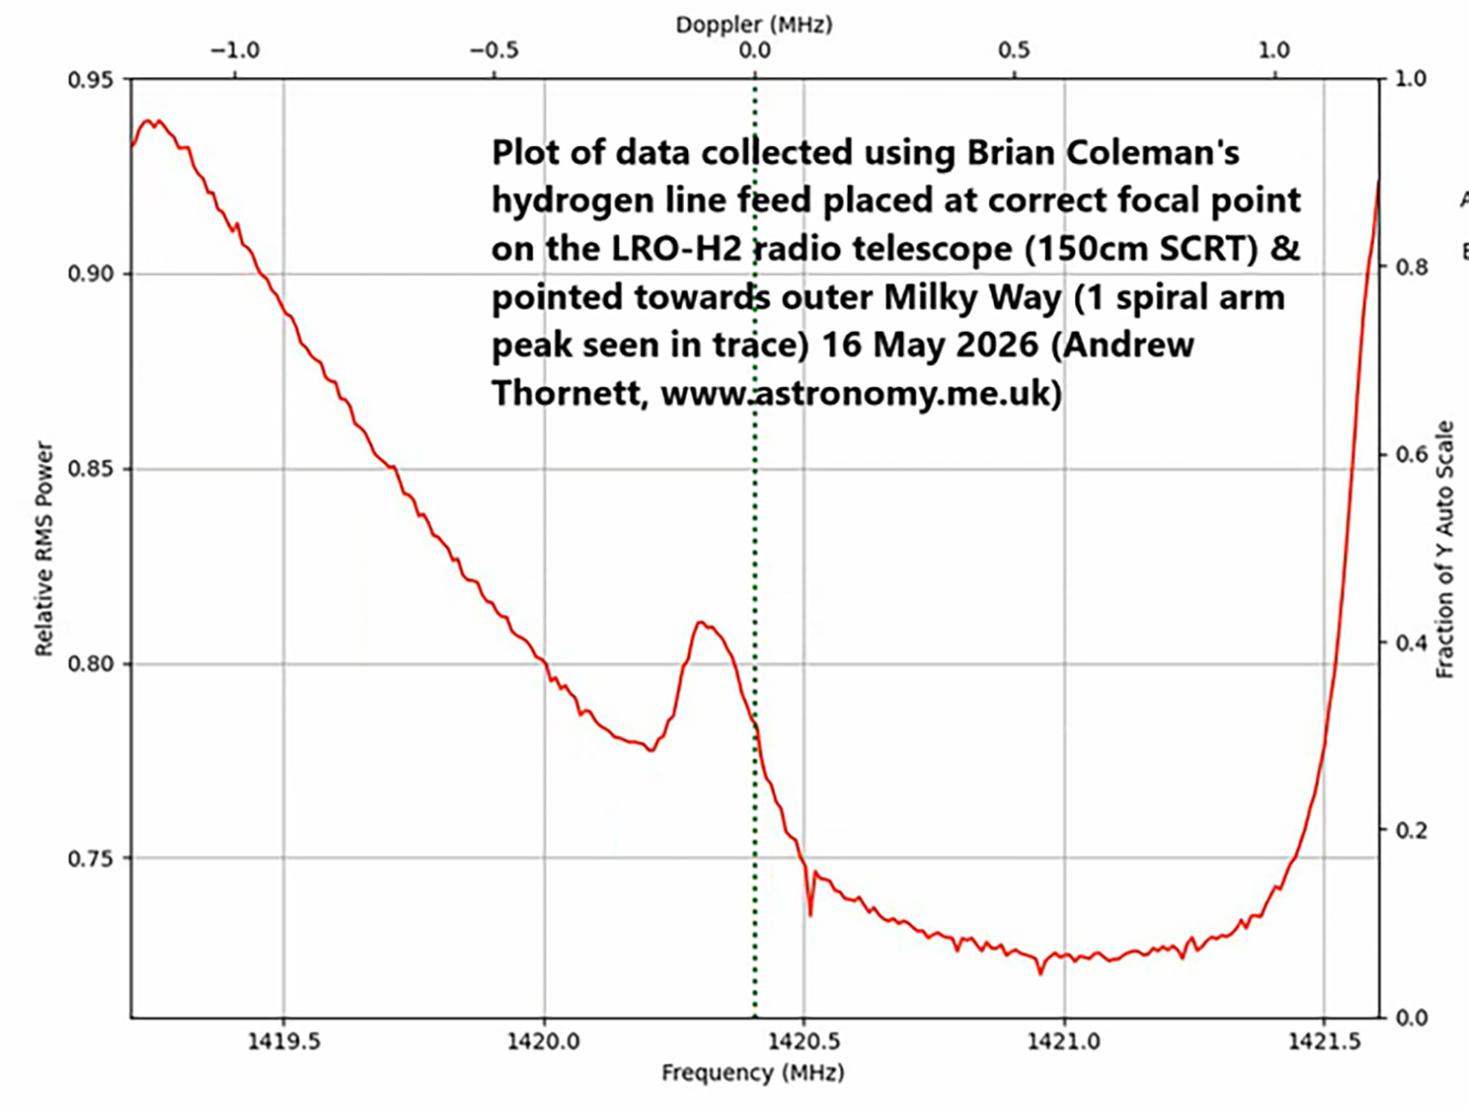

Slide 8
Comment from Jason
Hi Andy,
Back of the napkin calculations put you at around 0.63 dB above background for the first and about 0.54 dB for the second. That’s about half what I would expect (and consistent with your earlier results). I would suggest the next thing to try is cover the inner surface with aluminum window screening and see if that helps. My guess is that the steel is a very lossy reflector at 21cm. One modification at a time, we’re going to optimize your system!
Cheers!

Slide 9
Any thoughts on how to improve reception?
Ideas I have had so far:
Extend edge of dish to reduce ground spillover (aka Alex) – I have some mosquito mesh ready for purpose.
Confirm I really do have the feed at correct distance from dish centre.
Try moving feed slightly to sides by pulling on ropes whilst watching computer screen to check properly centralised.
Once confirmed at focal point, replace metal supports with wooden or plastic supports.
Possibly cover steel dish with aluminium mosquito screen? However, mixed results on line about this with some sources suggesting aluminium no significant improvement over steel of dish.
Dish is painted with Hammerite metal-protective paint – do you think that matters? Again, my online searches suggest it should not make a difference.

