Slide 1
Pointing Norsat 9000 LDF LNB on 1.2m satellite dish at sky and house 22/7/2026

Slide 2
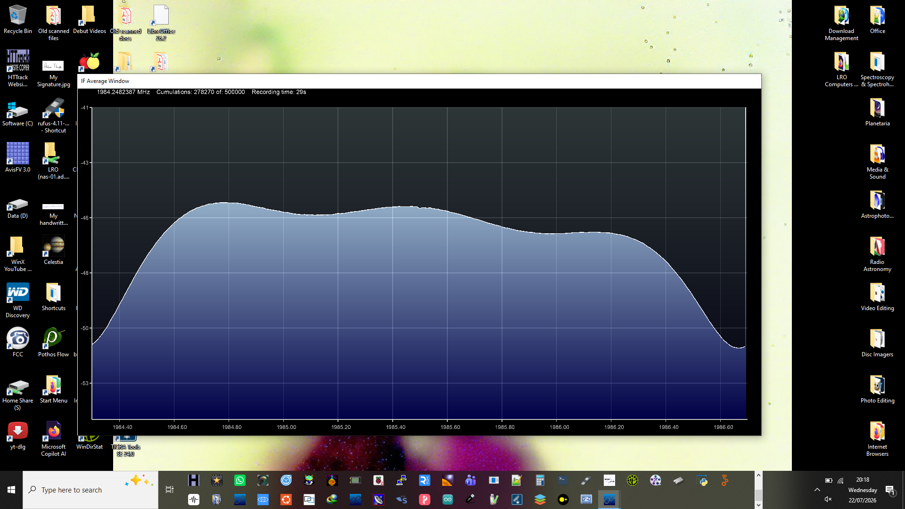
22/7/2026:
Pointed at sky.

Slide 3
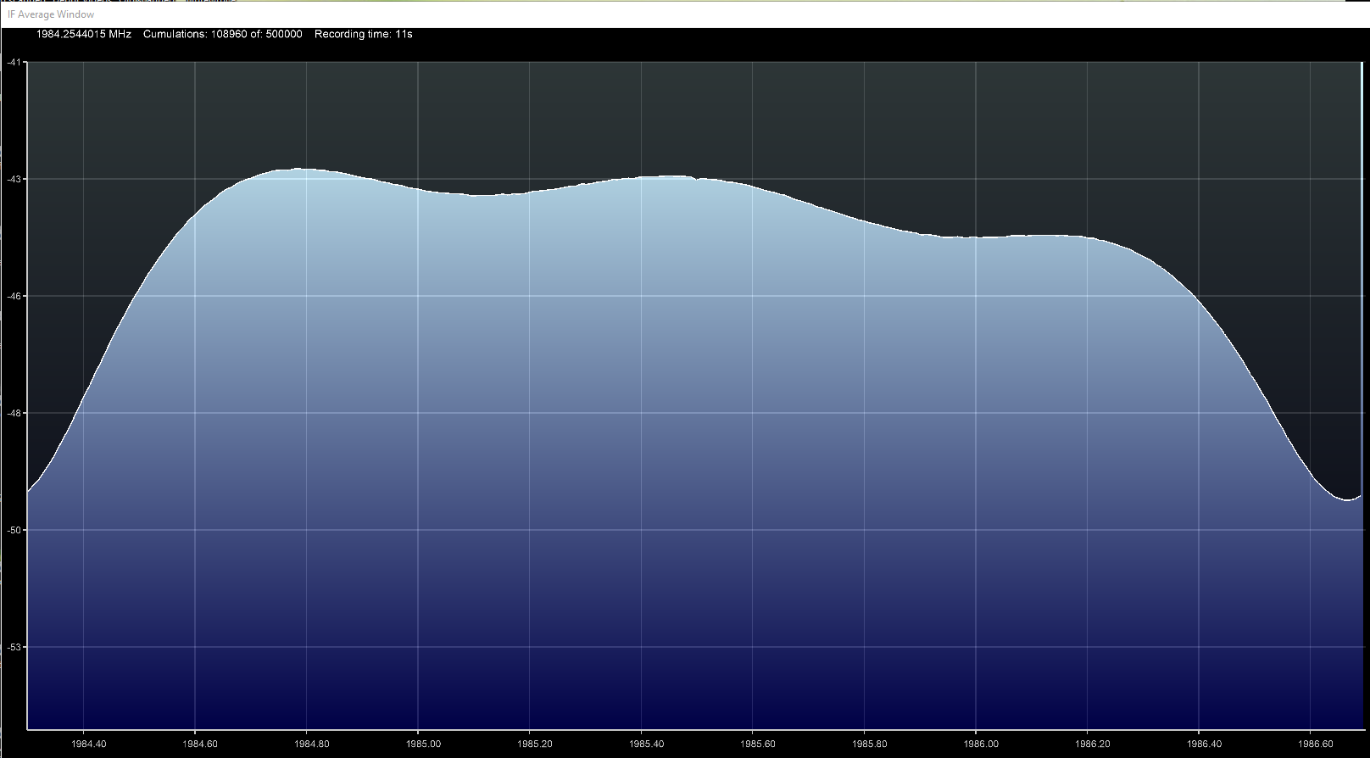
22/7/2026:
Pointed at house.

