Slide 1
Update on hydrogen line observing at Lichfield Radio Observatory.
Andrew Thornett
Lichfield Radio Observatory, www.astronomy.me.uk
andrew@thornett.net

Slide 2
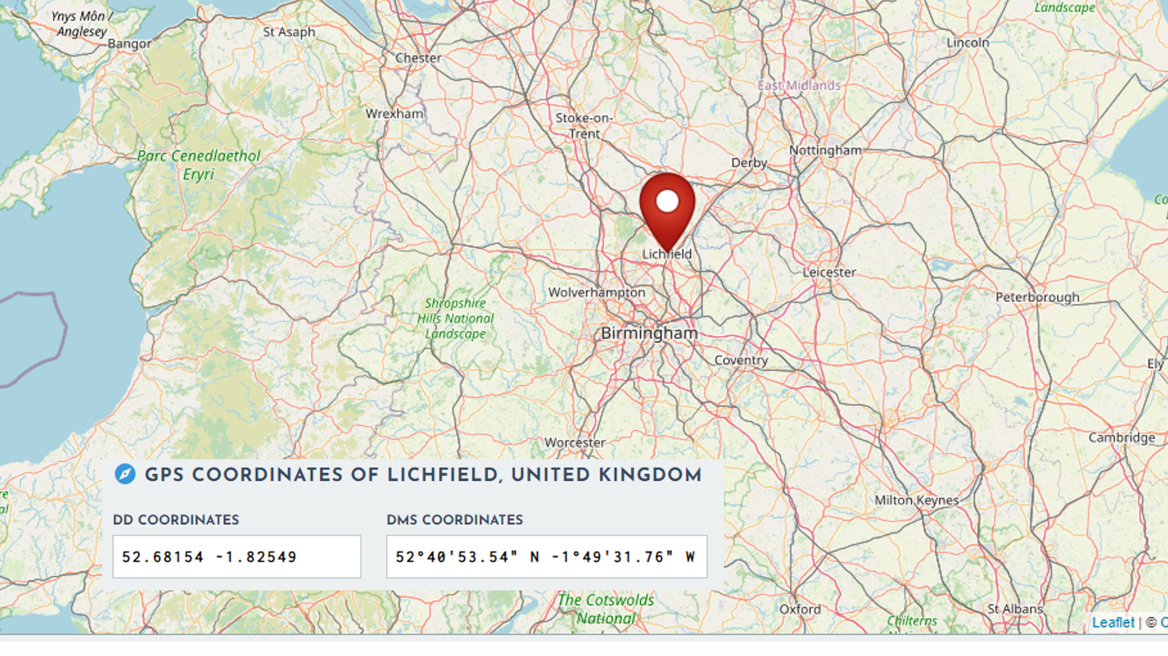
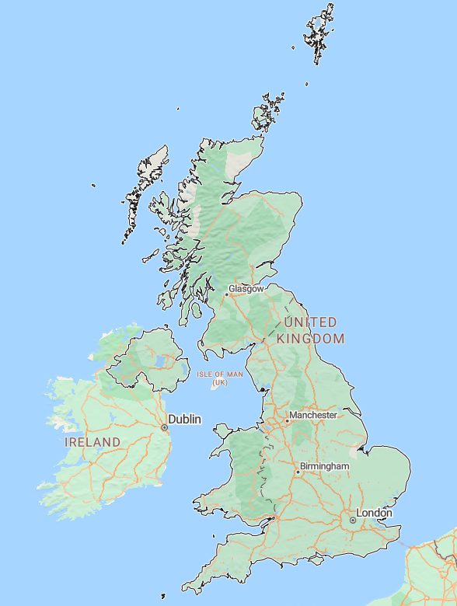

Slide 3
Astronomy Activities at LRO
Over the last five years, Lichfield Radio Observatory has developed as a significant amateur radio astronomy observatory in the middle of the UK.
Observing programmes cover radio astronomy & other activities:
  hydrogen line radio astronomy
  VLF/SIDs
  meteor radio scatter detection
  muon detection
  Magnetometry
  Visual astronomy
  deep sky astrophotography
  solar astrophotography
  spectroscopy.
  phase contrast microscopy.

Slide 4
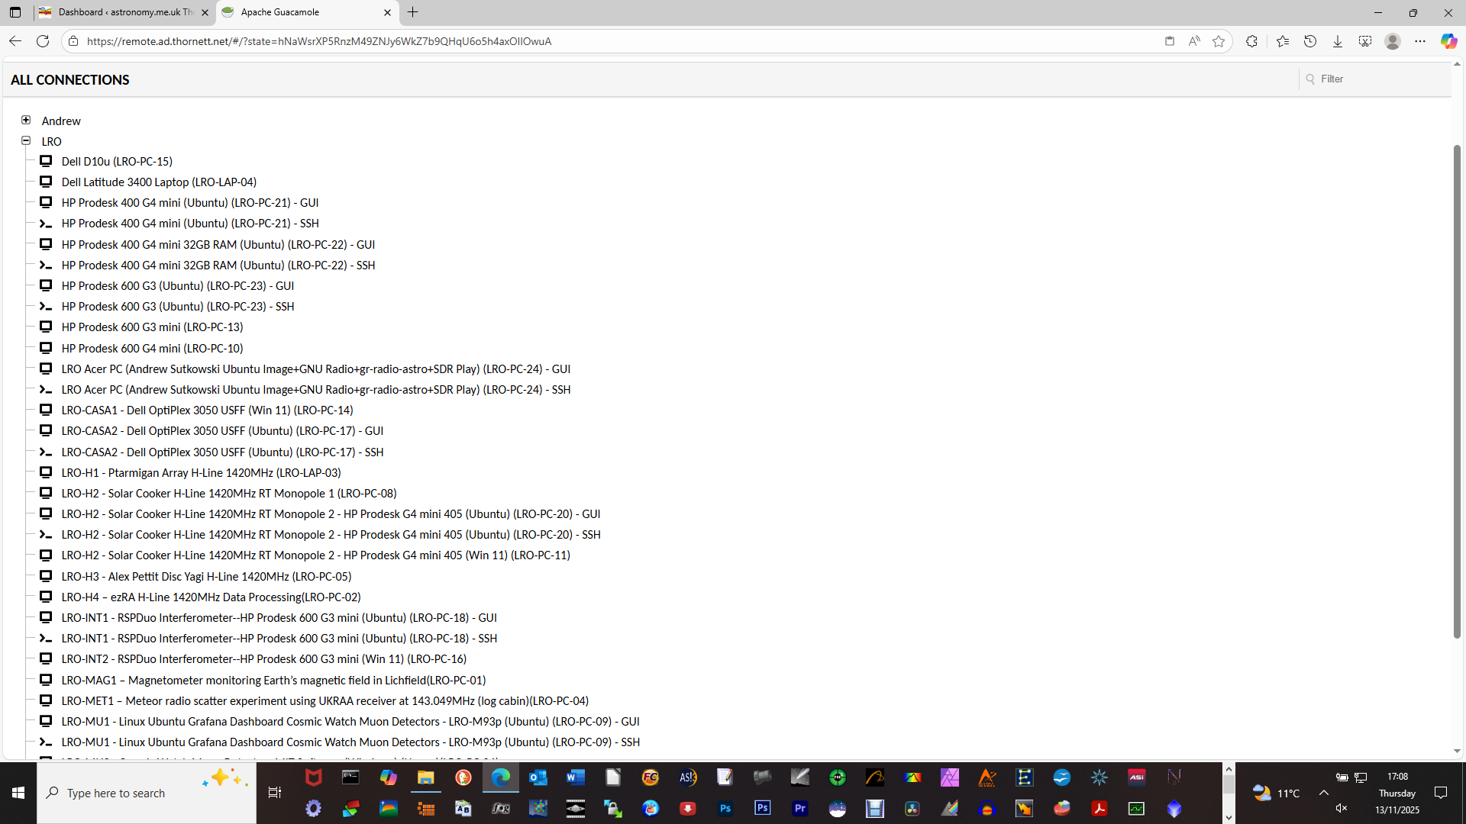
Apache Guacamole - remote log in for LRO computers

Slide 5
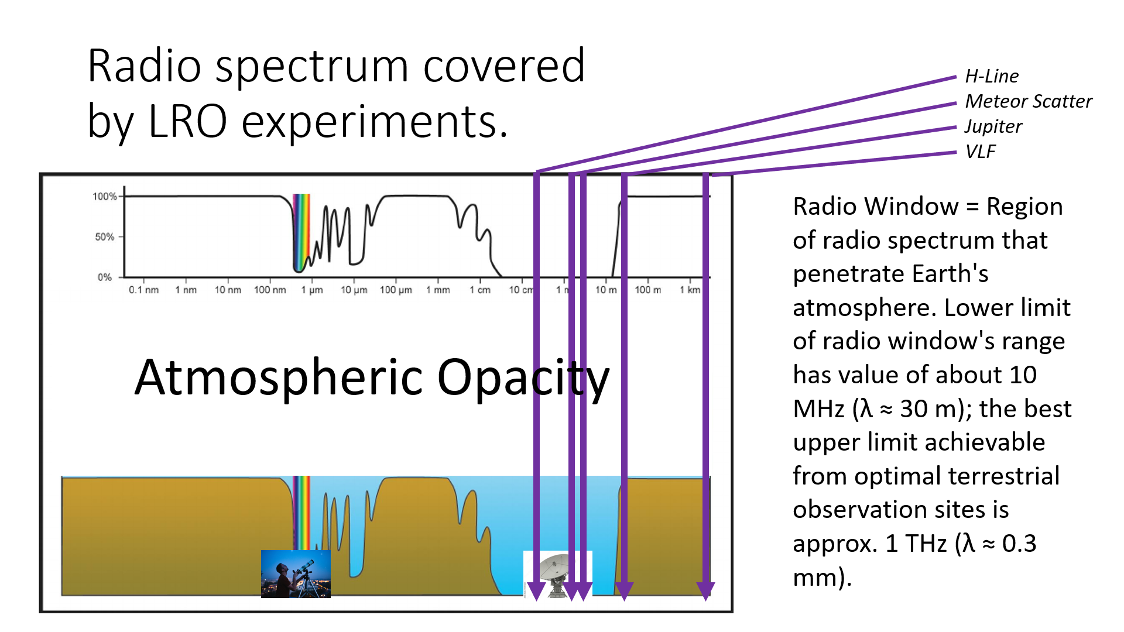

Slide 6
Hydrogen Line Radio Telescopes (1420 MHz)
LRO-H1 = Ptarmigan Triffid ex-military 4 x 4 dipole array, 86cm x 86cm in size.
LRO-H2 = 150cm rolled steel petal dish sold as solar cooker on ebay.
LRO-H3 = Alex Pettit Yagi tuned to 1420 MHz – this is one of Alex’s original design.
LRO-H4 = SETI League Horn of Plenty.
All of the above: Drift scanning on homemade wooden mounts, RTL-SDR V3/4/Nooelec NESDR SMARTee, Nooelec SAWBird H1 LNA/filter, KMR-400 coaxial cable.
LRO-H5 = 140cm ex-communications antenna with Discovery Dish hydrogen line feed. RTL-SDR V4, Drift scanning on homemade wooden mount, KMR-240 coaxial cable.

Slide 7
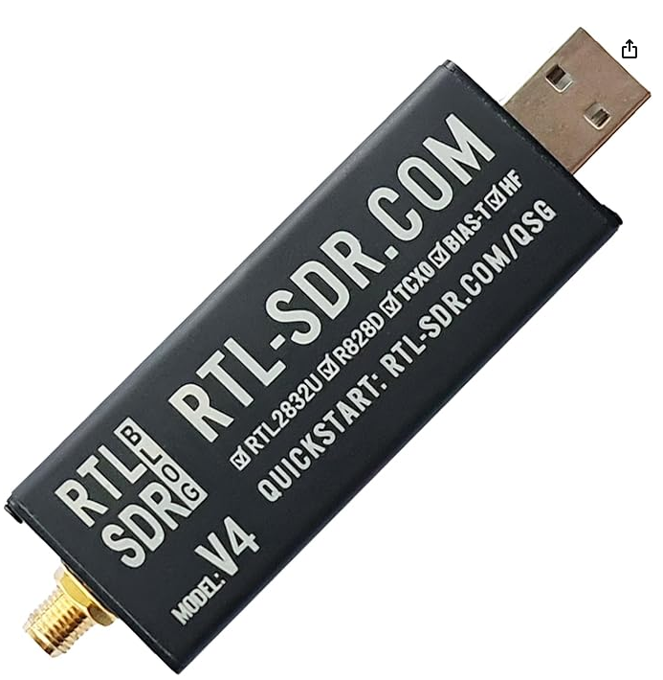
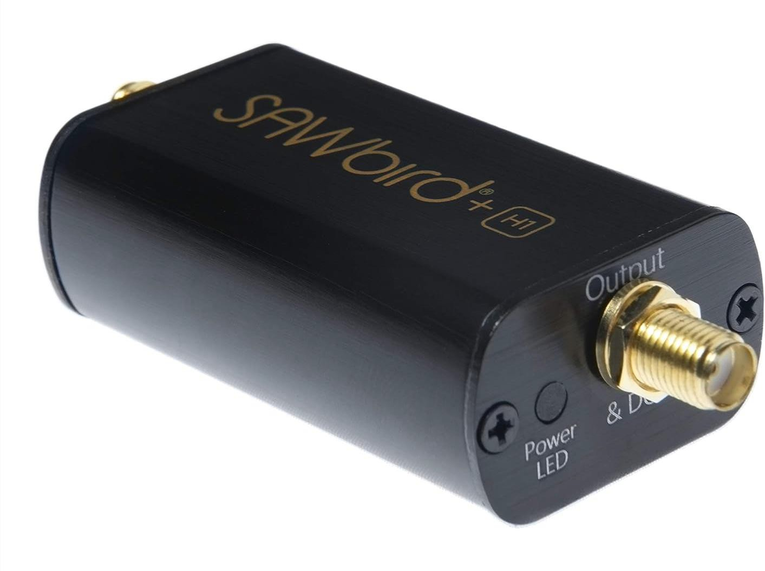








Most use these inexpensive & readily available devices
Nooelec SAWBird H1 LNA

Slide 8
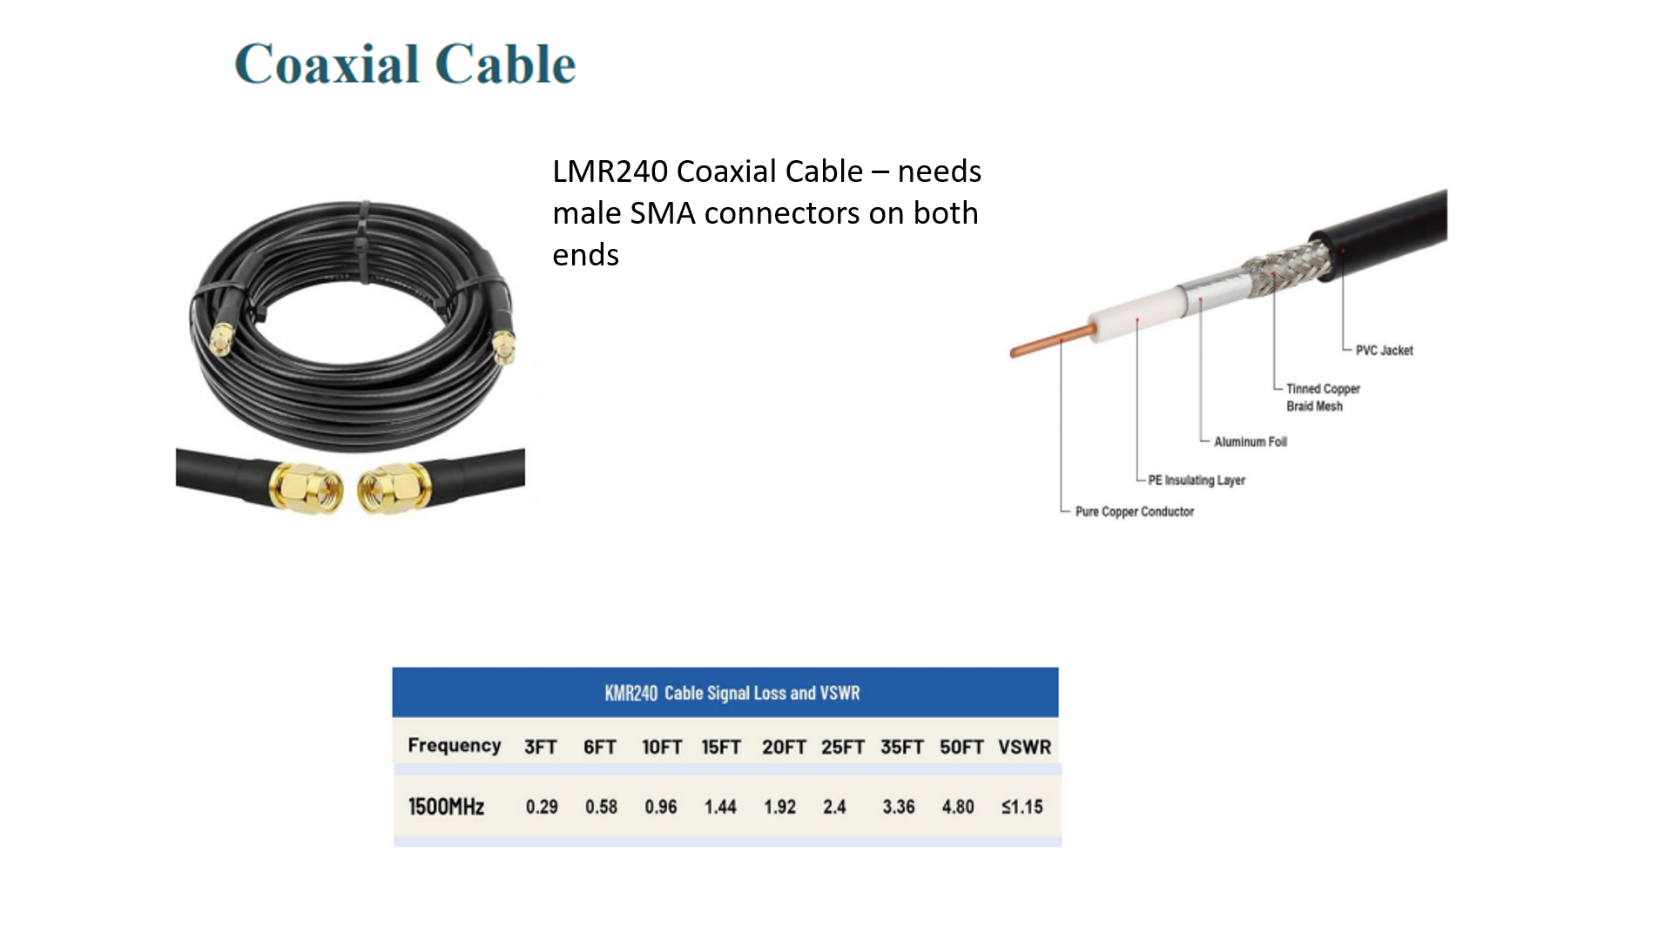

Slide 9
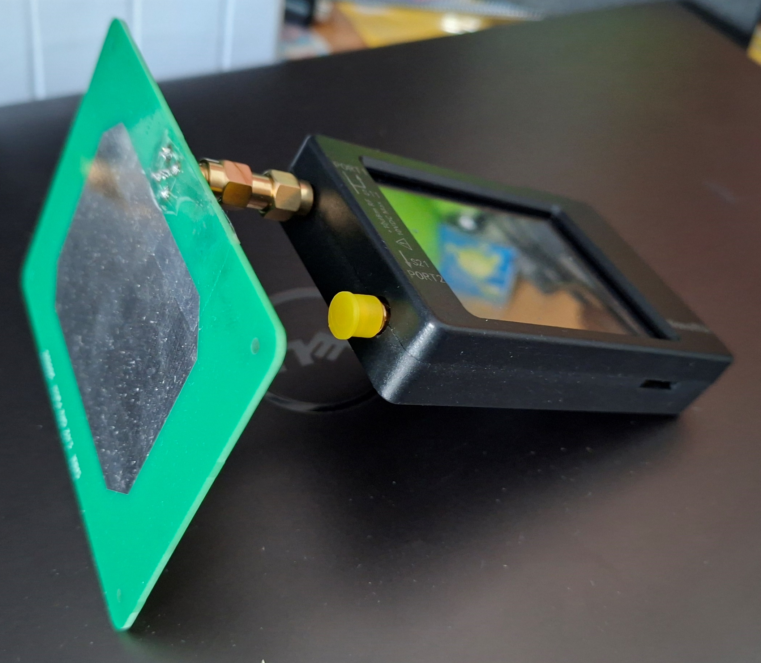
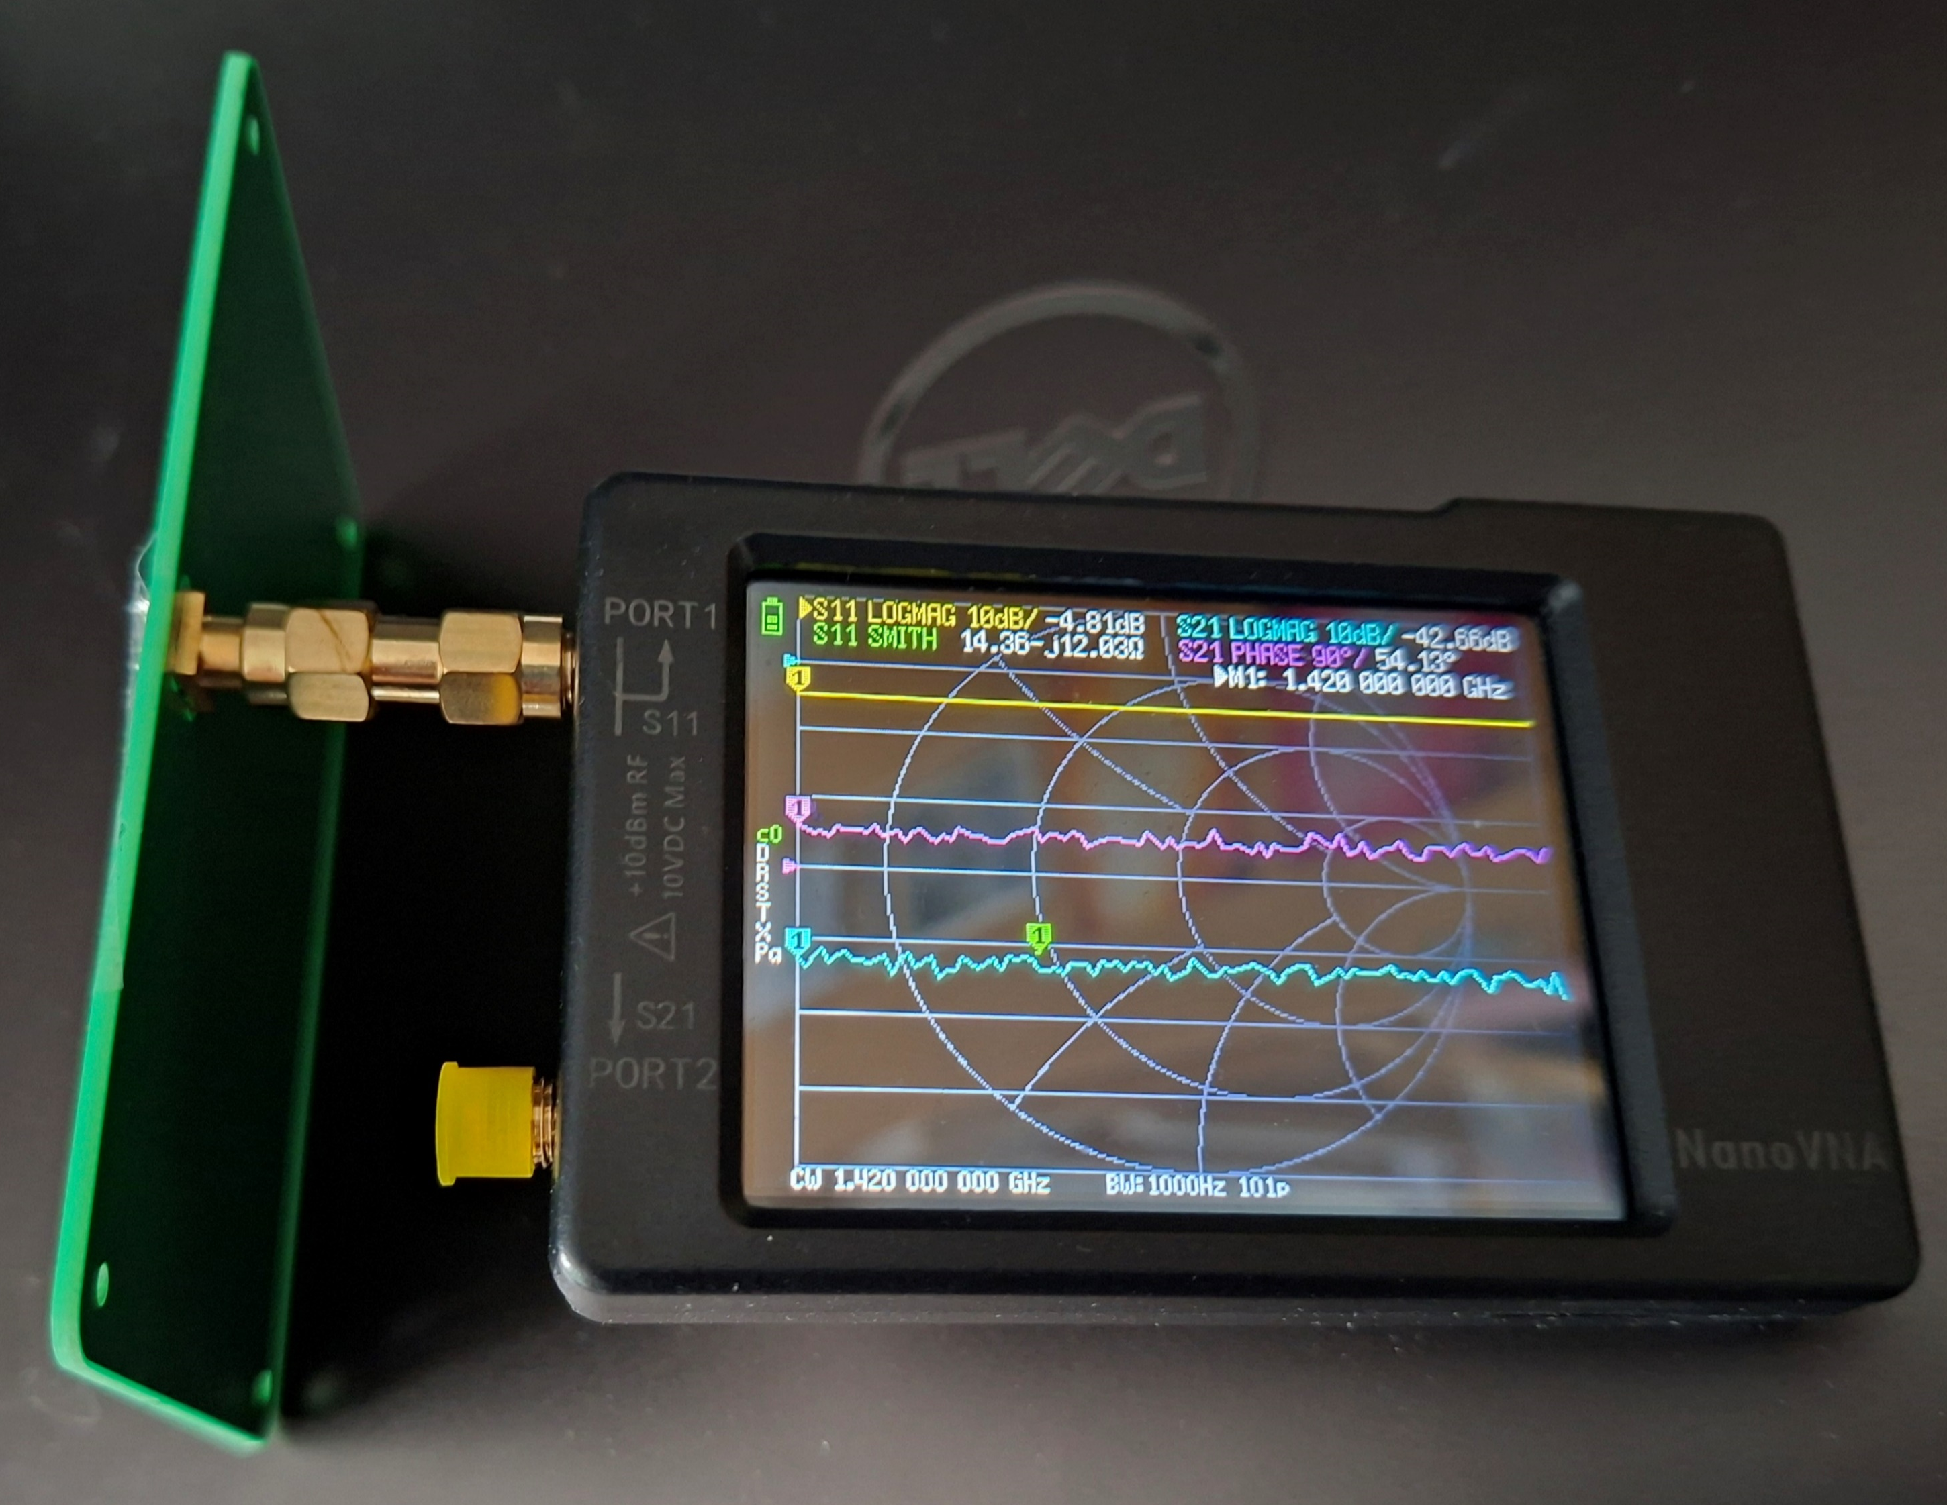
Signal Generator for testing hydrogen line RTs – components include Bob Stricklin’s 1420 MHz antenna and NanoVNA, set to 1420 MHz CW at lowest power level

Slide 10




Software used at LRO for Hydrogen Line

Slide 11
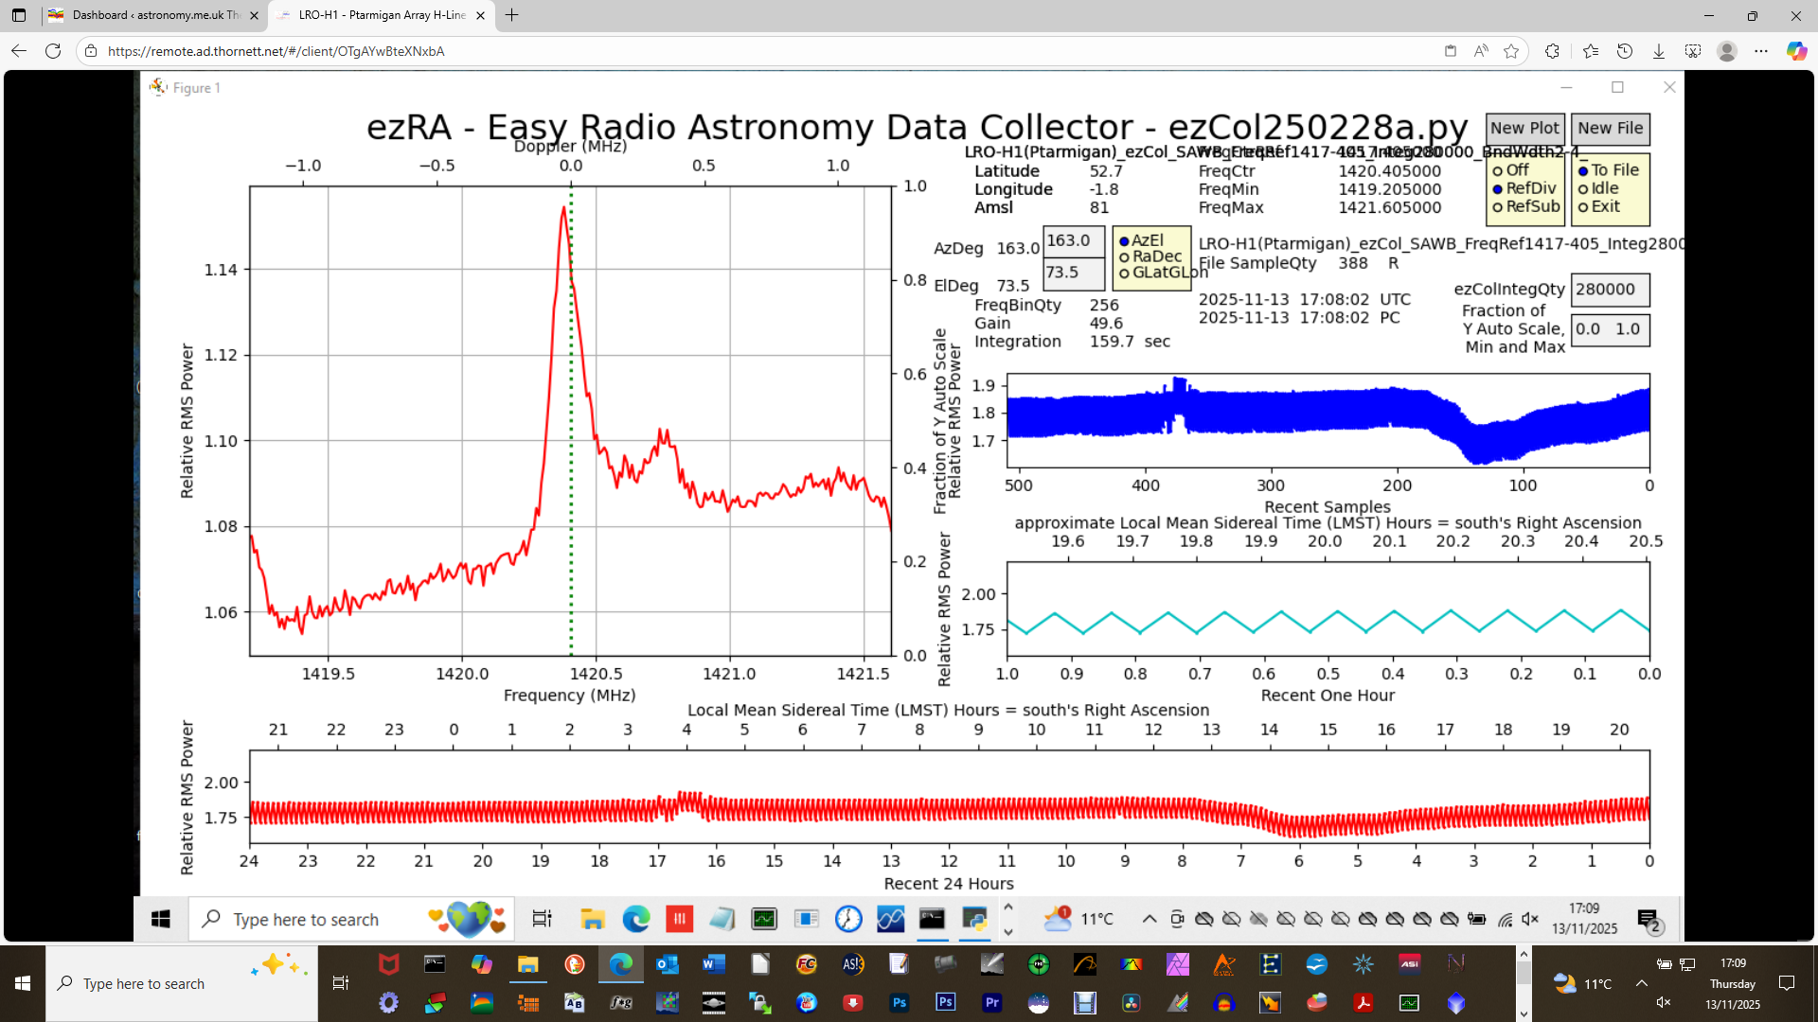

Slide 12
LRO-H1

Slide 13
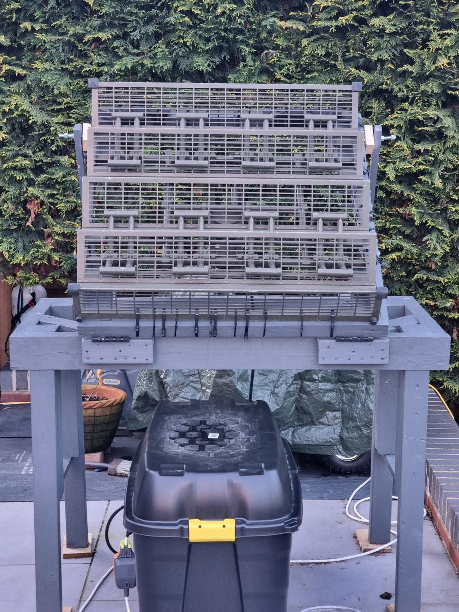
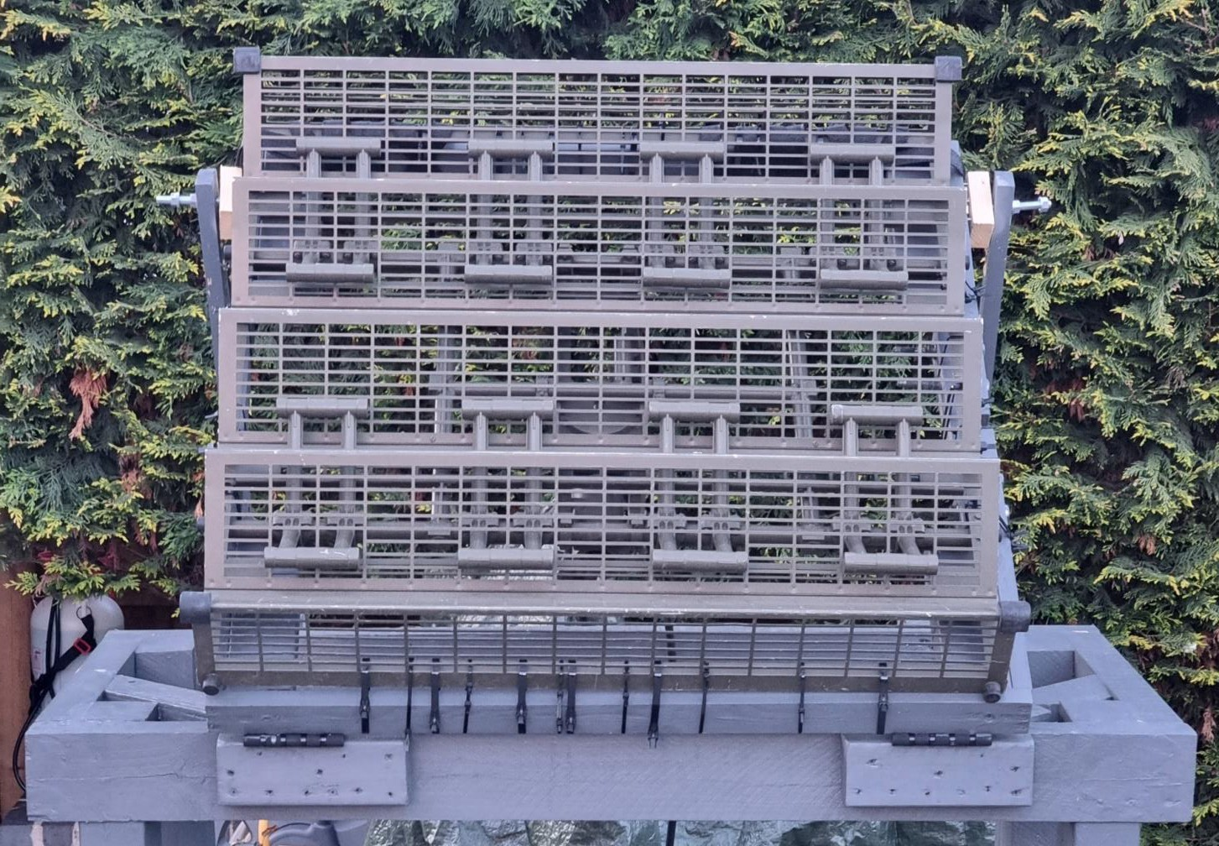
Ptarmigan Triffid Band 3 Ex-Military Dipole Array (UK)
My own aerial
86cm
Homemade simple wooden mount
86cm
Box containing mini-PC, SDR & SAWBird H1 LNA

Slide 14

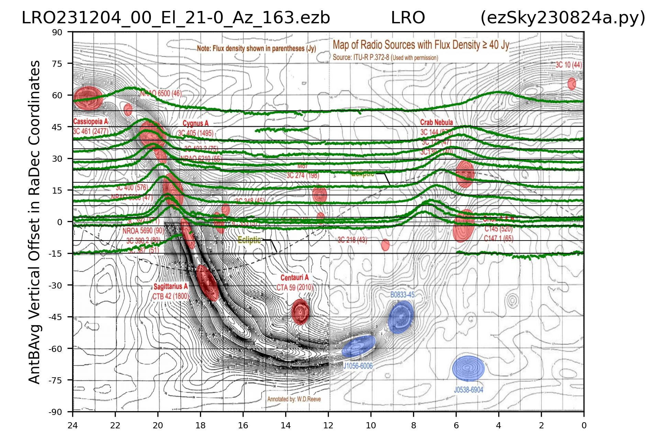










Peaks
Peaks consistent with Milky Way on background map
Each line represents 24-hour drift scan at different elevation

Slide 15

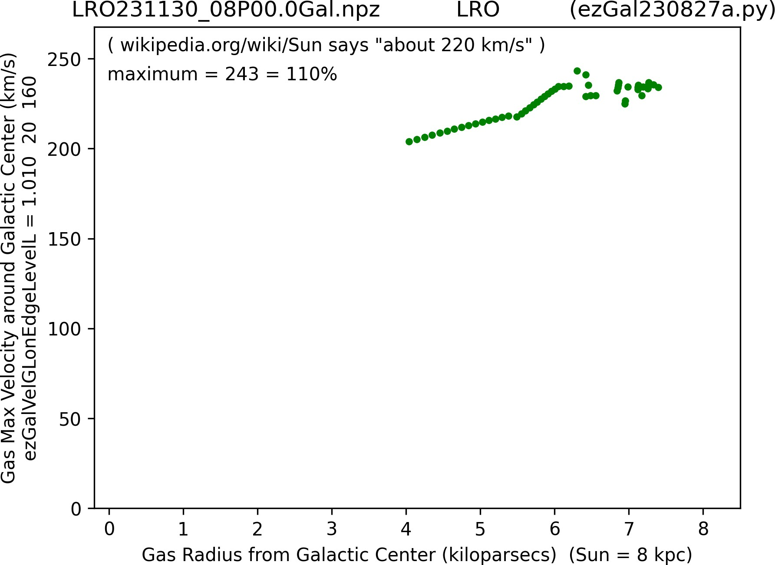
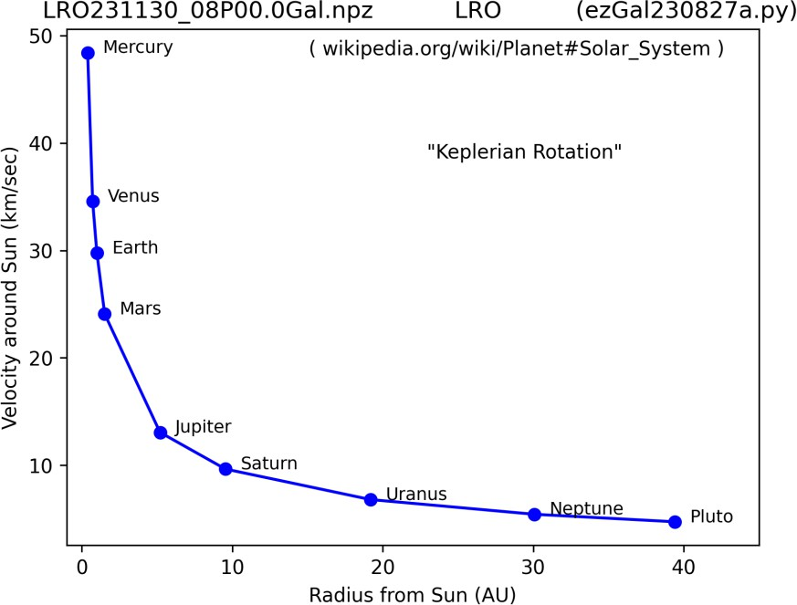
Below is typical Keplarian Rotation Curve which would be expected without dark matter, on right my data (ezRA suite/Pharmigan array)
Green = my corrected Data;
Blue line = line of best fit.
My data does NOT
show Keplerian Rotation. Best explanation = extra
unseen mass in Milky Way galaxy out to at least 8kpc (kiloparsecs).

Slide 16
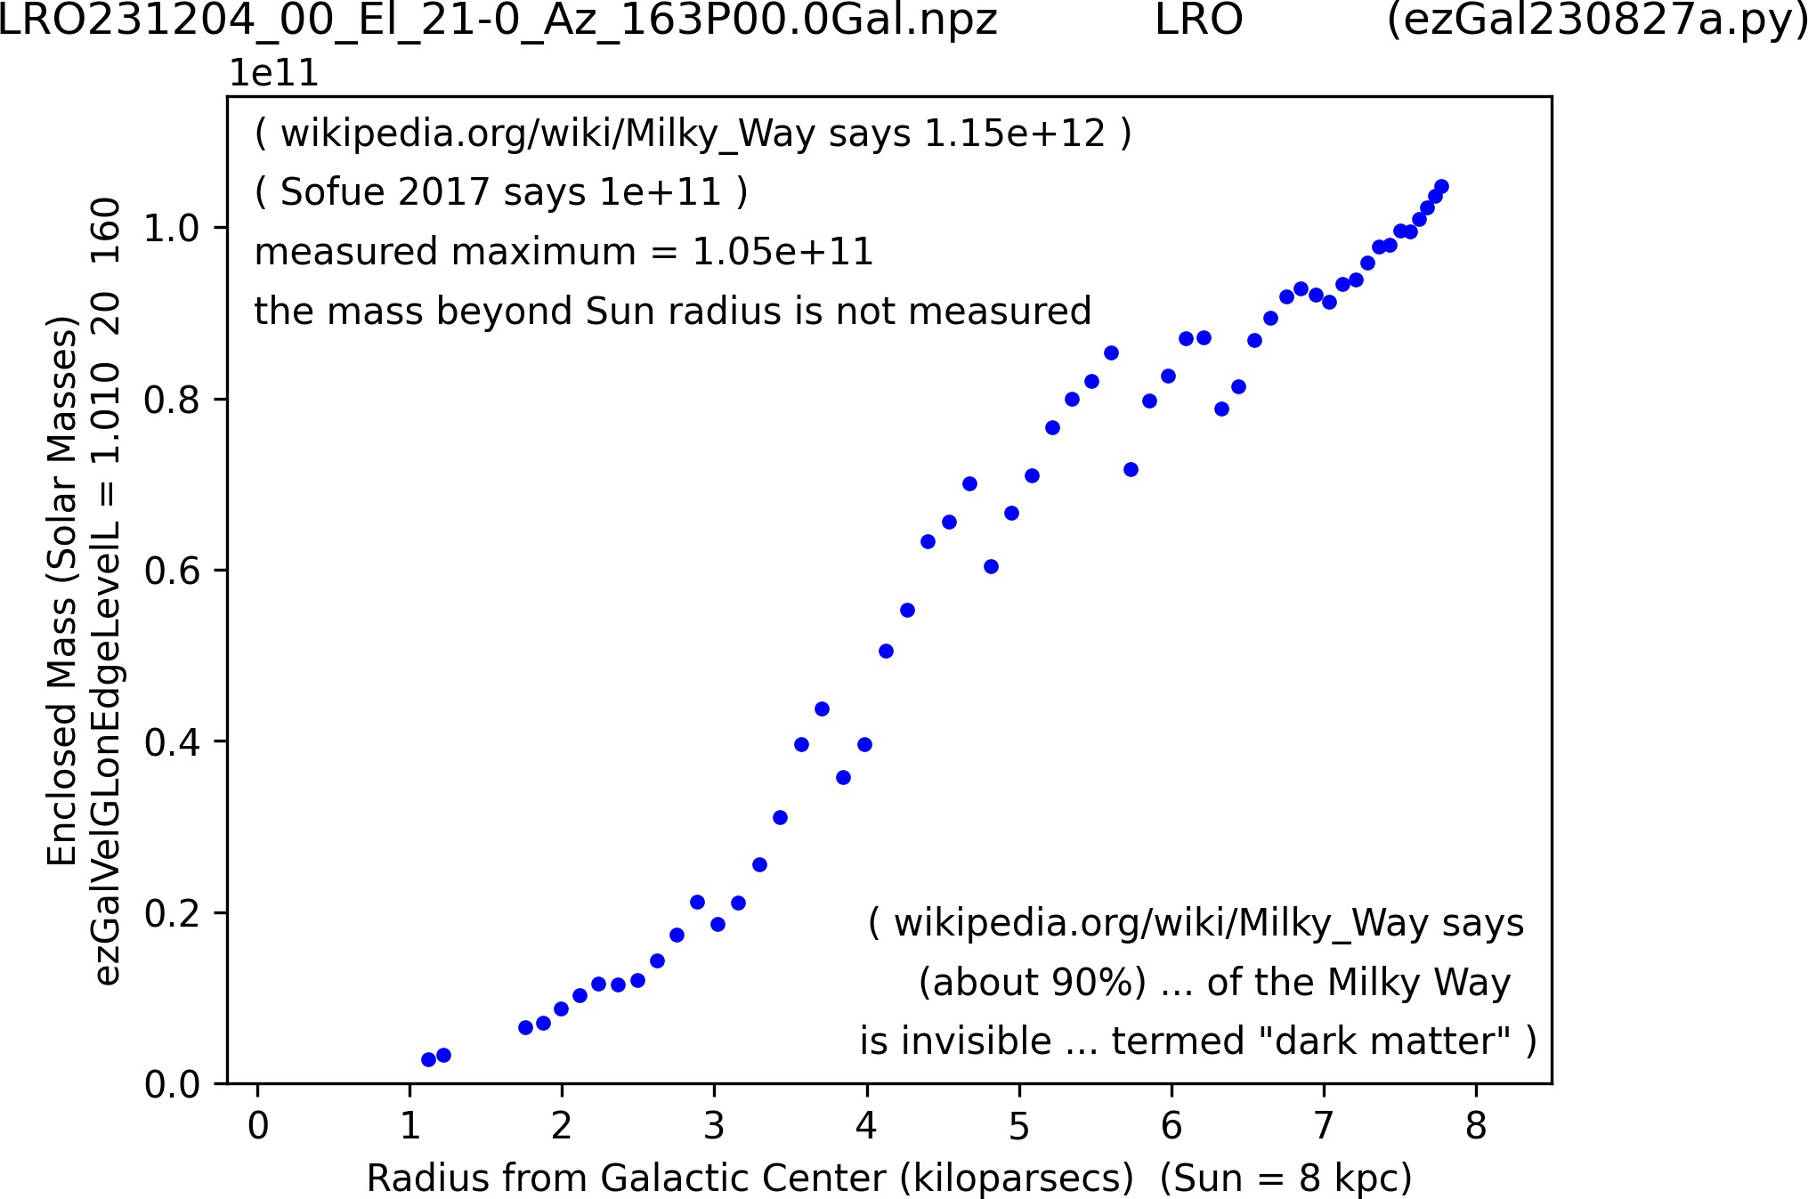











Slide 17
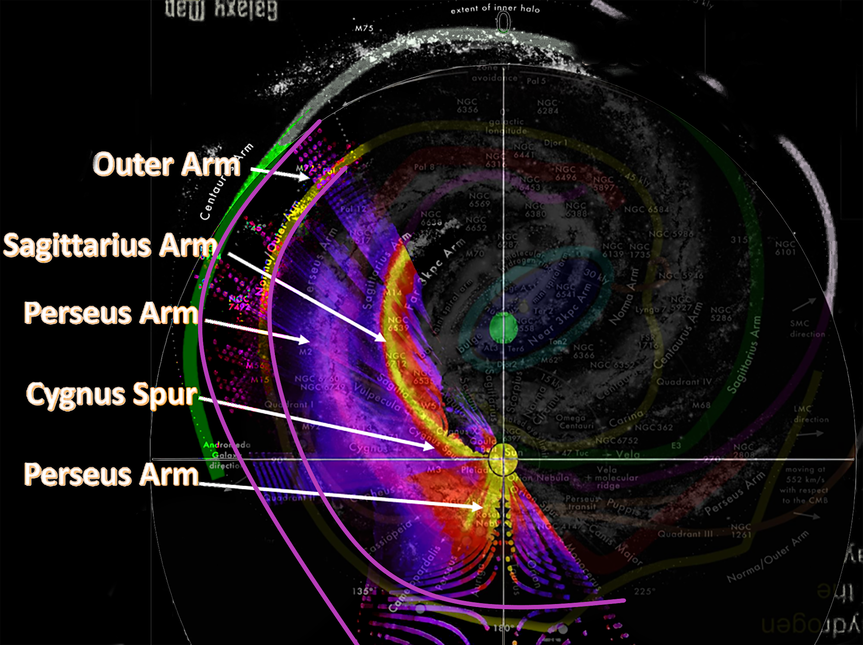
LRO-H1 Milky Way Map

Slide 18
Location of Sun
3D Plotting of Milky Way arms LRO-H1

Slide 19
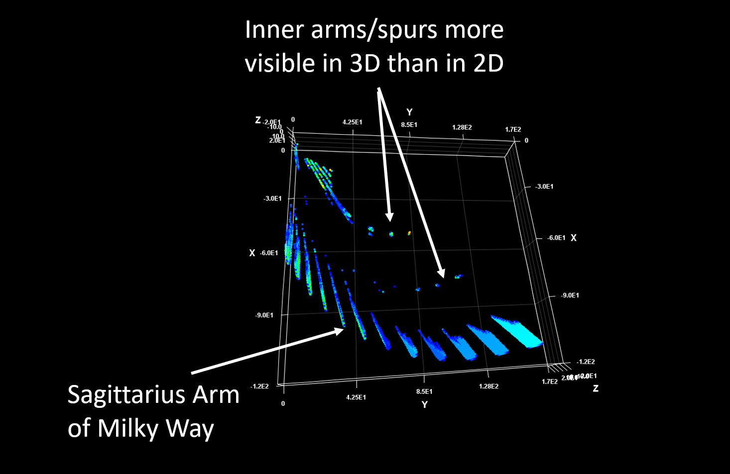

Slide 20
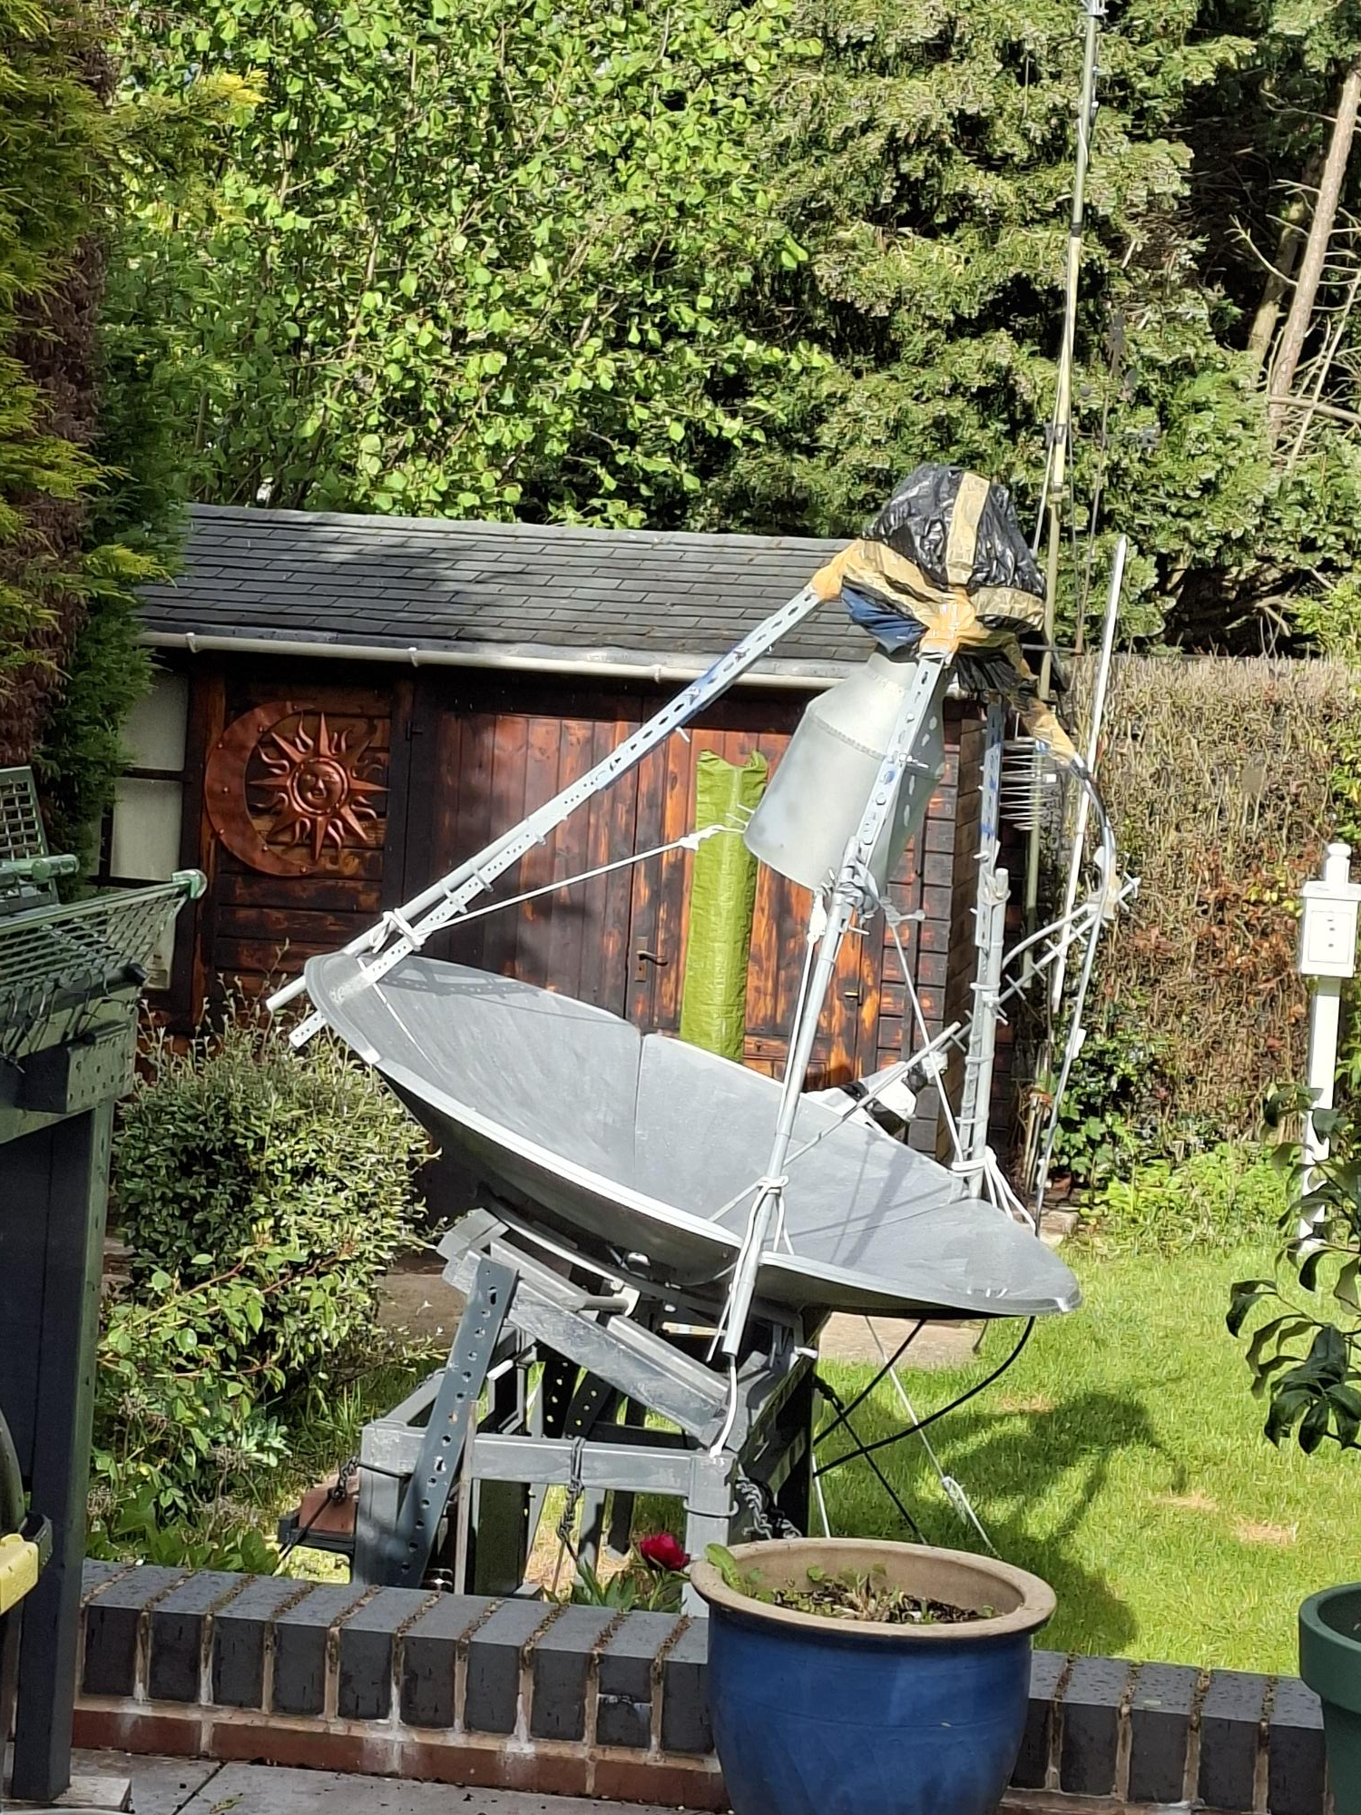
LRO-H2

Slide 21
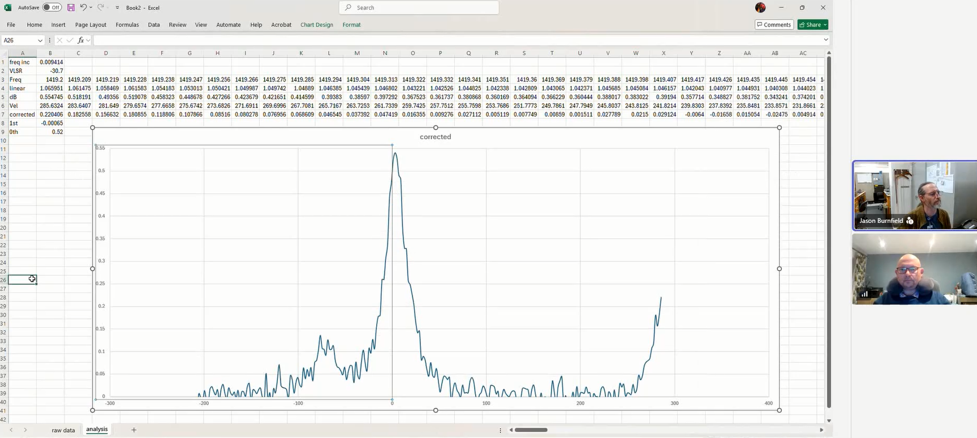
Assessing performance of LRO-H2 - Cygnus
dB
(y-axis)
Frequency Doppler Shift MHz (X-axis)

Slide 22
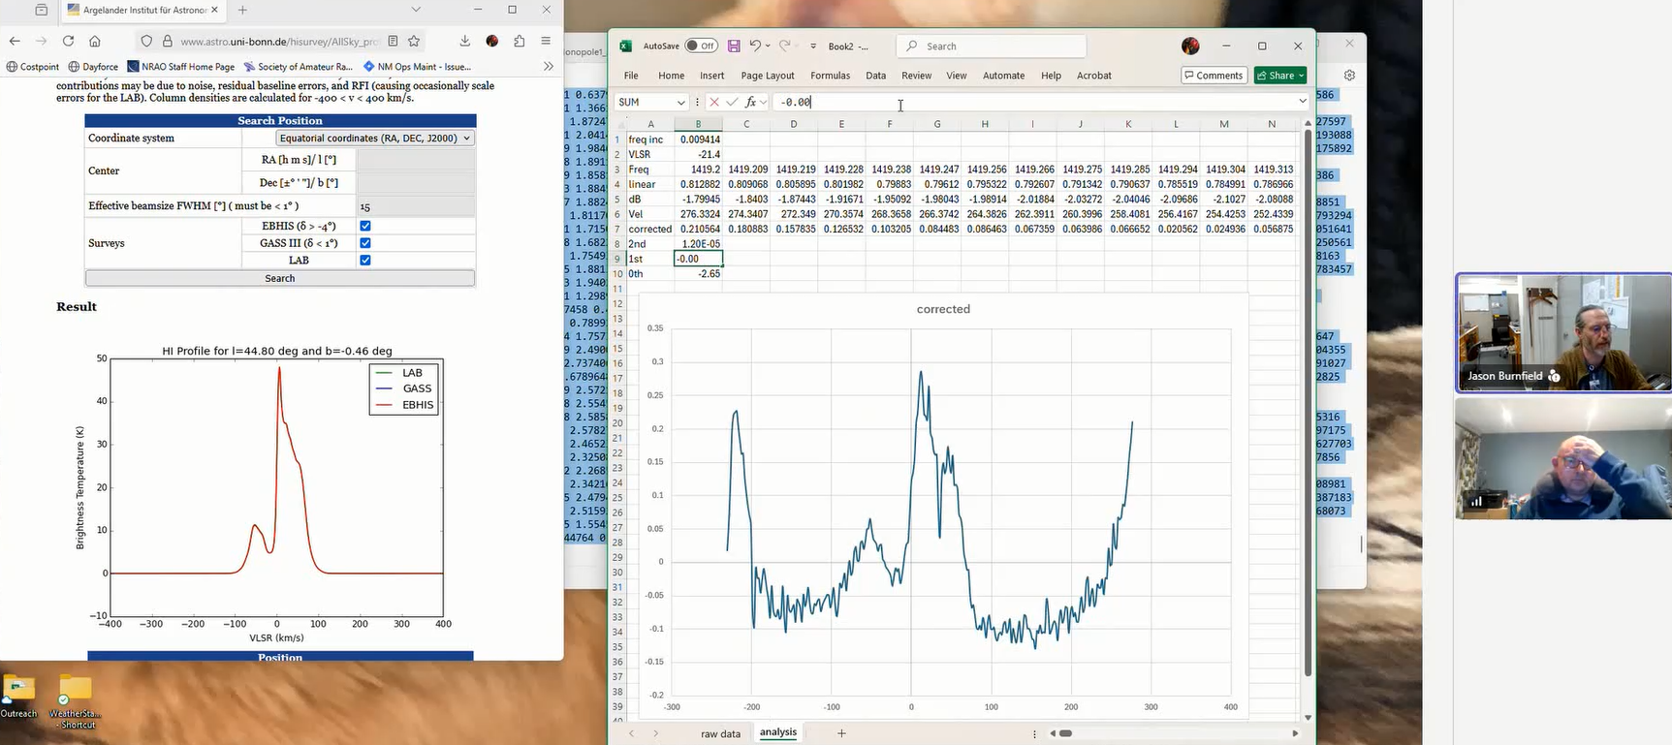
Comparing H-Line Plot at LRO-H2 (right) to LAB Survey (left)

Slide 23
Comment from Jason
Hi Andy,
Back of the napkin calculations put you at around 0.63 dB above background for the first and about 0.54 dB for the second. That’s about half what I would expect (and consistent with your earlier results).
Cheers!

Slide 24
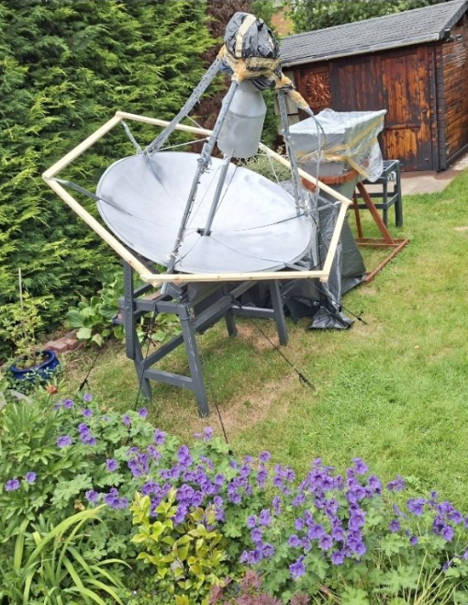
Framework designed to support aluminium window netting to reduce ground noise.
However, as soon as I added the wood, seemed to have introduced visible flexor to dish as its angle was changed.
Potentially could be detrimental to function of dish at 1420 MHz.
Such flexure might explain why this dish has not been performing as expected – I was advised that it might be due to ground noise but now I wonder…
Attempting to reduce ground noise on LRO-H2

Slide 25
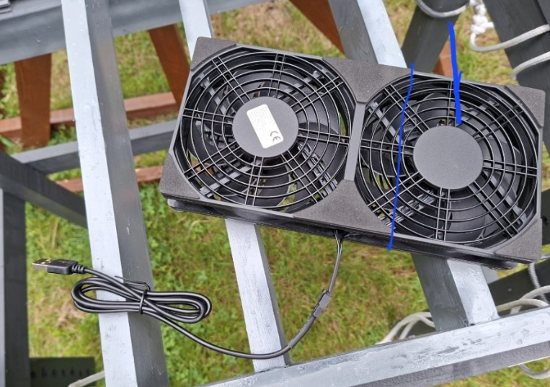
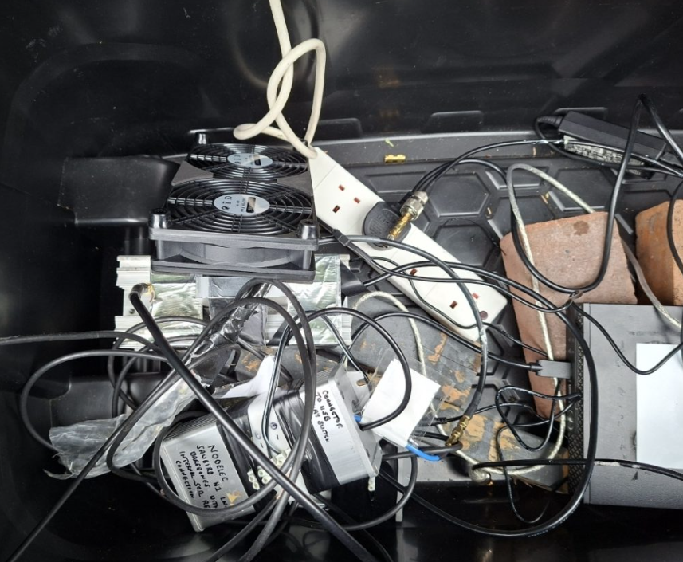
Cooling SDR on LRO-H2
USB-powered cooling fans
NESDR attached to large aluminium heatsink
HIB-enabled relay switch to switch in and out 50 ohm dummy load on SAWBird H1 Barebones

Slide 26
LRO-H4

Slide 27
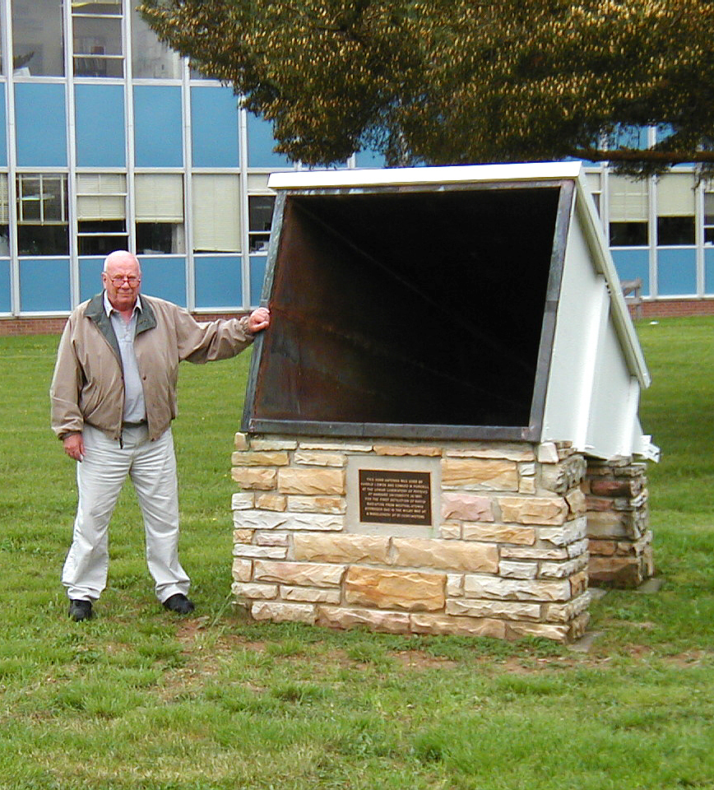
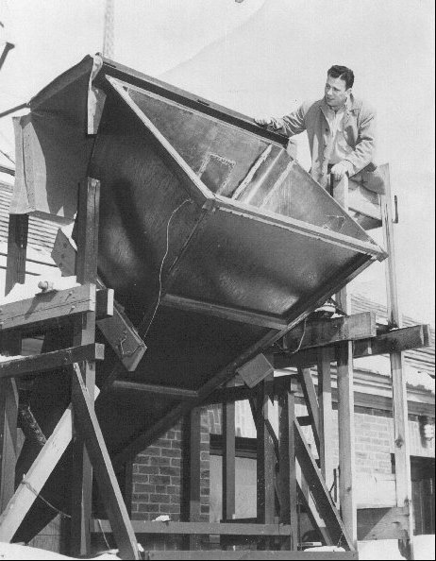
Harvard University graduate student Harold I. "Doc" Ewen built horn antenna left.
Designed to first measure 1420 MHz hyperfine transition line of interstellar hydrogen
Its physical dimensions were constrained by size of parapet in Harvard's Lyman laboratory where his receiver apparatus was installed.
Horn now displayed at Green Bank Observatory, where we are today.

Slide 28
SETI Horn of Plenty based on scaled version of Ewen’s hydrogen horn
Ewen's horn had gain just under +24 dBi, with nearly symmetrical pattern producing half-power beamwidth ca. 10 degrees in both e-field & h-field.
Its size too big for amateur use = 10 feet long.
SETI opted for 4 feet long & 3 feet wide, based on available materials.
They chose 26-gauge galvanized sheet steel which was at the time readily available in 3-foot x 4-foot sections, at under $10 per sheet from a local fabricator of heating, ventilation and air-conditioning ductwork.)
Scaled all remaining dimensions to the horn width and length above, and retained same L-band waveguide dimensions used by Ewen.
Gain is 3 to 4 dB below Ewen horn, with symmetrical beamwidths of 16 degrees in both planes.

Slide 29
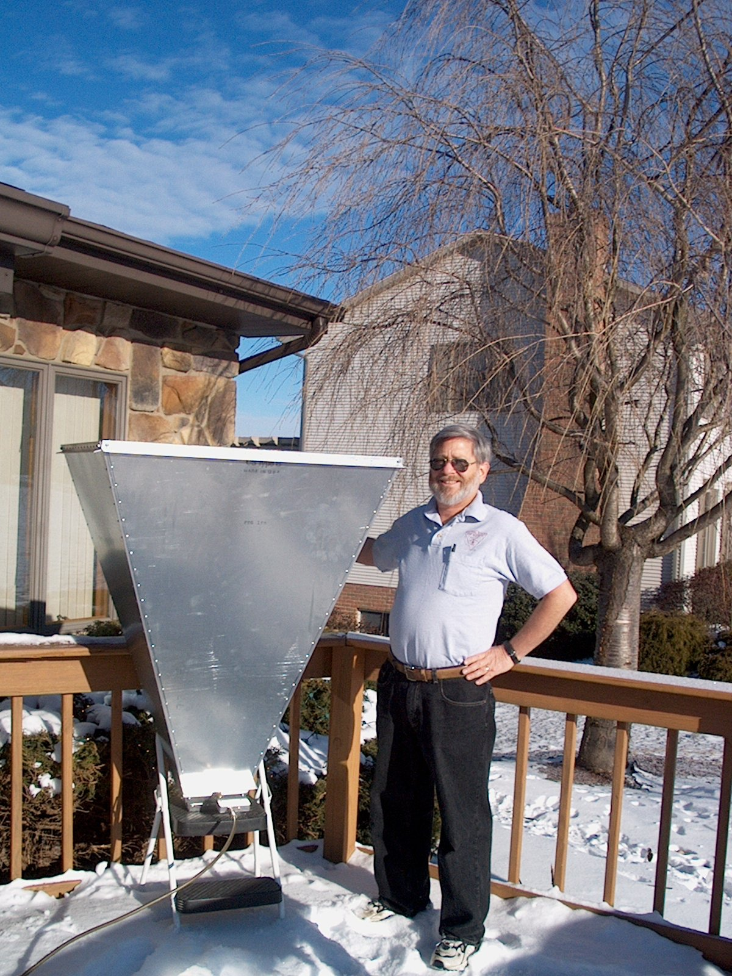
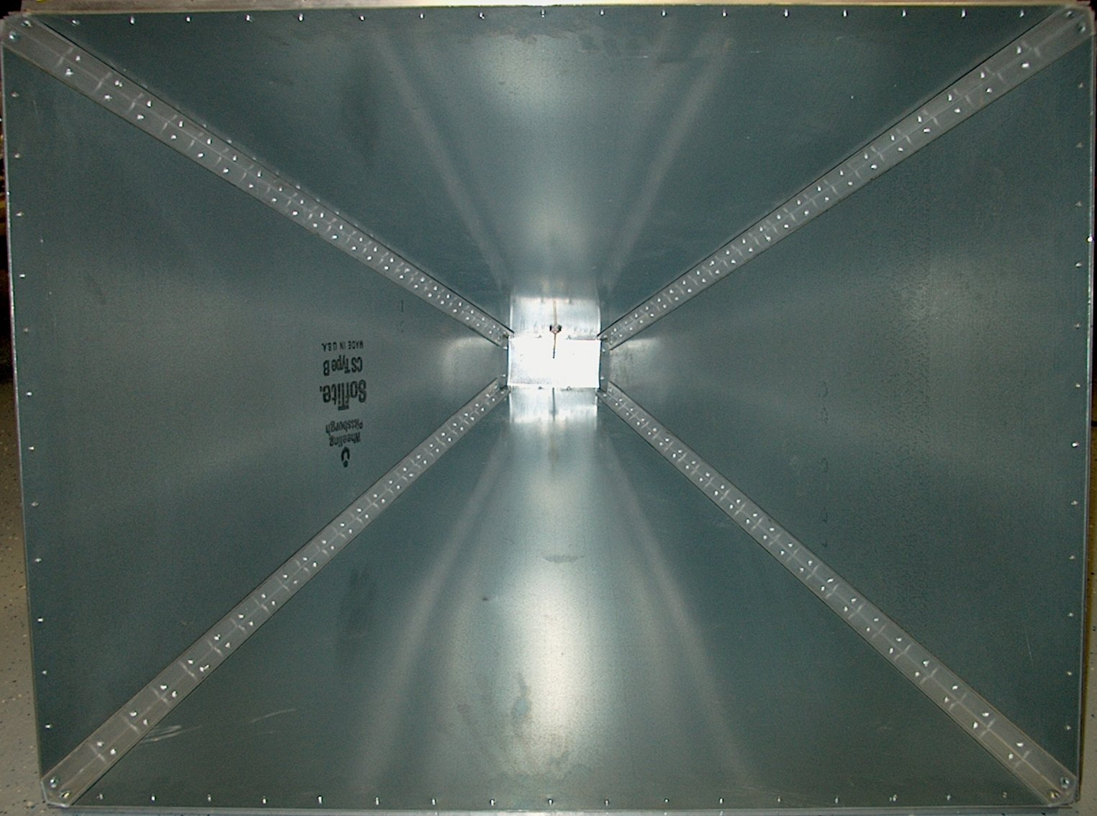
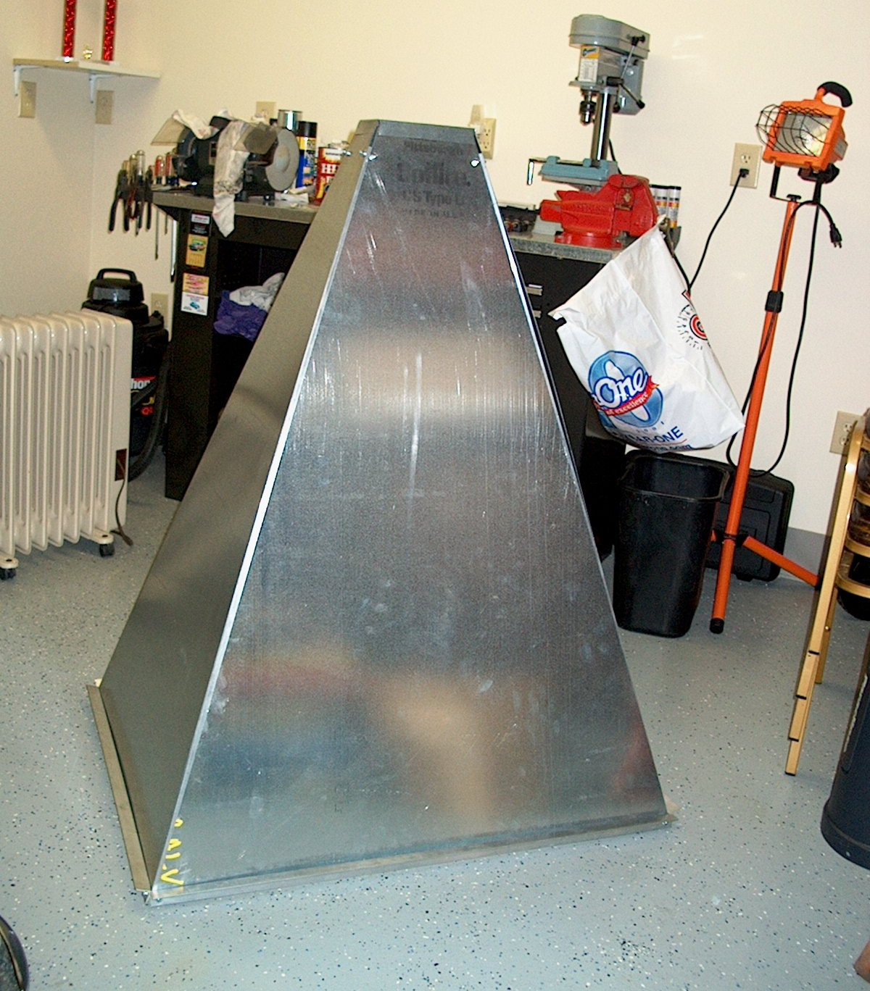
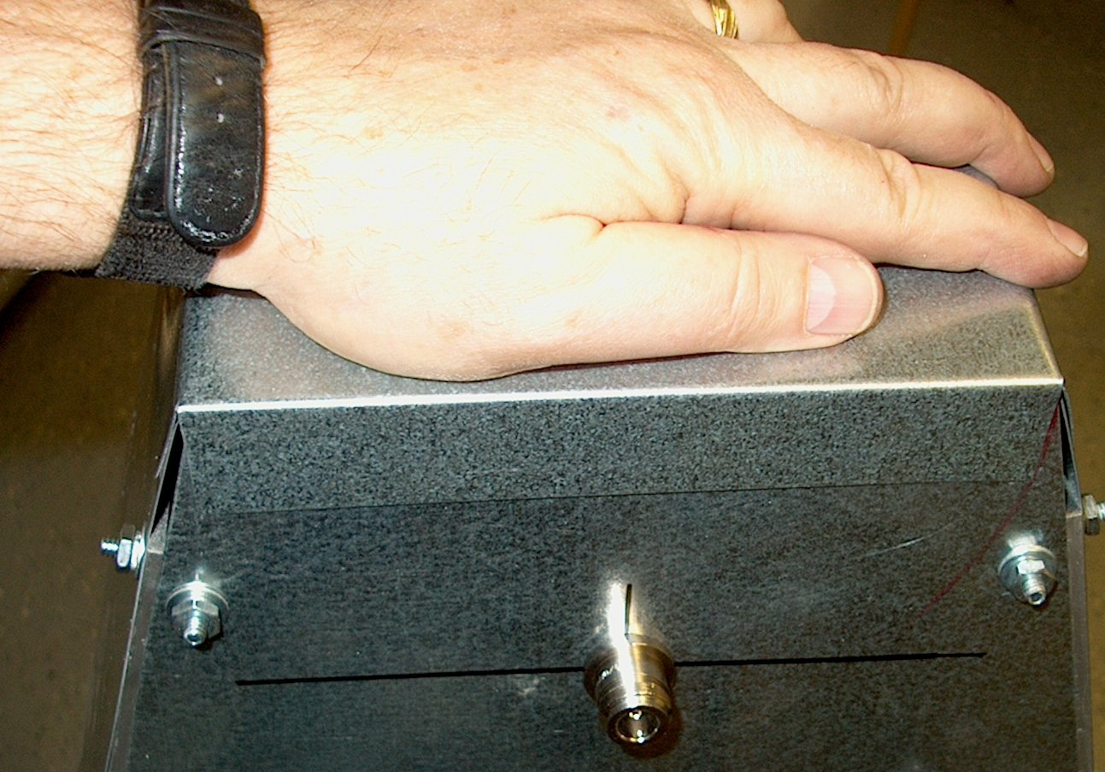
Original prototype of SETI Horn of Plenty

Slide 30
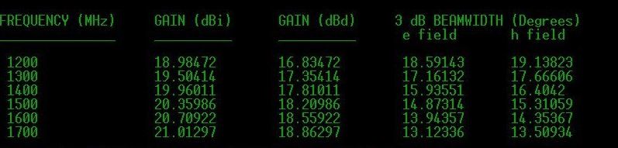
Theoretically predicted gains of SETI Horn of Plenty (from SETI League website)

Slide 31
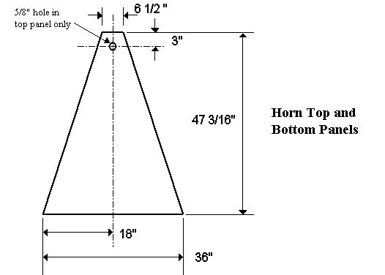
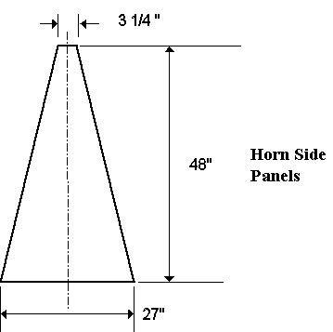
Dimensions of SETI League Horn of Plenty

Slide 32
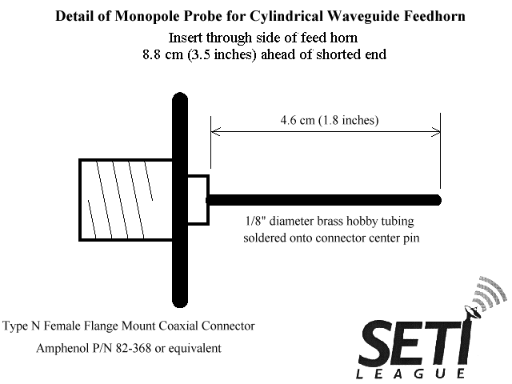
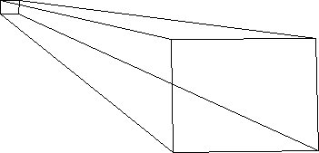
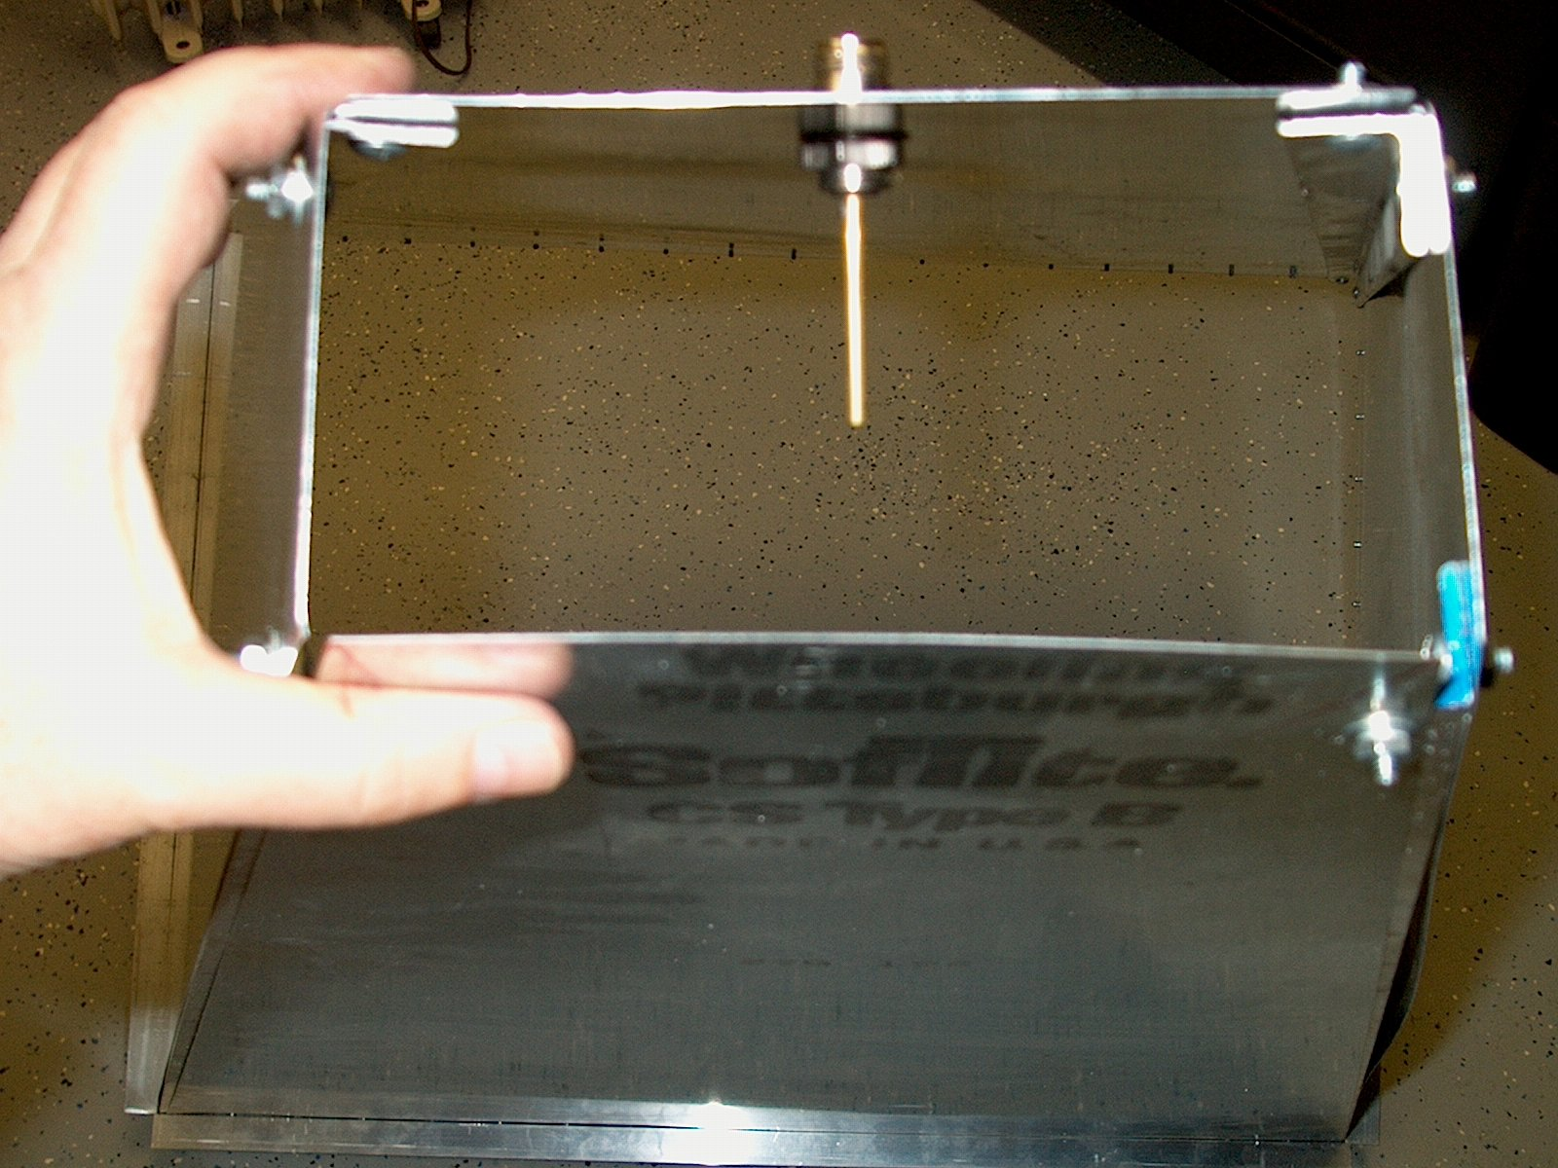

Slide 33
Performance of SETI Horn of Plenty (from SETI website)
SETI Horn 3-4 dB gain deficit compared to original Ewen horn
BUT offset by >10dB improvement from modern receivers
SETI Horn gain similar to 1m dish.
Horn design may even provide greater signal to noise ratio than expected from gain figures alone, due to:
  excellent broadband impedance match
  inherent lack of overspill
  low sidelobes
  ➔ ground noise pickup will be significantly less than that of alternative antennas

Slide 34
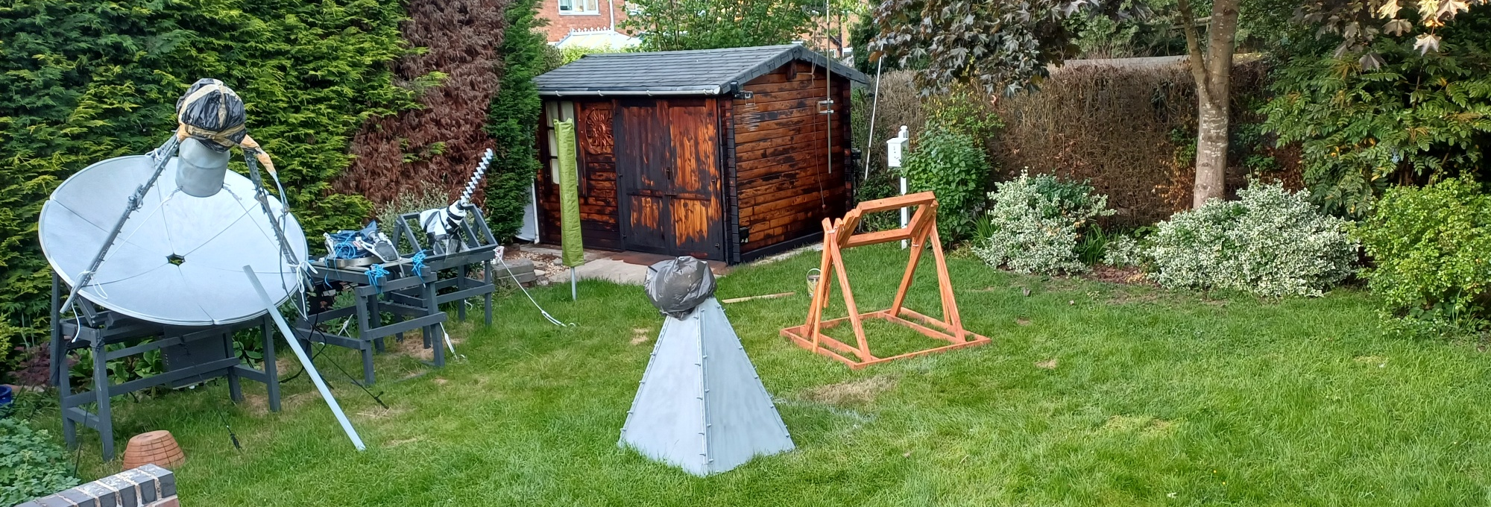
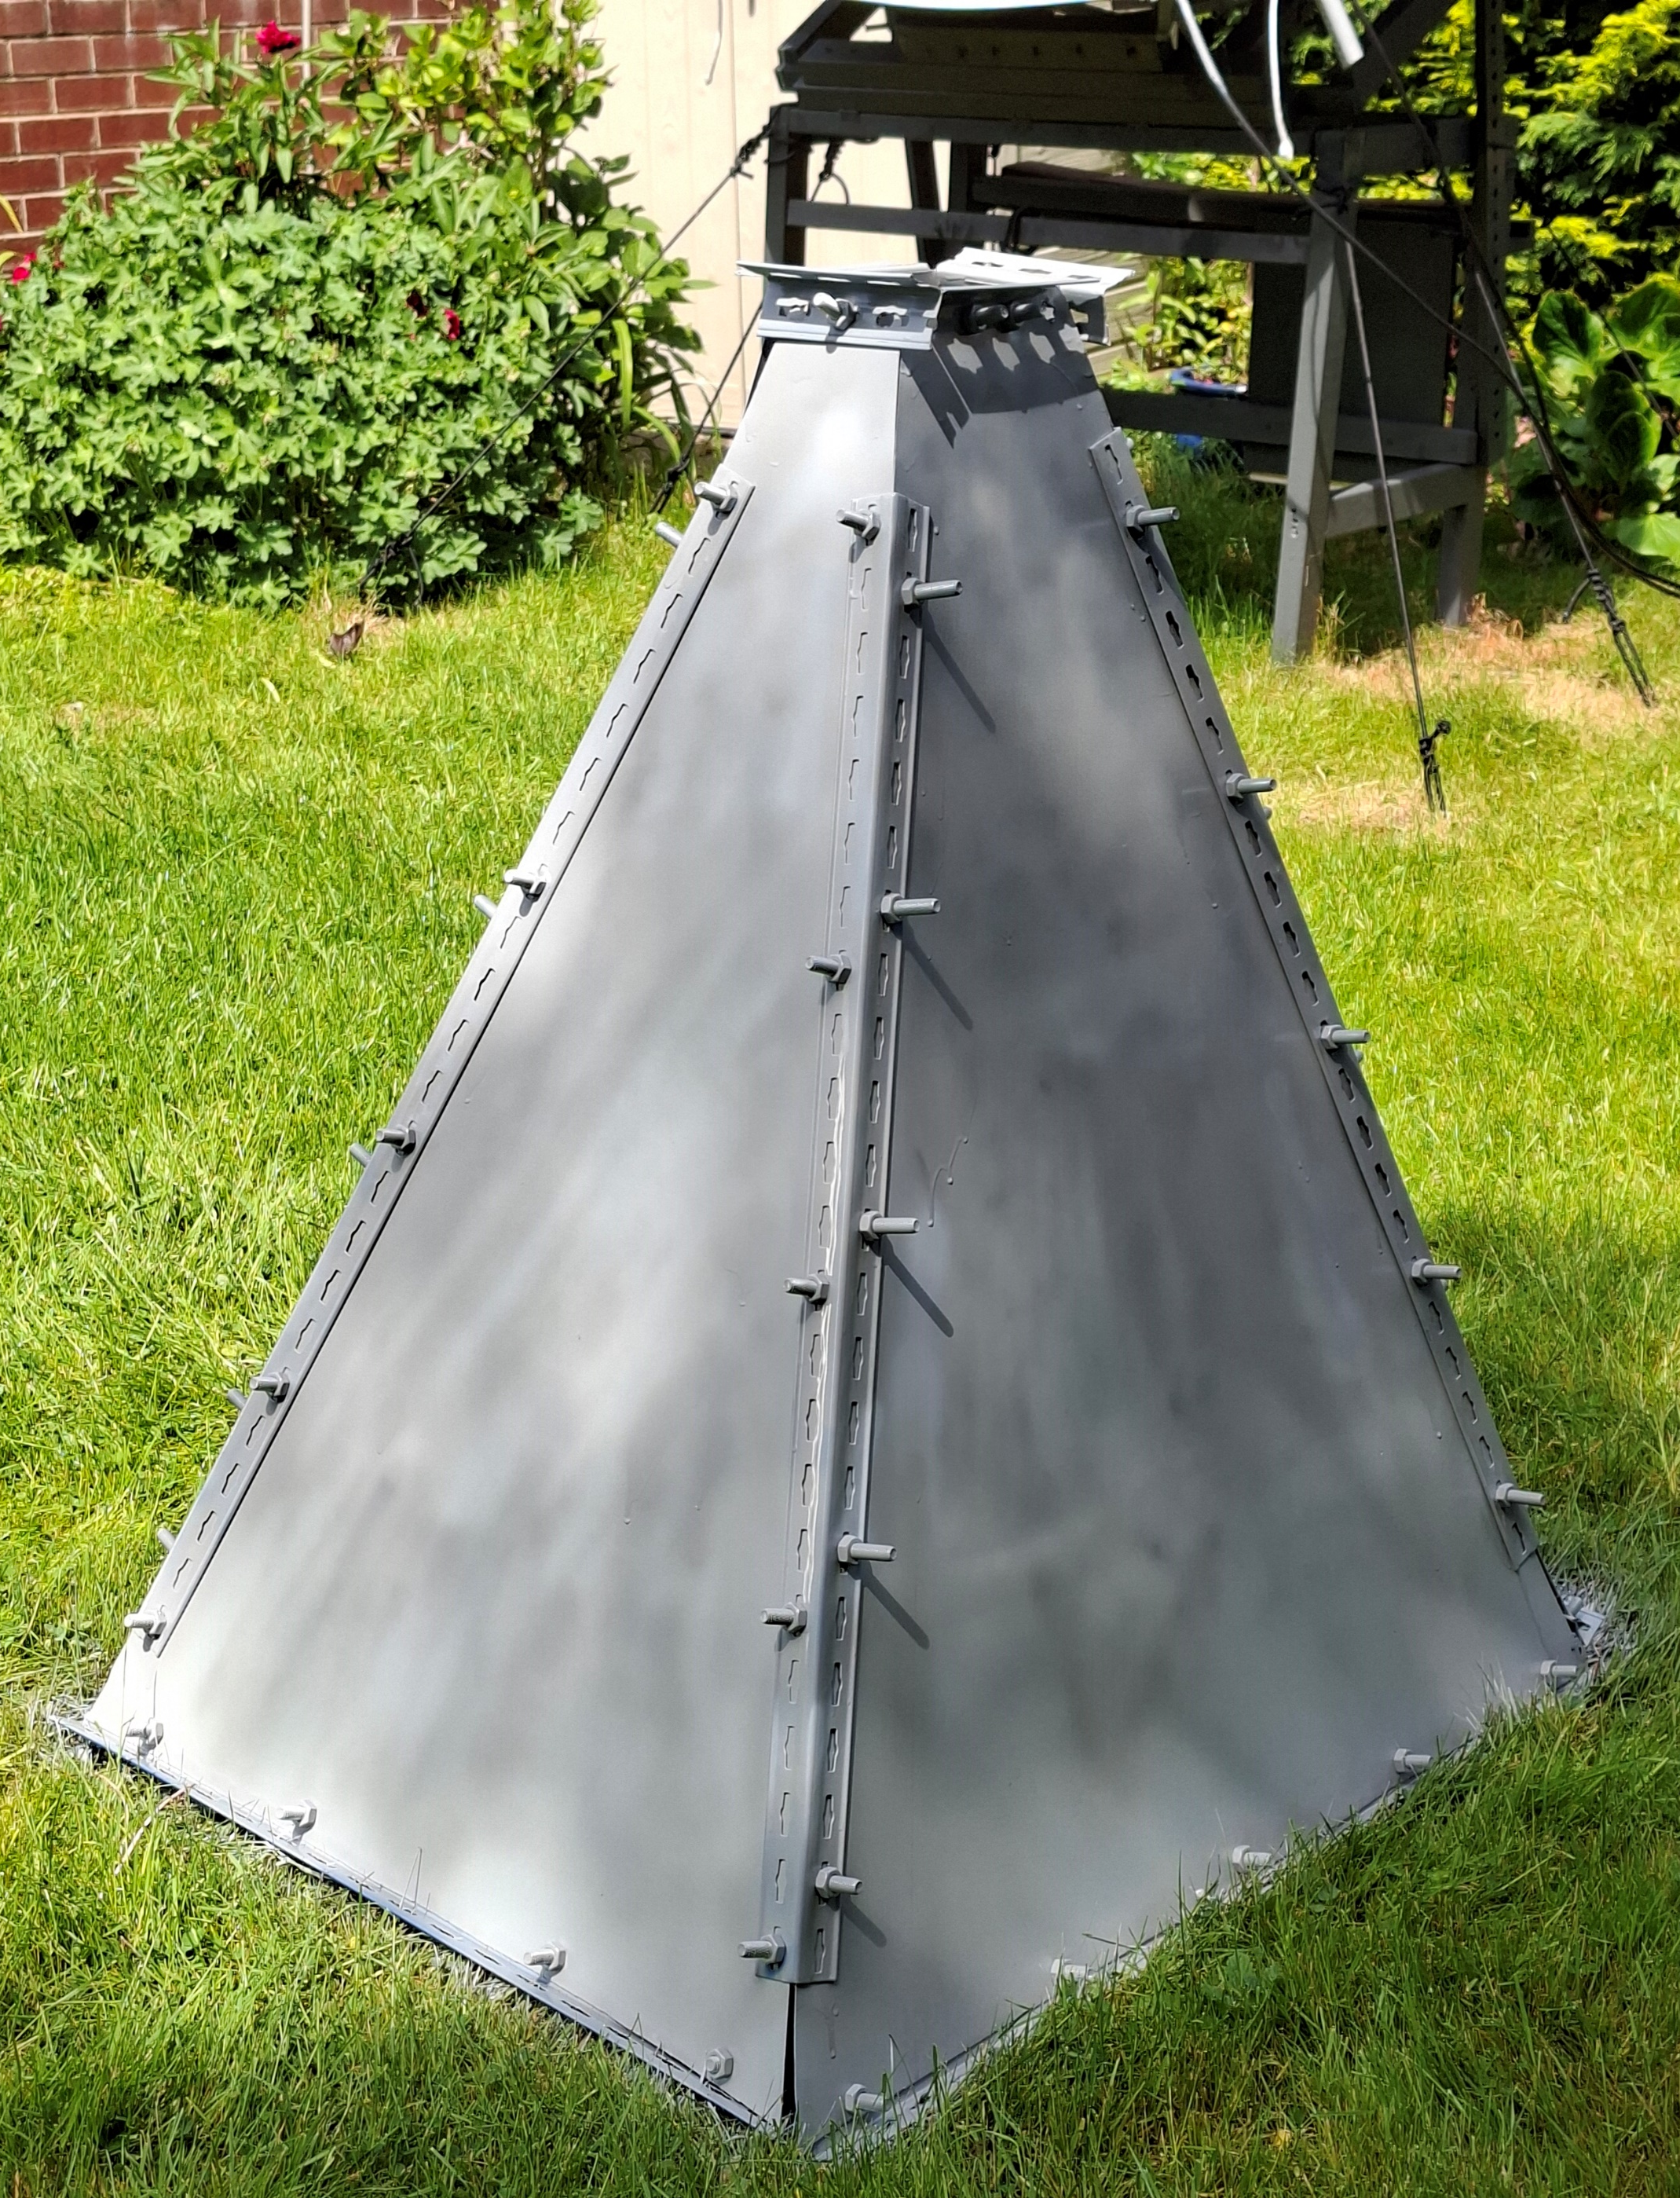
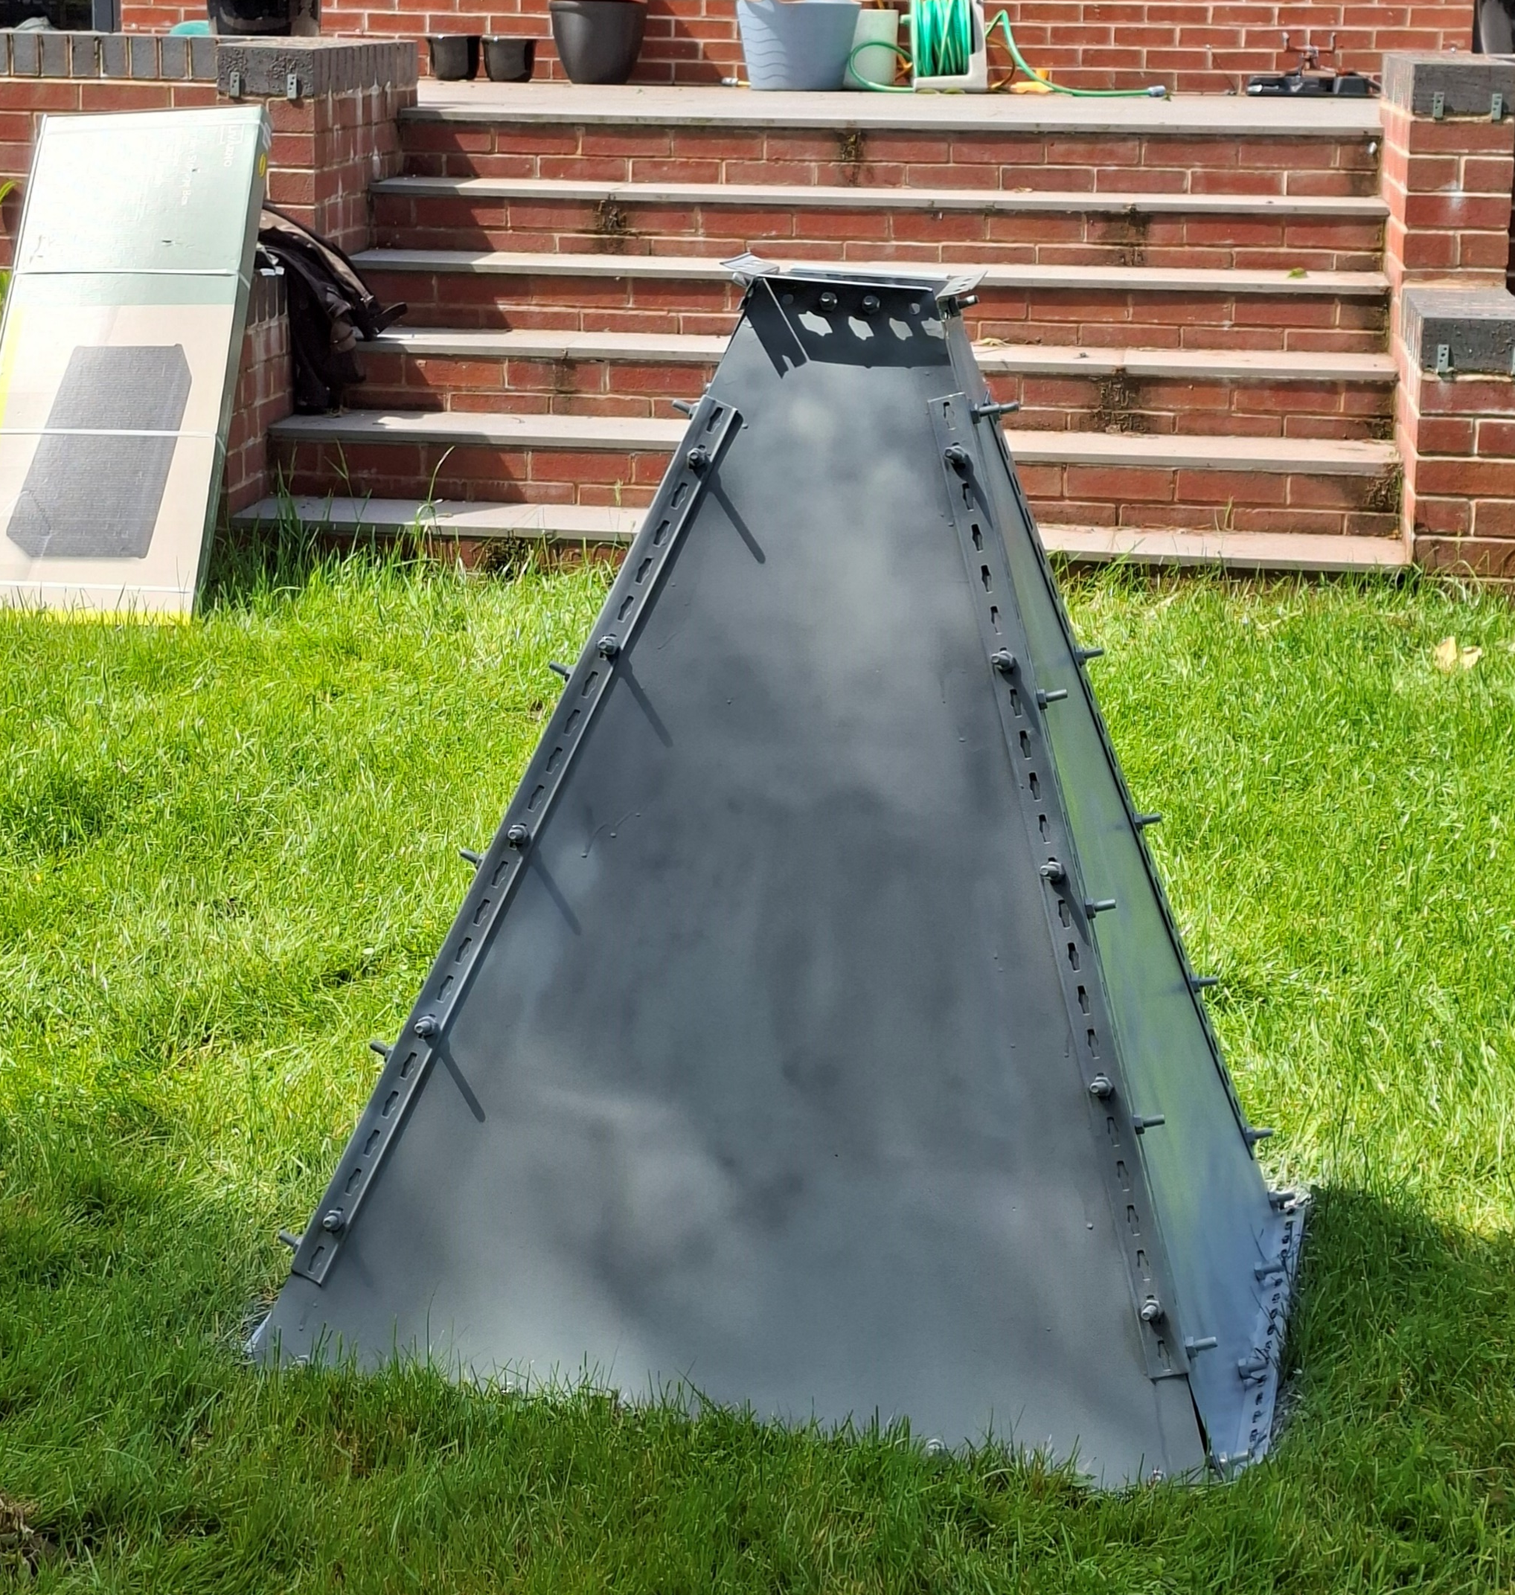
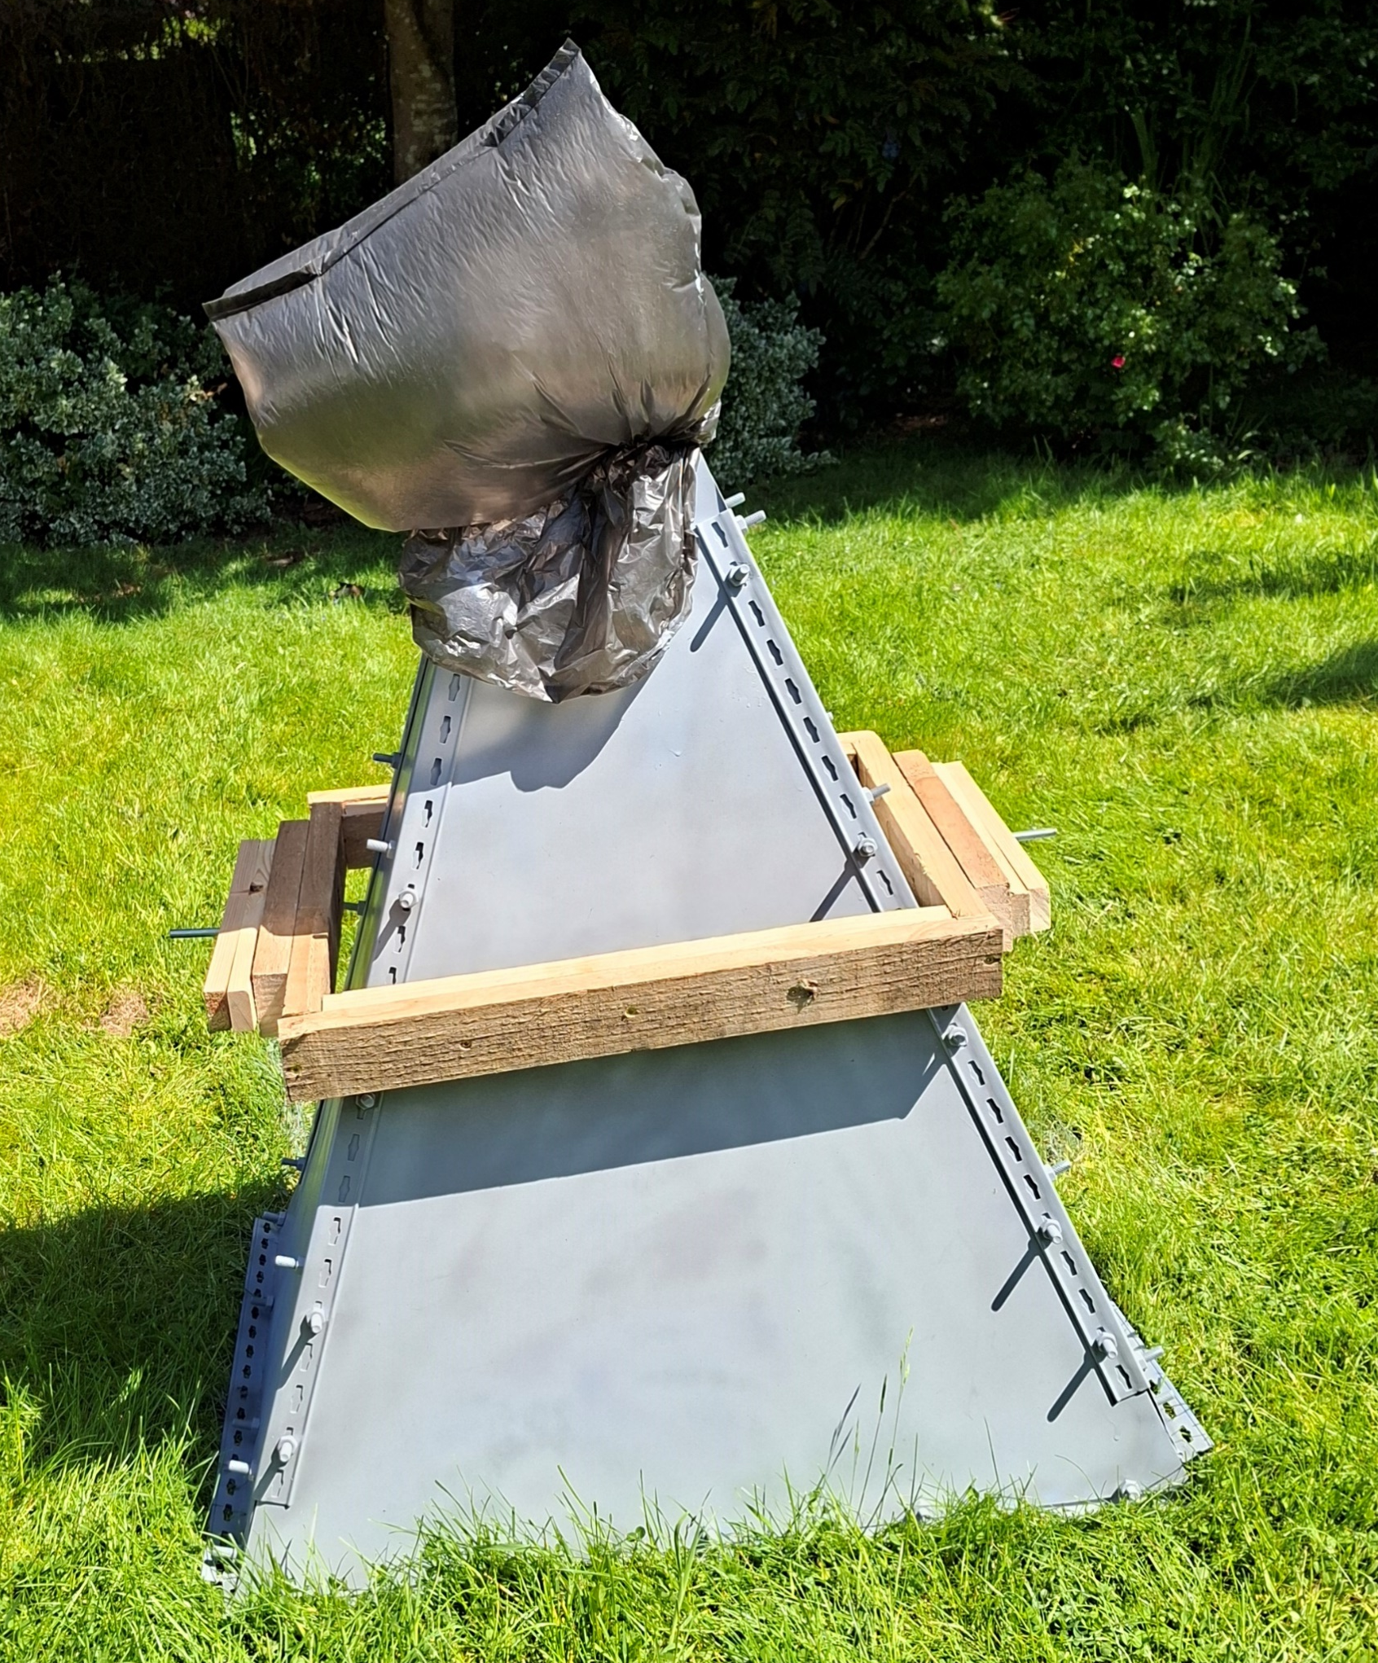
Building the LRO Horn of Plenty

Slide 35
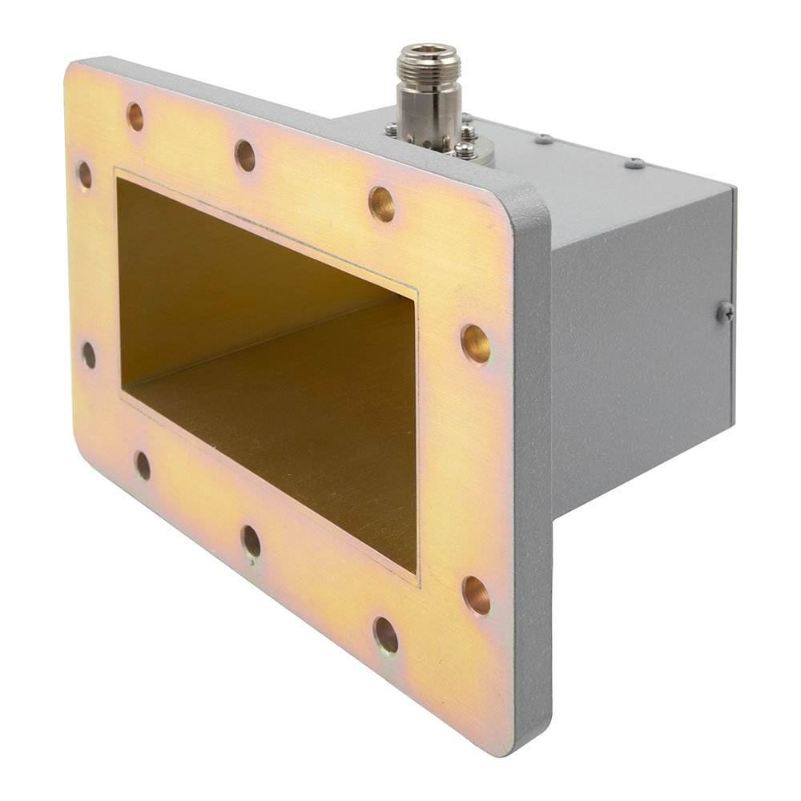
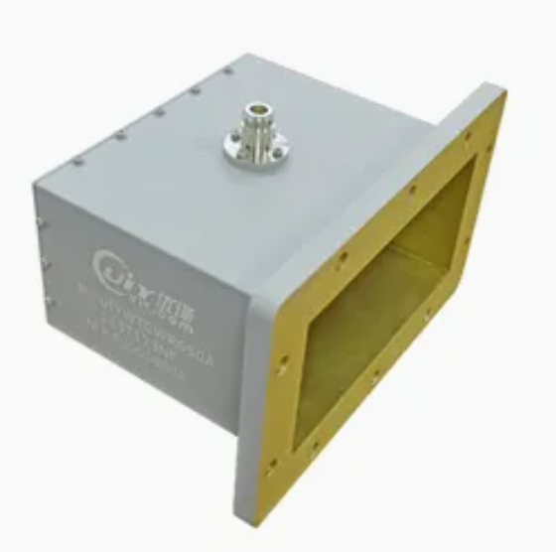
WR-650 Waveguide used on LRO horn.

Slide 36
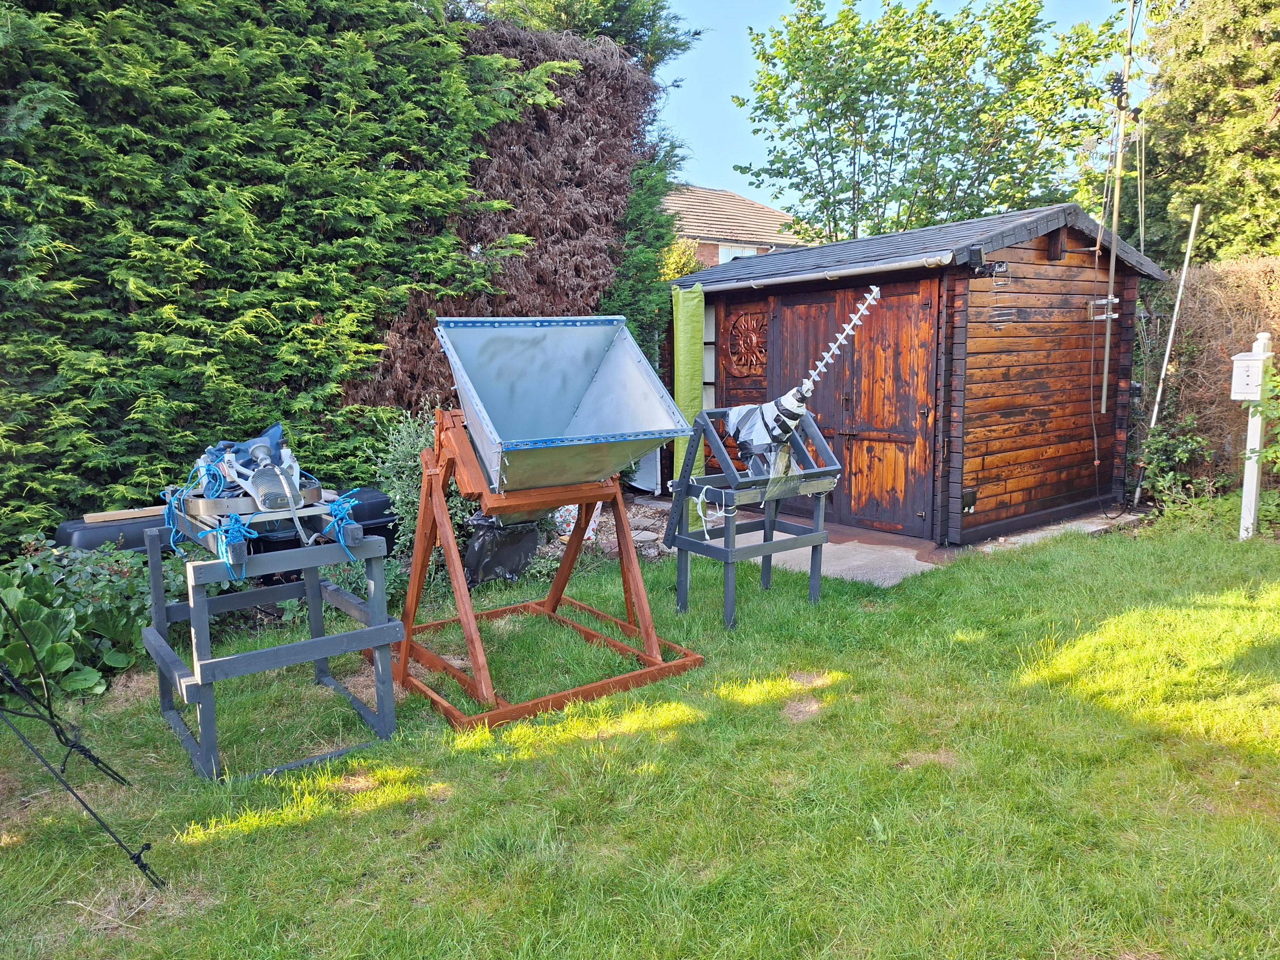
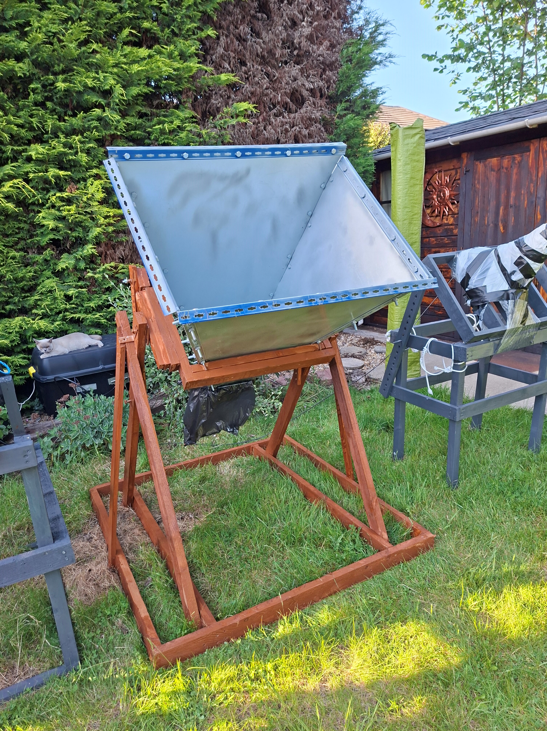
Simple wooden mount

Slide 37
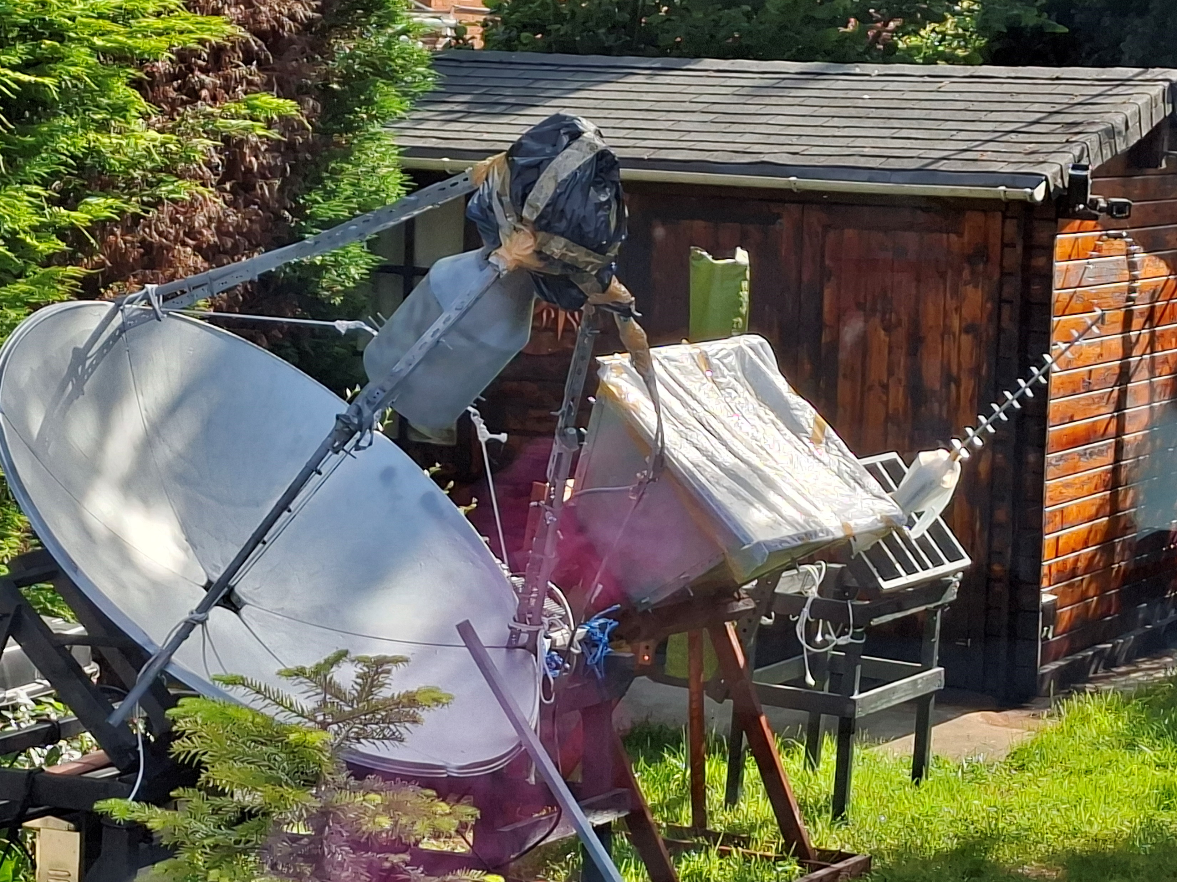
From left to right:
Solar Cooker RT.
Horn of Plenty.
Alex Pettit H-Line Yagi.

Slide 38
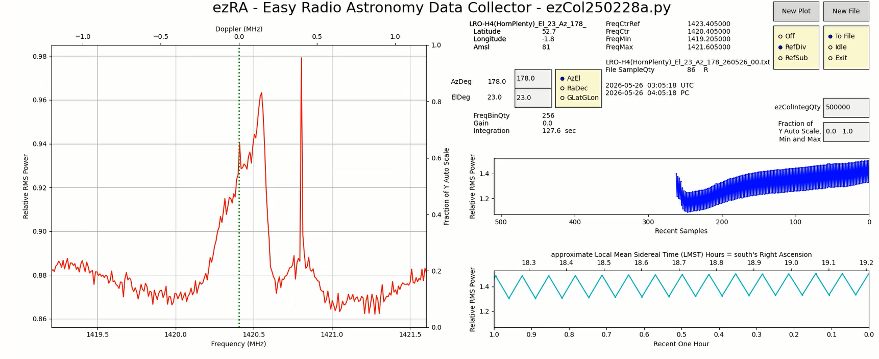
Calculated max. gain with LRO SETI Horn of Plenty using Nooelec SmarTee XTR SDR = 0.855 dB above background.

Slide 39
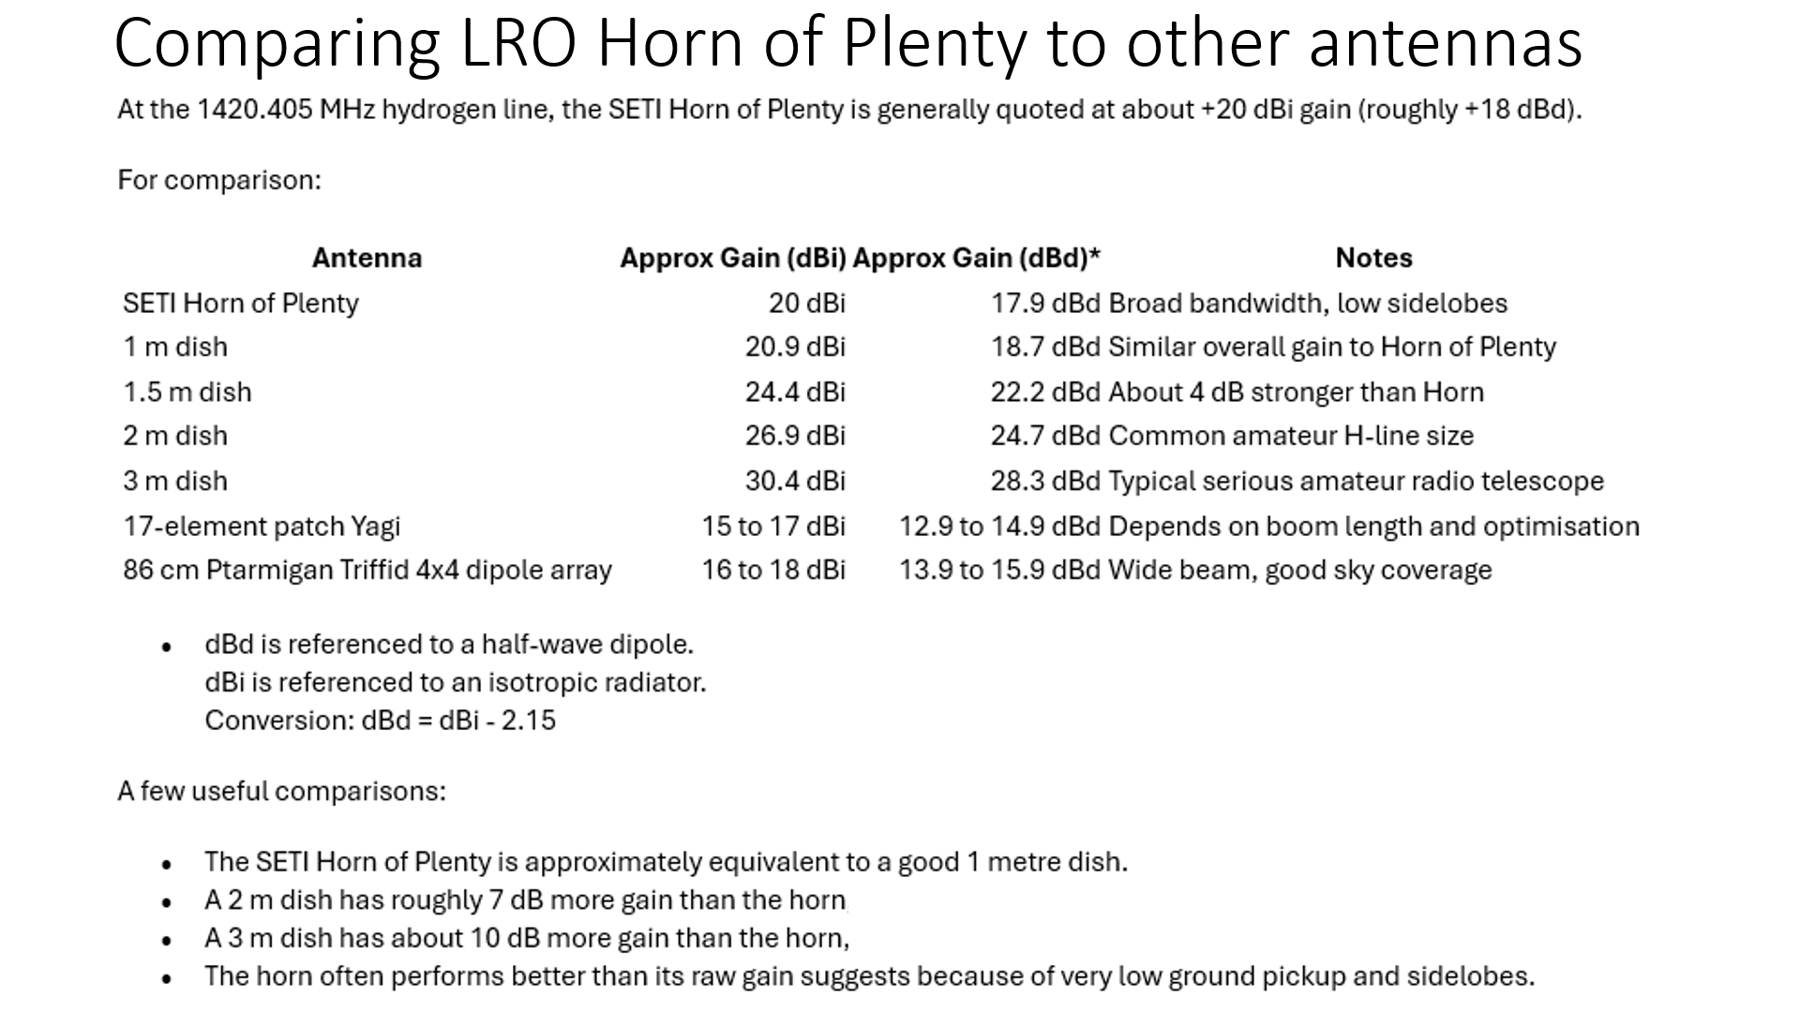

Slide 40
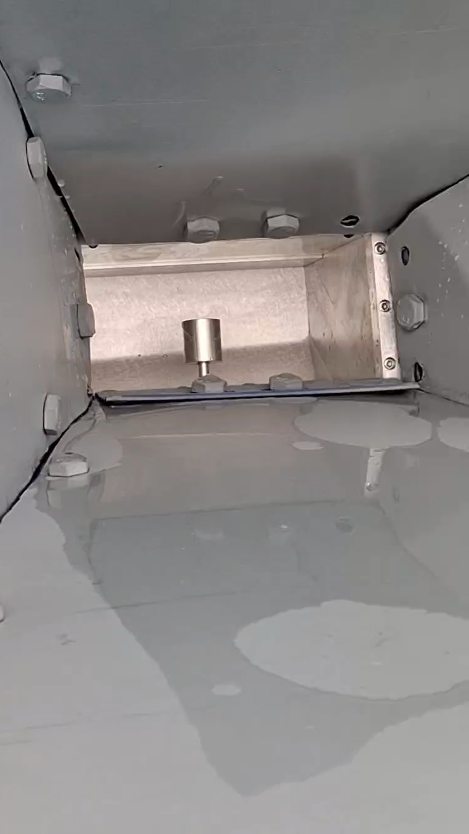
Water slopping around in bottom
WR-650 waveguide on horn of plenty

Slide 41
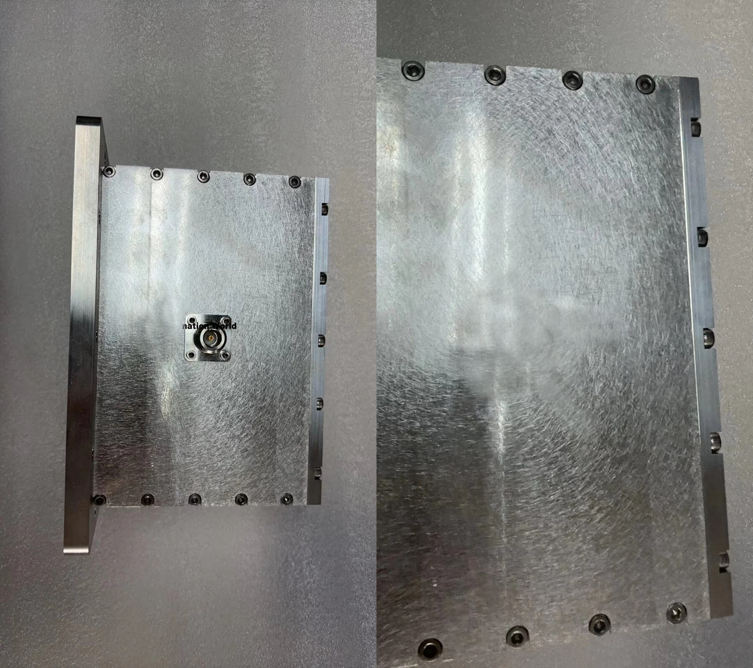
Other side of waveguide
Holes
Drilled
Here
Top Bottom

Slide 42
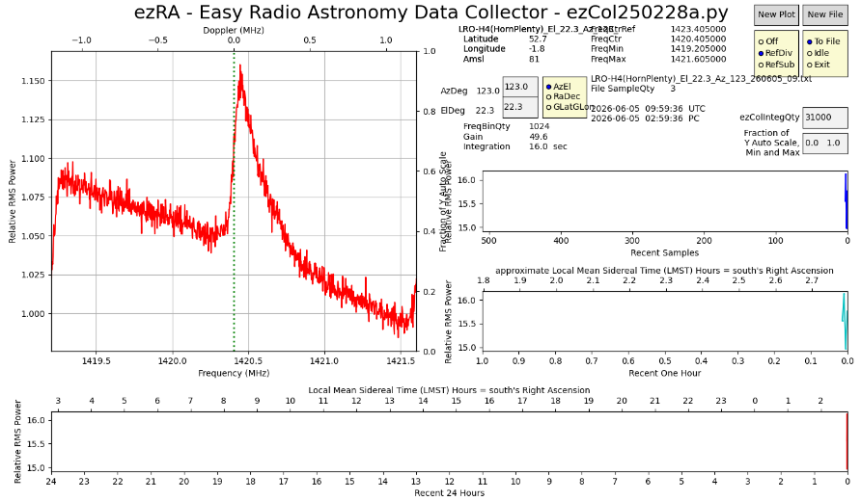
Back in action after drilling 2 small holes at back of waveguide – 10 bits (1024 FFT bins)

Slide 43

Increasing FFT further to FFT 12 = 4096 bins

Slide 44
Results of initial mapping attempt
LRO-H4, LRO SETI League Horn of Plenty

Slide 45

Shows Milky Way moving above and below beam of telescope every 24 hours

Slide 46

LOT OF RFI!!
The series of overlapping curves obscured by RFI spikes

Slide 47

Reasonable series of traces.
These traces show small peaks but lot RFI possibly due to trees in beam of telescope at lower elevations

Slide 48
Processing occurs in this direction from bottom to top
Ref=
introduction of reference sample
AntRaw =
Raw antenna data

Slide 49

Mis-match between data peaks and position of Milky Way on background map

Slide 50
In spite of all these problems, I obtained following results
Shows how effective clever processing of H-Line by Ted Cline’s ezRA is at overcoming the local RFI to present reasonable results.

Slide 51

Centre of Milky Way
Our Solar System.
Although only small amount data collected so far, Milky Way arm already starting to appear

Slide 52


Slide 53



Slide 54
Hot off the press! Latest results from the LRO SETI Horn of Plenty (LRO-H4)
I have now had much greater success with this radio telescope (latest results 27/7/2026 – this data is not in the version of these slides in your conference pack).

Slide 55

LRO-H4: Mapping Arms of Milky Way
Spiral Arms

Slide 56

LRO-H4: Weighing Milky Way

Slide 57

Above =
Expected curve without dark matter present.
Main graph does not match this.
LRO-H4: Dark Matter Curve

Slide 58
LRO-H5

Slide 59


ORIGINAL FEED SUPPORTS_____DISCOVERY FEED_____
Replacing LRO-H2 with communications dish & Discovery H-Line Feed
Original feed supports – helpful to identify correct focus position

Slide 60
18/6/26 First light tests LRO-H5 radio telescope – 140cm communications dish with Discovery hydrogen line feed.
At first, not working at all, just like solar cooker dish – I then discovered that the computer listed SDR as connected even when it wasn’t. Changed to alternative mini-PC and Hydrogen peak immediately appeared.
[Aside: Does this mean that the failure of solar cooker dish to show hydrogen latterly was due to computer problem?]
My wife prefers 140cm communication dish & Discovery feed in our garden, so I think it is staying!
Wonderful thing about Discovery feed is that it is easy to adjust focal position just by pulling stalk up and down whilst watching laptop screen to observe response – no fiddly or difficult adjustments.

Slide 61

Gain = 1.5 dB peak above background
(thanks to Jason Burnfield for calculatn)

Slide 62


Very early results from LRO-H5 – Discovery feed on 140cm communications dish

Slide 63

c
c

Slide 64

c

Slide 65

Much reduced RFI compared to LRO-H2 & LRO-H4

Slide 66



Slide 67


Slide 68
Conclusion.
If you want to build hydrogen line radio telescope, my experience suggests you should consider the following 2 designs:
SETI League Horn of Plenty.
Deep communications dish + Discovery H-Line feed.

Slide 69
Why choose SETI League Horn of Plenty?
Very forgiving design, so works even if your dimensions are not too accurate.
Solid, robust, if build with galvanized steel will cope with range of weather.
Supposedly minimal side-lobes and reduced ground-spill.

Slide 70
Why choose Deep communications dish + Discovery H-Line feed?
Deep dish reduces ground spill-over.
Communication dish solid, does not rust, easier to mount than petal dishes.
Finding focus easy with Discovery feed.
Discovery feed performs at high level comparable to best elsewhere.

Slide 71
Where next?
Formal analysis of performance of dishes using SDR#/IF Average, cold sky and hot ground.
Test performance of some new low noise amplifiers I have been given.
Complete maps of Milky Way on the new LRO H-line telescopes and compare those maps.
With Jason Burnfield, exploring the possibility of taking spectra of hydrogen emissions in extra-galactic sources using small telescopes available at LRO.
Any further suggestions from the audience are welcome!

Slide 72






